Slide 1
Exploring the World
Today we visit...

Slide 3
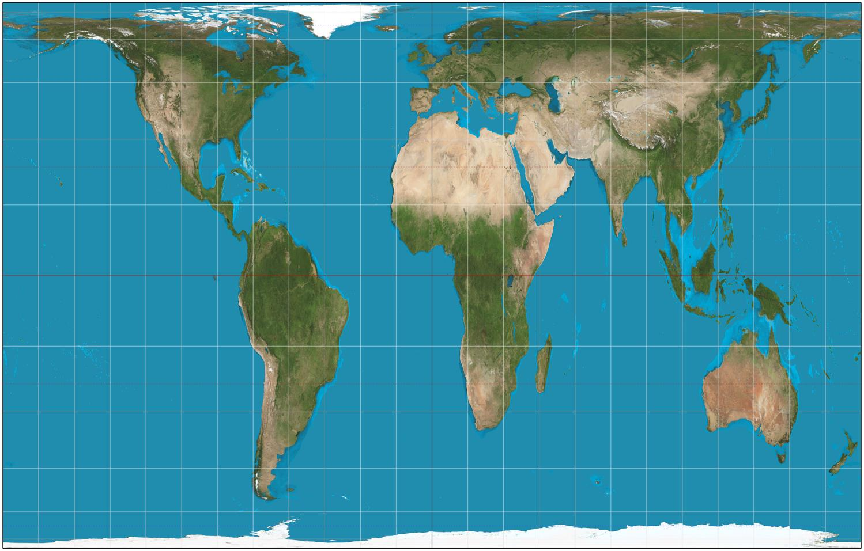

Slide 4
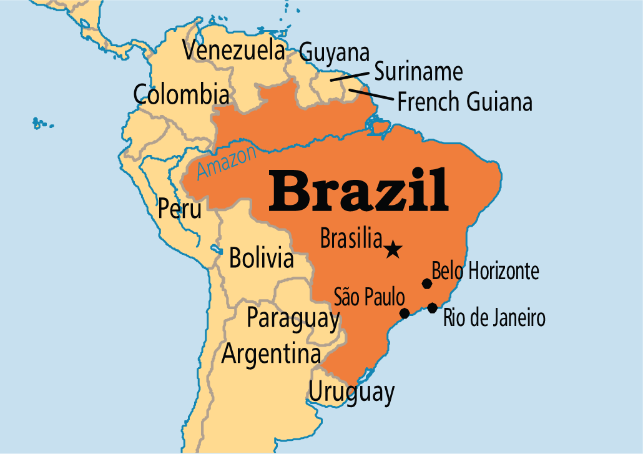

Slide 5
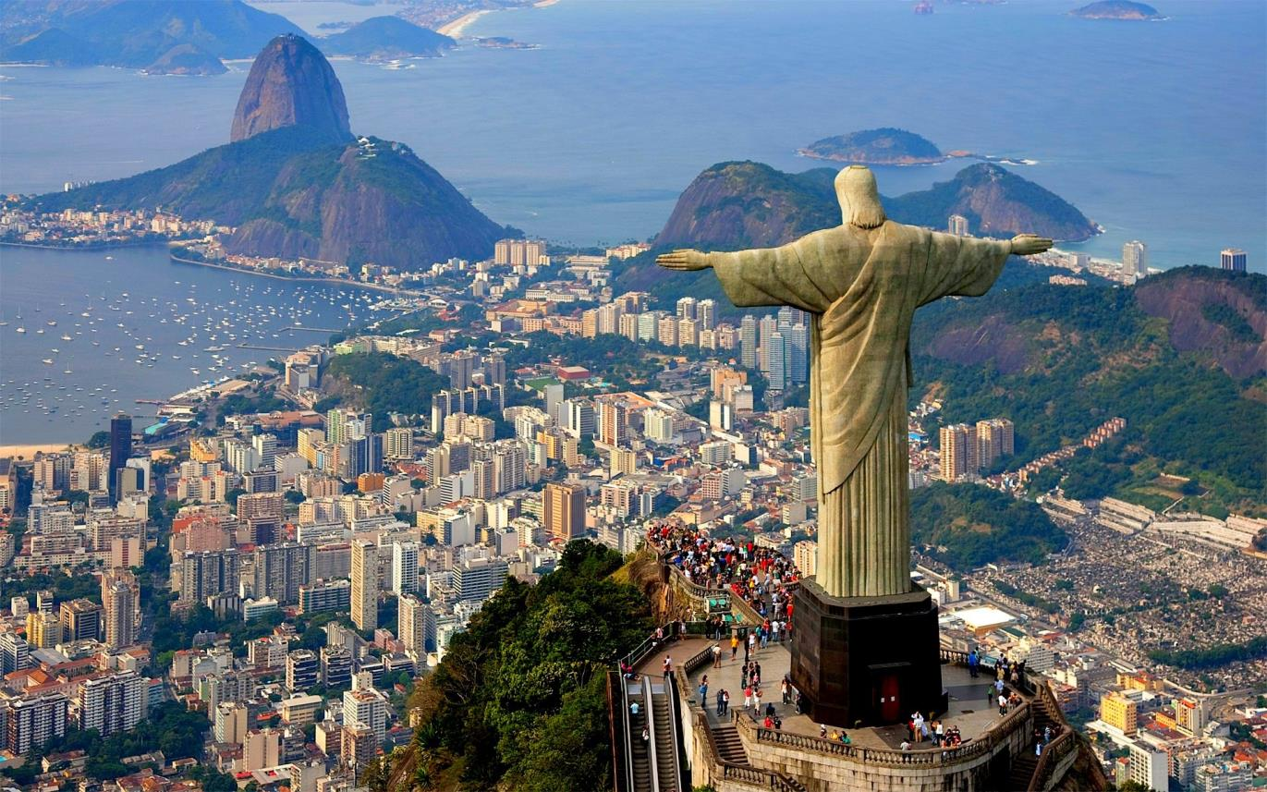

Slide 6
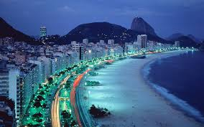

Slide 7
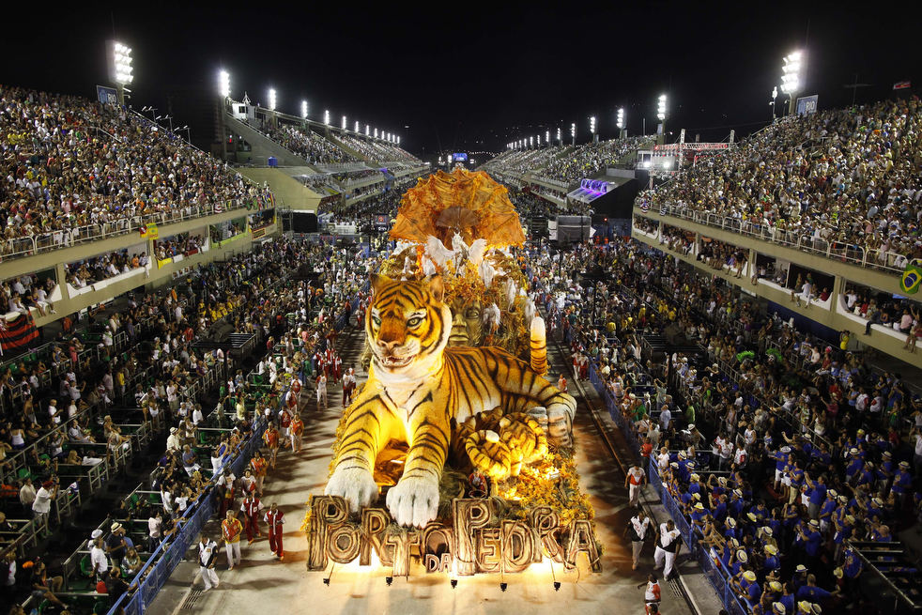

Slide 8
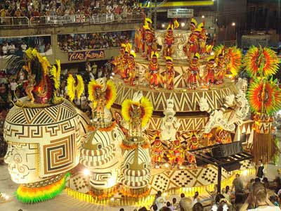
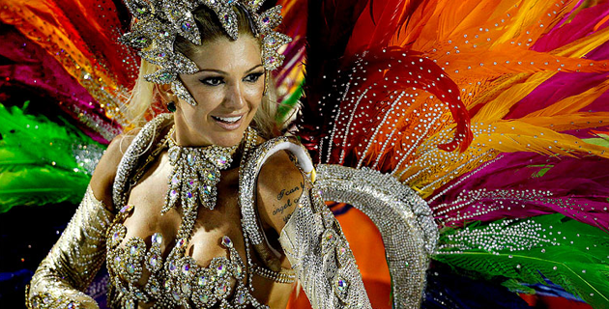
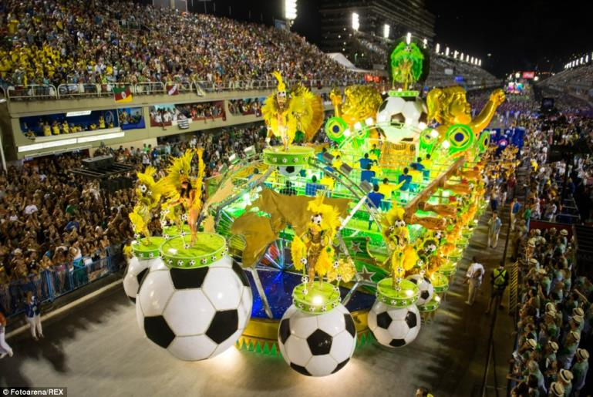
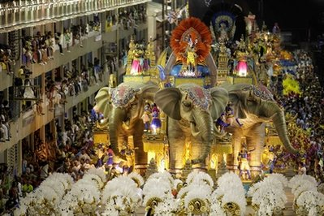

Slide 9
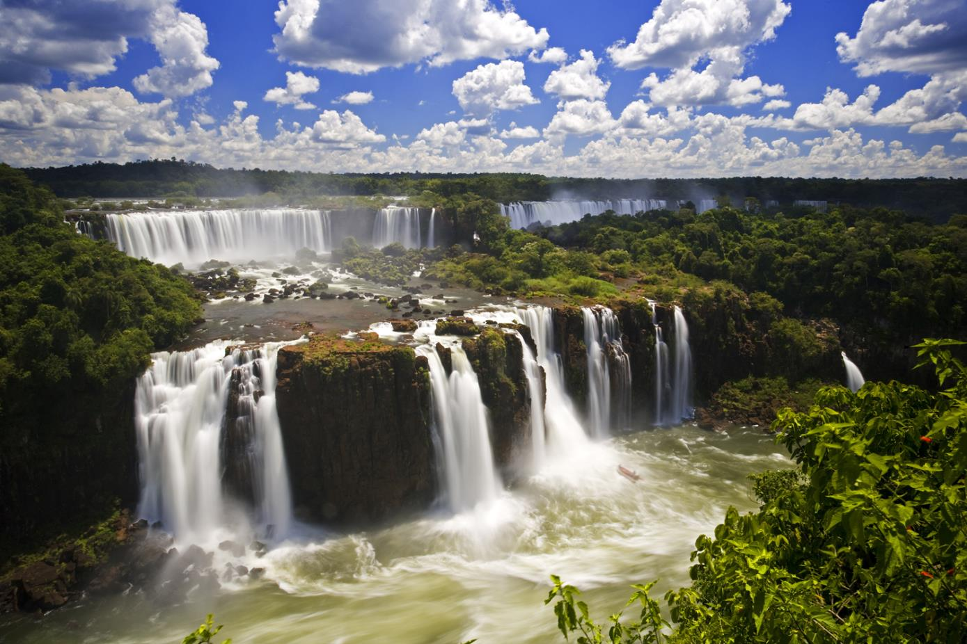

Slide 10
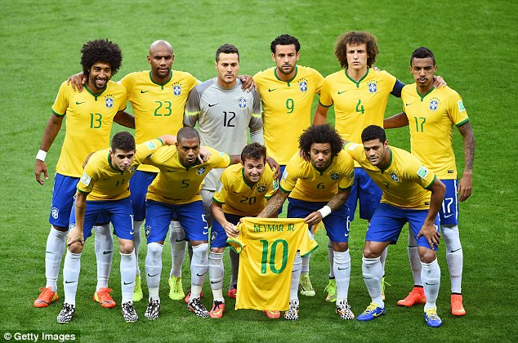

Slide 11
Brazil is the largest country in South America.
The name Brazil comes from a tree named brazilwood.
Brazil is the only country in South America that speaks Portuguese.
Brazil is the 5th largest country in the world by both land area and population.
The capital city is Brasilia, while the largest city is Sao Paulo.
Other major cities include Rio de Janeiro, Salvador and Fortaleza.
Brazil has a large coastline stretching 7491 kilometres.
The Amazon River flows through Brazil, it is the 2nd longest river in the world.
Around 60% of the Amazon Rainforest is located in Brazil.
The climate in the majority of Brazil is tropical.
Brazil is home to armadillo, tapirs, jaguars and pumas.
Soccer is the most popular sport in Brazil with the national team consistently among the best in the world, winning the World Cup a record 5 times.

Slide 12
