Slide 1
Exploring the World
Today we visit...

Slide 2
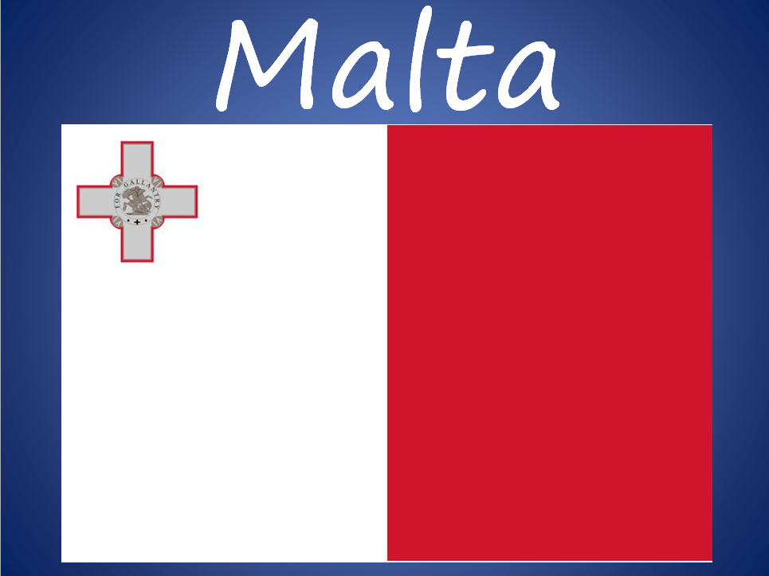

Slide 3
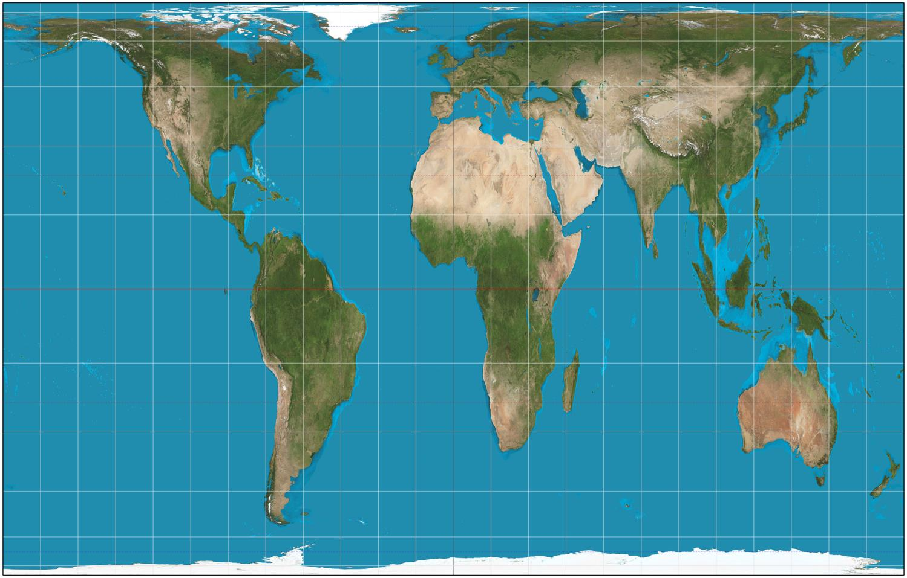

Slide 4
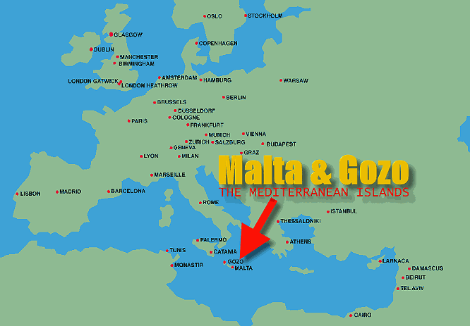

Slide 5
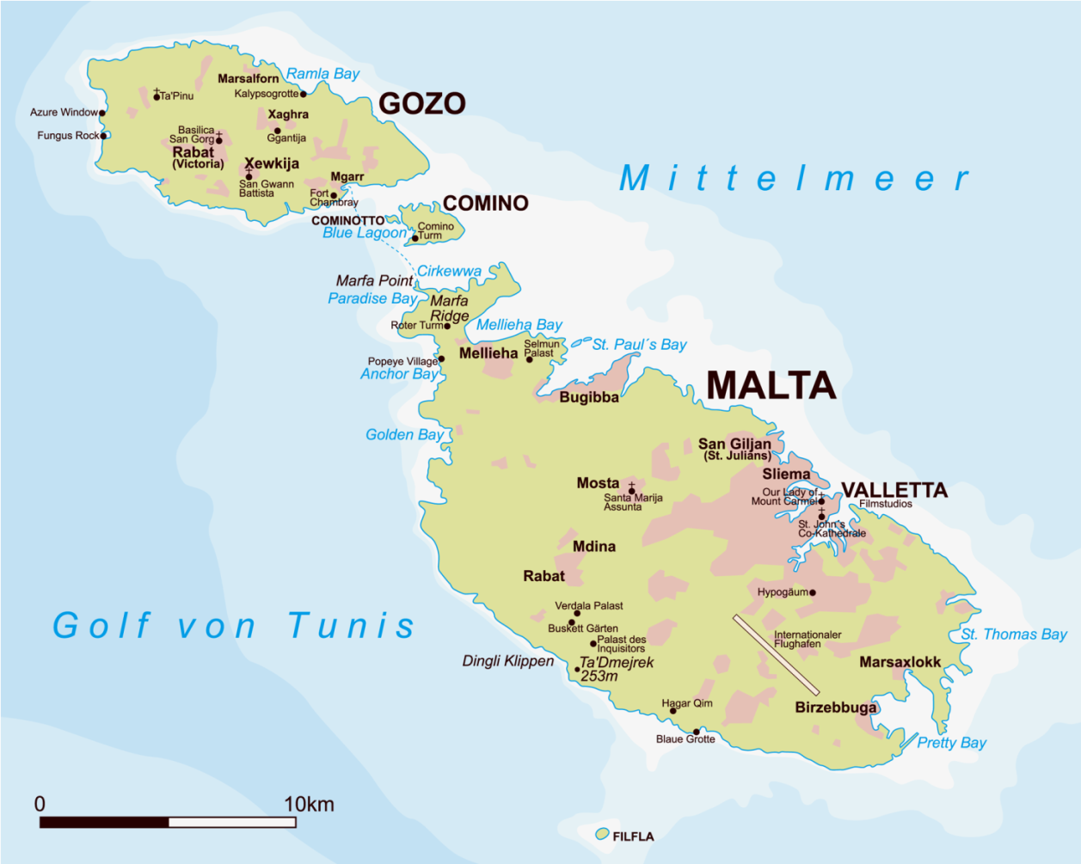
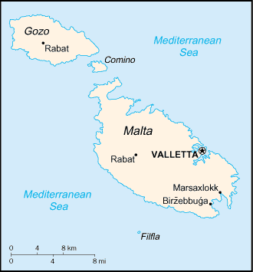

Slide 6
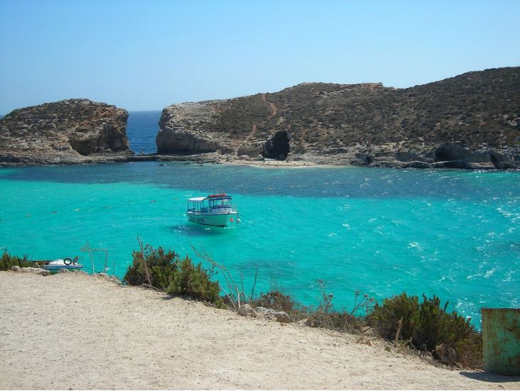

Slide 7
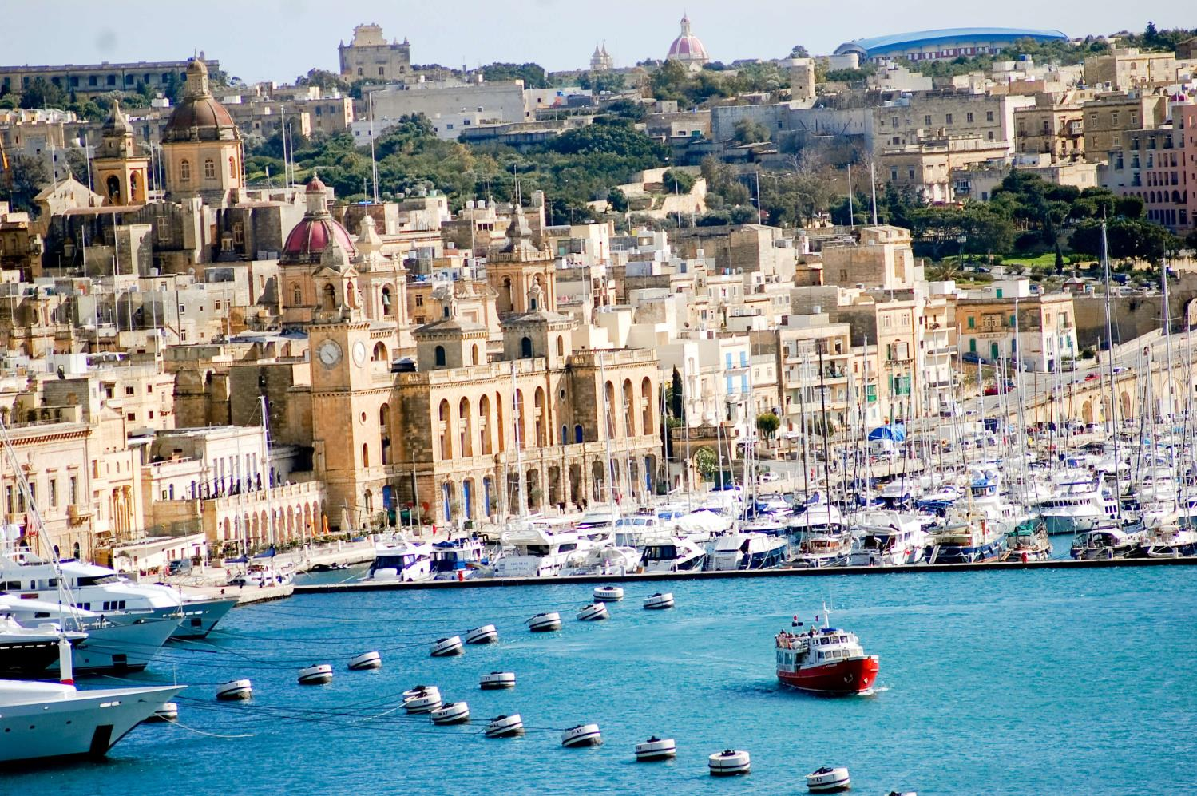
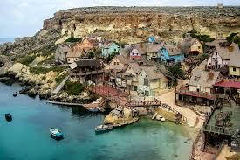

Slide 8
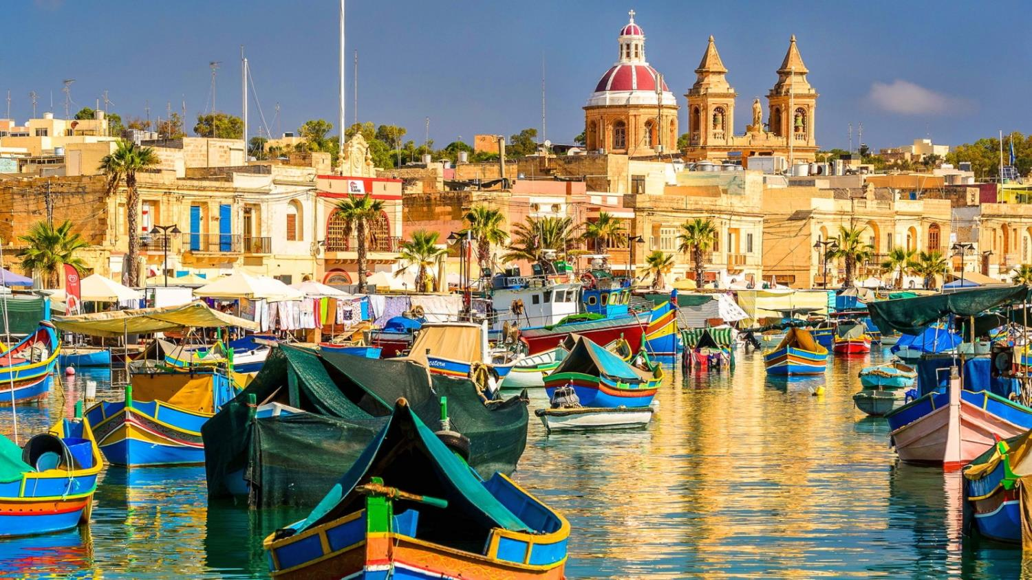

Slide 9
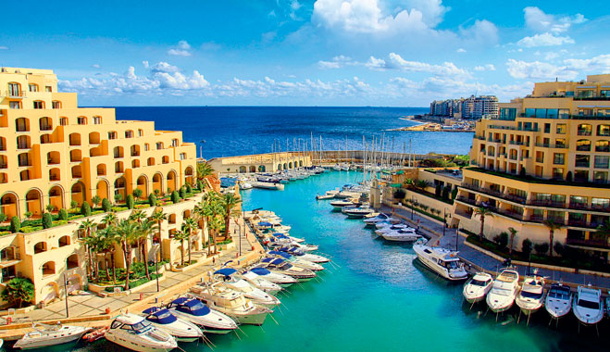

Slide 10
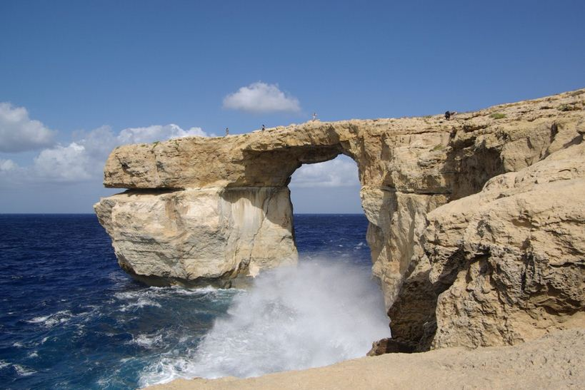

Slide 11
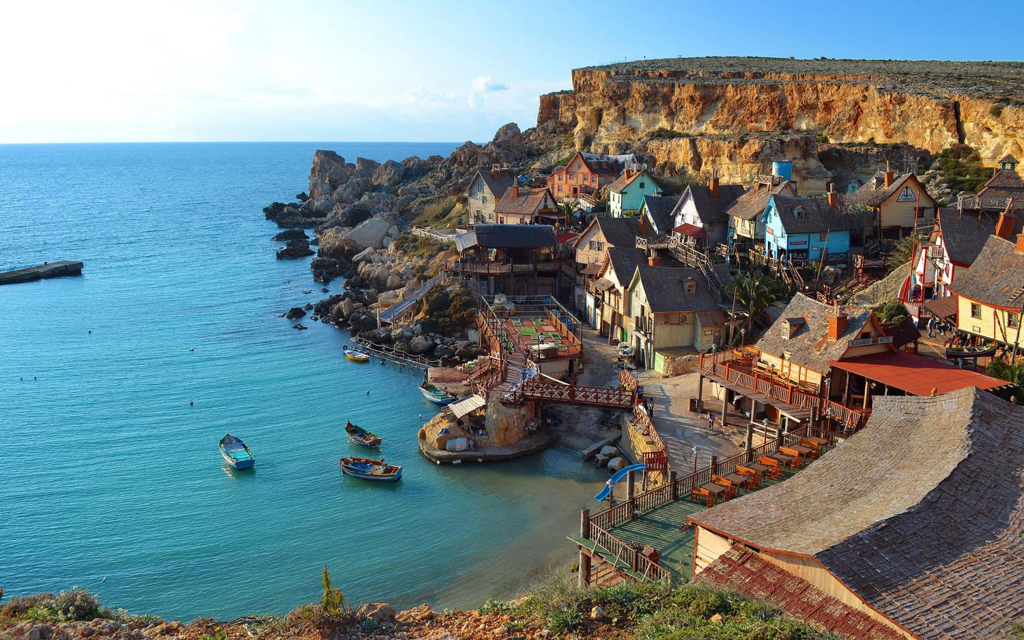

Slide 12
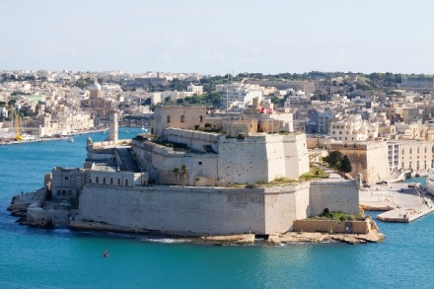

Slide 13
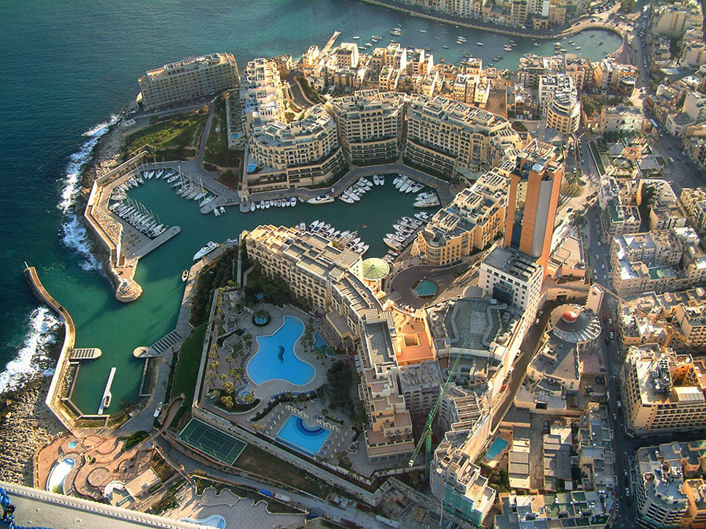

Slide 14
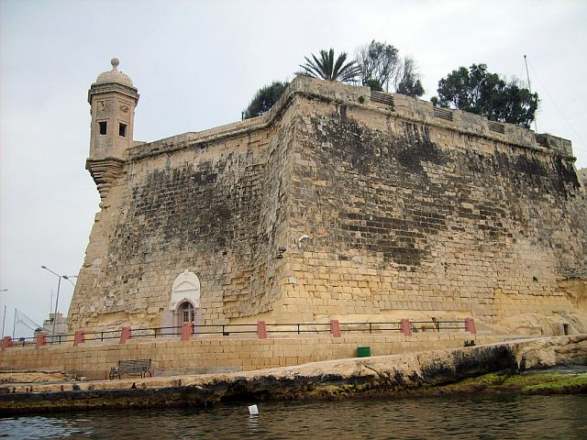

Slide 15
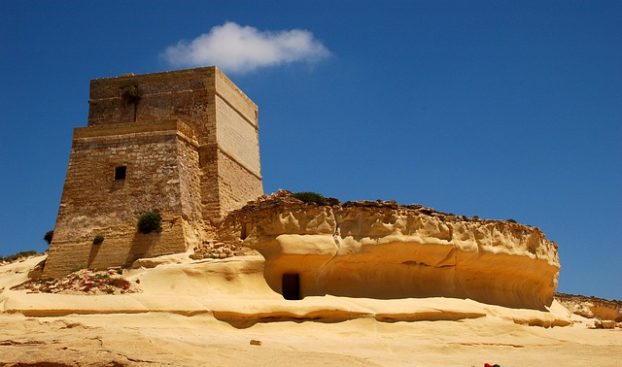

Slide 18
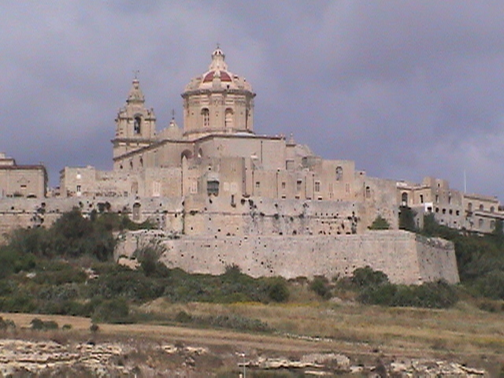

Slide 19
Capital: Valletta Population: 409,836 Malta is a small island nation in the middle of the Mediterranean Sea. Malta has a rich history with some of the world's oldest free-standing architecture. The Phoenicians and the Carthaginians both built ports on the island. Later, the island became part of the Roman Empire. It is also famous as the place where Saint Paul from the Bible was shipwrecked. The island continued to change hands over the centuries. In 533 AD it became part of the Byzantine Empire and then, in 870, it was taken over by the Arabs. In 1090, Count Roger of Normandy drove out the Arabs and the Normans took control. In 1530 Charles V gave the island to the Knights of St. John. They became known as the Knights of Malta. The Knights of Malta built up the island including towns, forts, and churches. They maintained control until Napoleon and the French arrived in 1798. With the help of the British, the people of Malta were able to expel the French in 1800. They joined the British Empire in 1814. Malta played an important role as a naval and military base during both world wars. In 1964 Malta became an independent nation and joined the European Union in 2004.

Slide 20
People have lived here for thousands of years. There are underground dungeons and rooms, churches and amphitheaters built by the Romans. The island is rocky and the soil is poor, but the country has been a strong shipping region for centuries. Boats traveling between Africa and Europe stop here.
Malta attracts many tourists who come for its sunny beaches, architecture and culture.
Fun Facts about Malta for Kids
Valletta is the capital of Malta.
400,000 people live here.
The people speak Maltese and English.
mostly Catholic.
Malta has its own money – the lira.

Slide 21
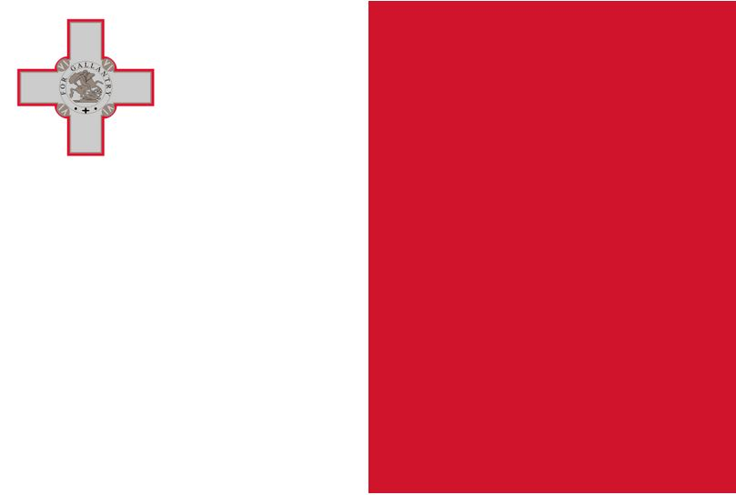
The National Flag of Malta consists of two equal, vertical stripes: white in the hoist (left) and red in the fly (right). A representation of the George Cross, awarded to Malta by King George the Sixth on 15 April 1942, is carried, edged with red, in the canton of the white stripe. The George Cross was awarded to Malta for the fortitude of the population of the island under sustained enemy air raids and a naval blockade, which almost saw the islands starved into submission during WWII.

Slide 22
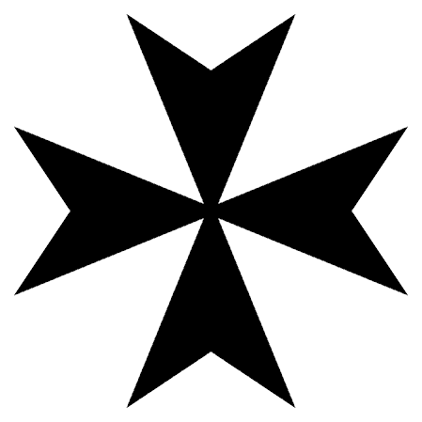
The Maltese Cross
The Maltese cross is a symbol of the Knights of St. John or Knights of Malta. The cross is eight pointed and has the form of four ‘V’ shaped segments joined at their tips. The Maltese Cross remains the symbol of the Orders of St. John and St. John Ambulance.

Slide 24
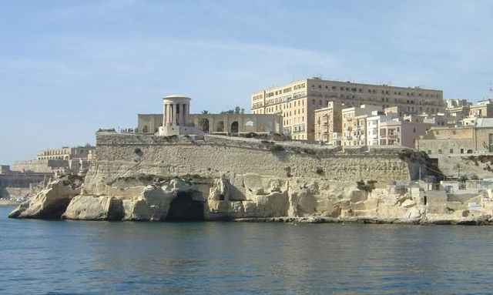

Slide 25
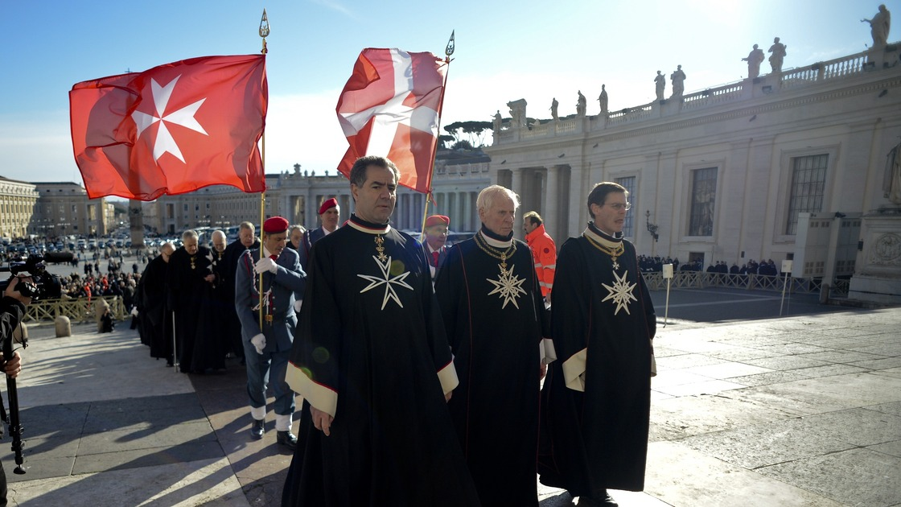

Slide 26
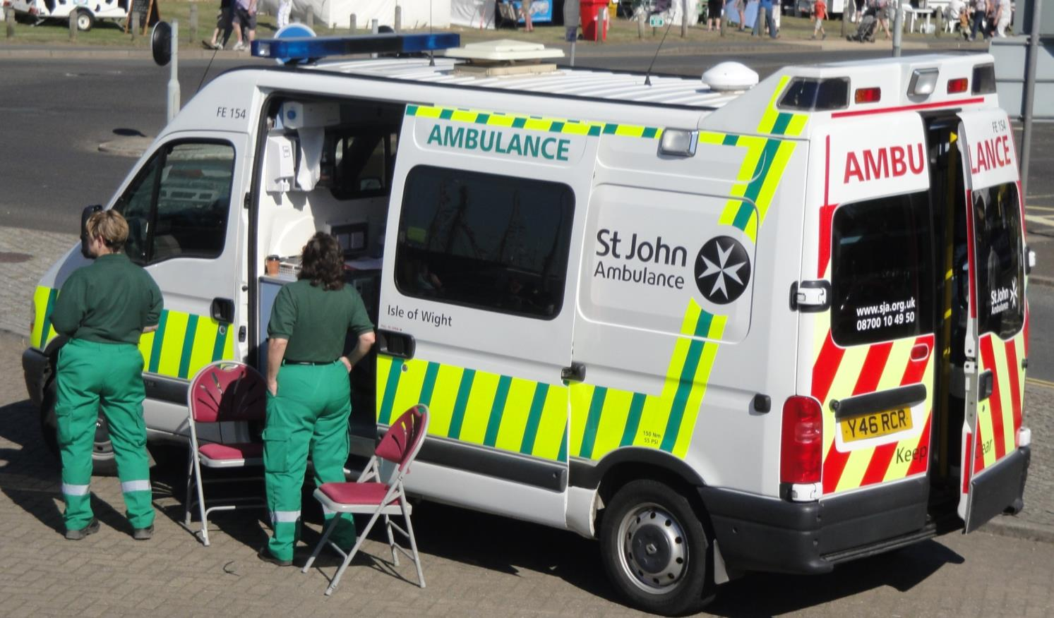

Slide 27
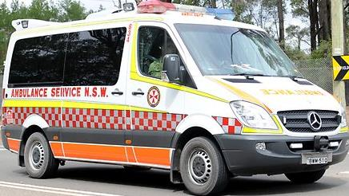

Slide 28
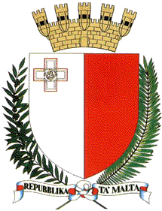
The Emblem of Malta bears a heraldic representation of the Maltese flag. Above the shield a mural crown in gold with a sally port and eight turrets represents the famous golden limestone fortifications of Malta and denotes a City State. Around the shield are two wreathes of branches: the dexter olive on the left, and the sinister Palm on the right. These are symbols of peace. The branches are tied at their base with a white ribbon, backed in red, on which is written “Repubblika ta’ Malta” in black capital letters. - See more at: http://www.expat-quotes.com/guides/malta/tourism/national-symbols-of-malta.htm#sthash.DA60kZfm.dpuf

Slide 29
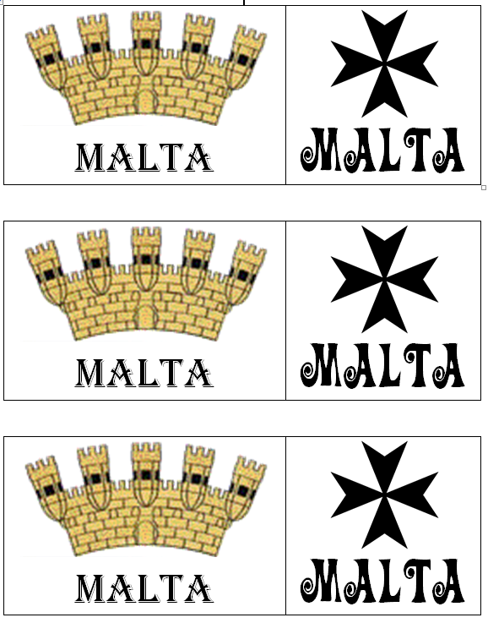
Passport and Suitcase
Computer video
Computer powerpoint
Draw a Maltese cross
Draw a flag
Draw a fort
Build a fort!
Map jigsaws
Our ‘Explore the World’ box
Flag match

