Slide 1
Exploring the World
Today we visit...

Slide 3
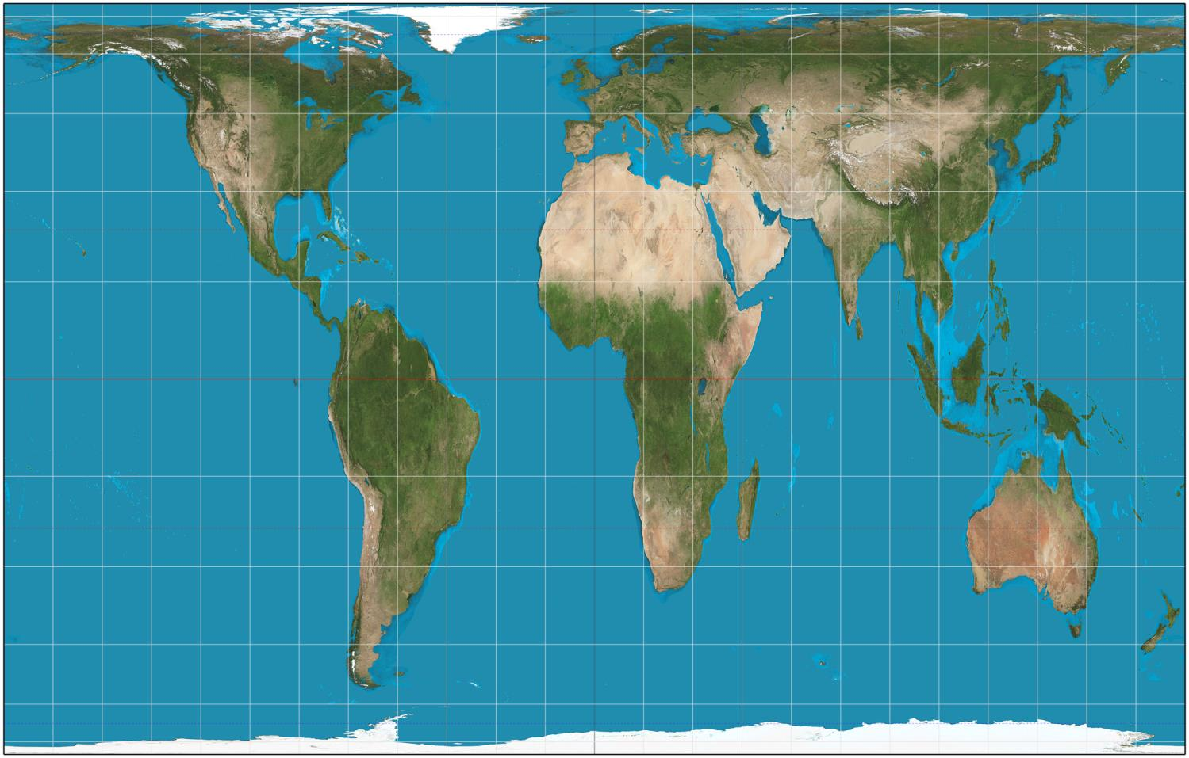

Slide 4
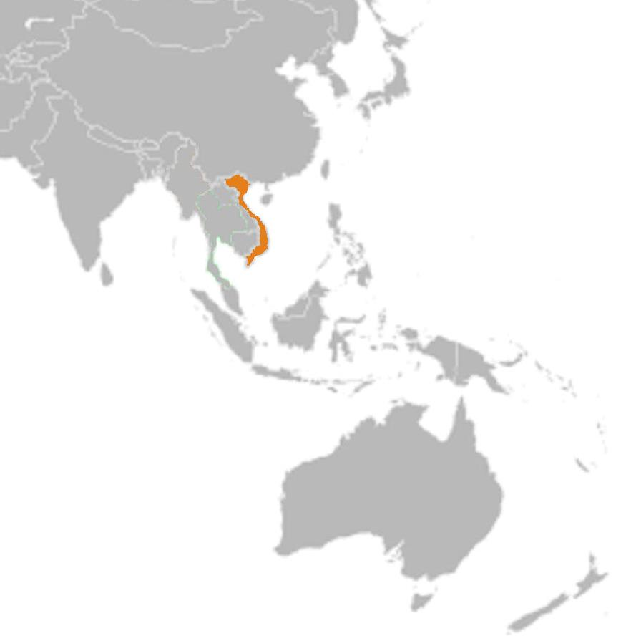
Population:
93 million

Slide 5
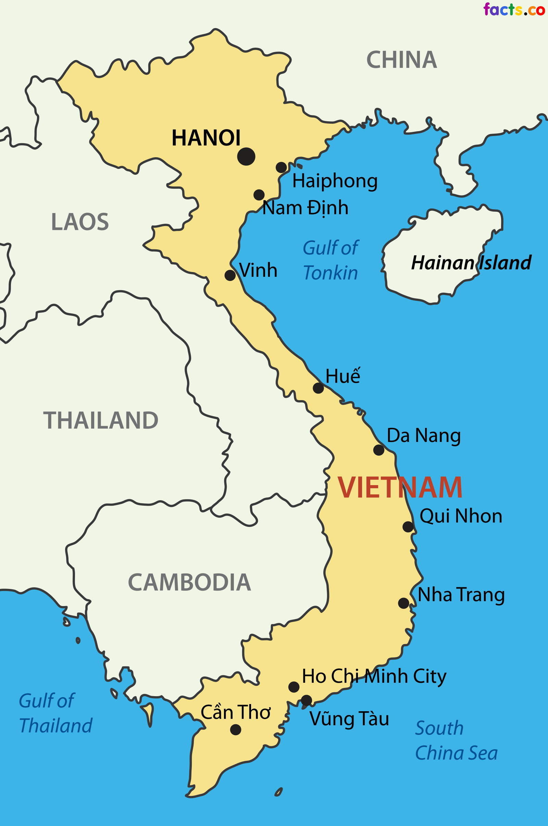

Slide 6
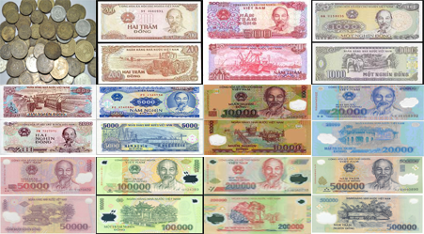
Capital: Hanoi
Official language: Vietnamese, though English is widely spoken
Currency: Dong

Slide 7
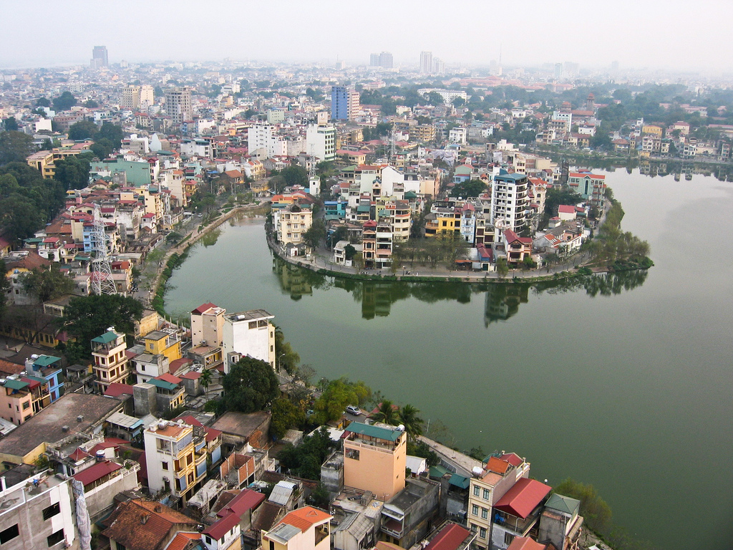

Slide 8
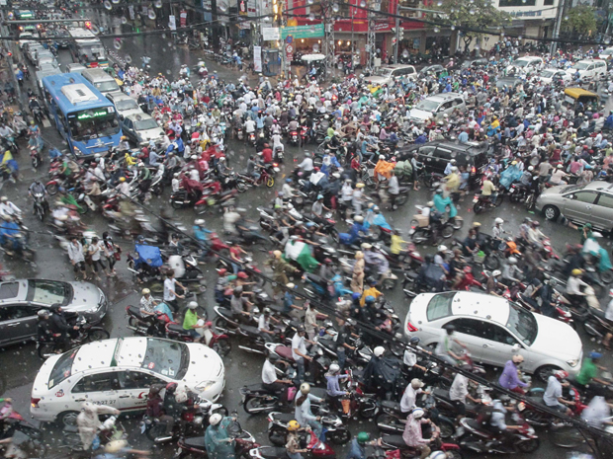
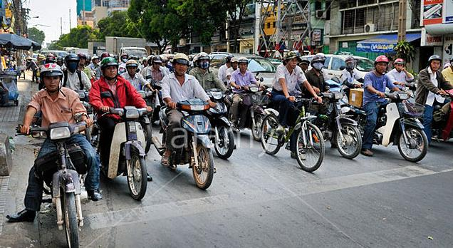

Slide 9
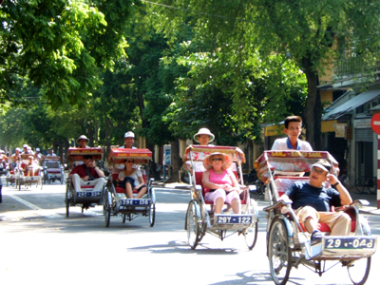

Slide 10
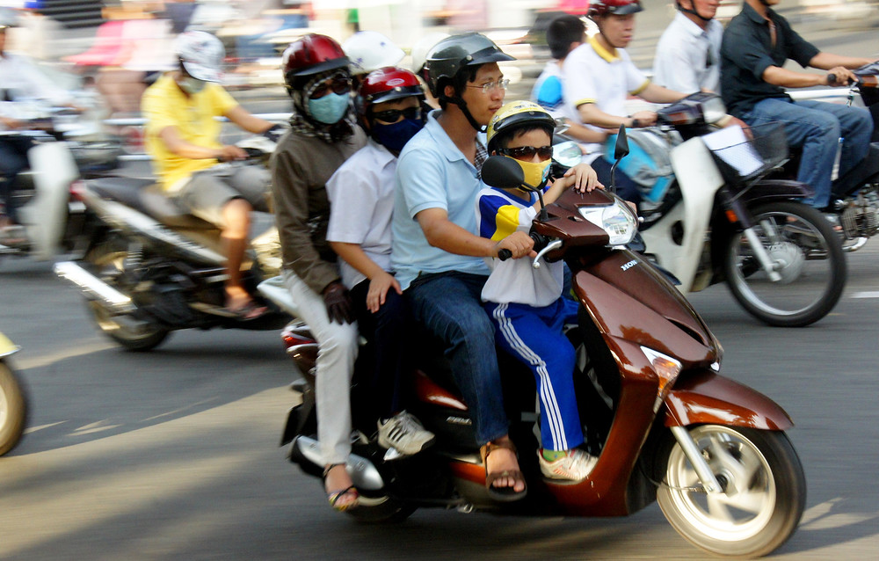

Slide 11
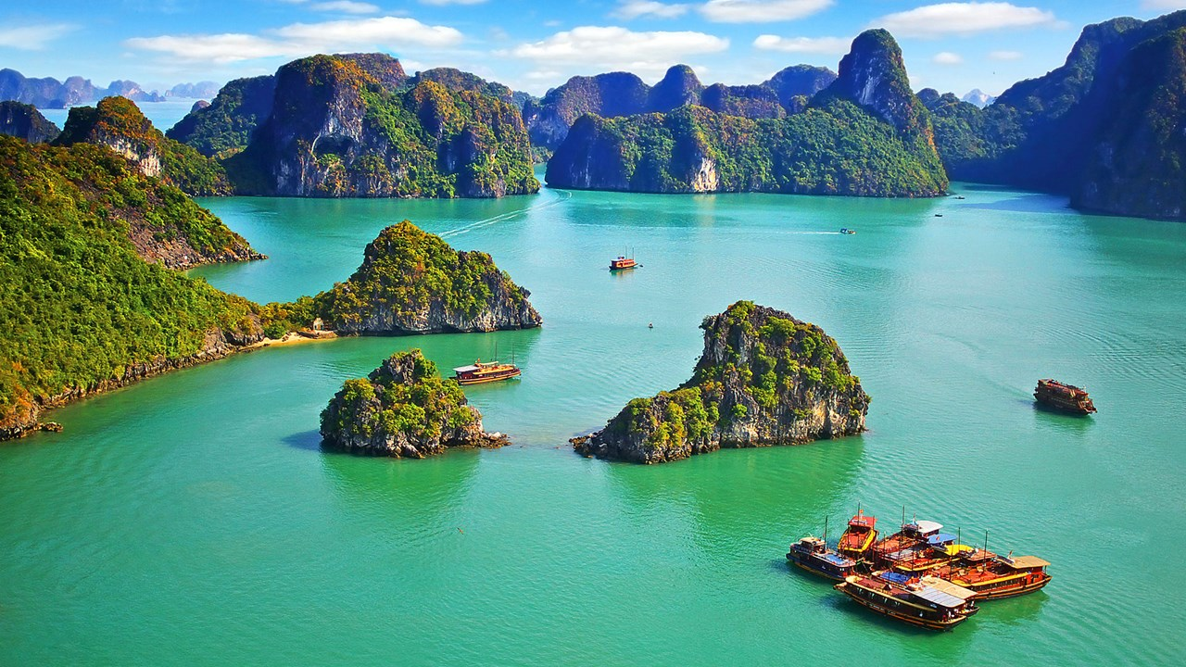

Slide 12
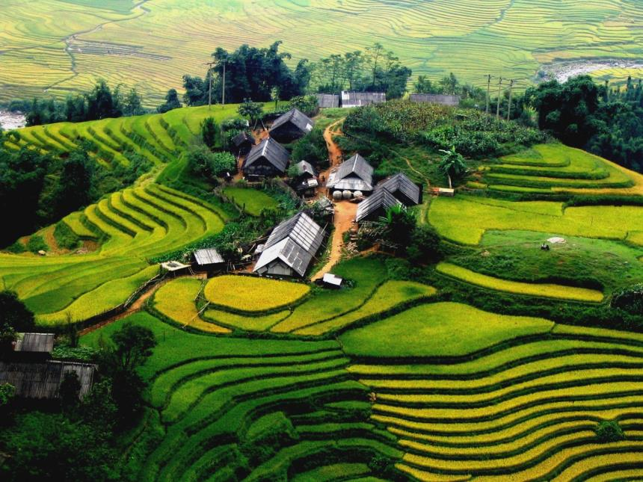
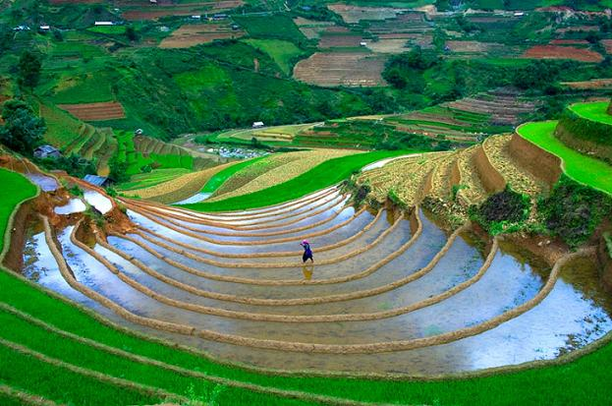

Slide 13
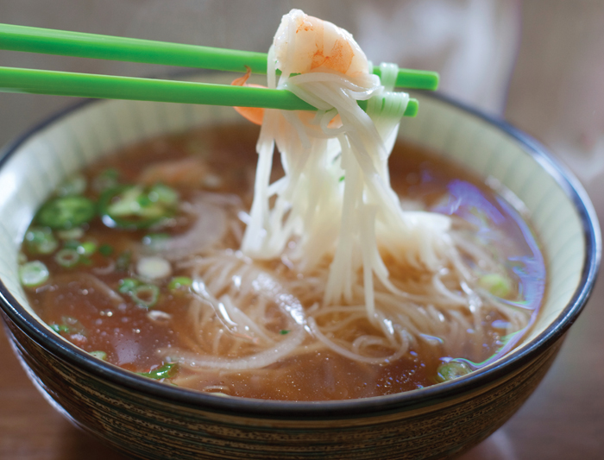
Vietnamese food is a blend of Chinese and Thai styles and is considered one of the healthiest cuisines in the world with its combination of fresh ingredients like fresh herbs, seafoods, fruits and vegetables along with fish sauce, shrimp paste, soy sauce and rice.

Slide 14
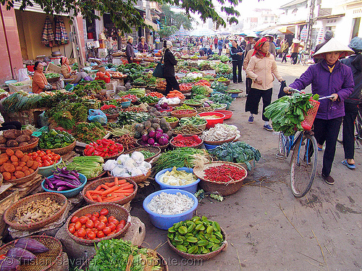
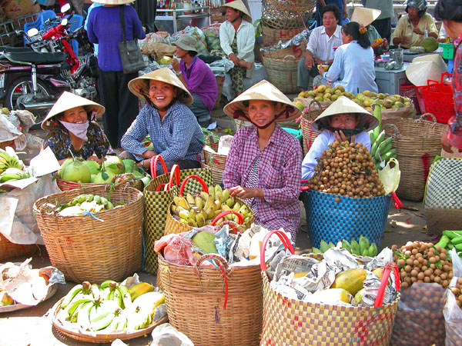
Products: Rice, coffee, rubber, tea, pepper, cashews, soybeans, corn, sugarcane, peanuts, sweet potatoes, bananas, poultry, fish, seafood; clothing, shoes

Slide 15
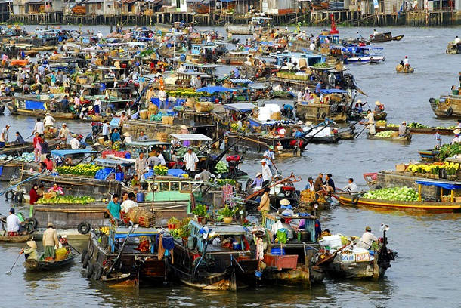

Slide 16
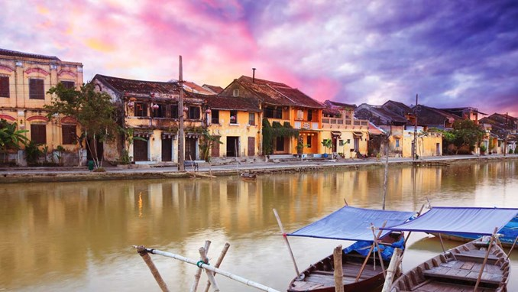

Slide 17
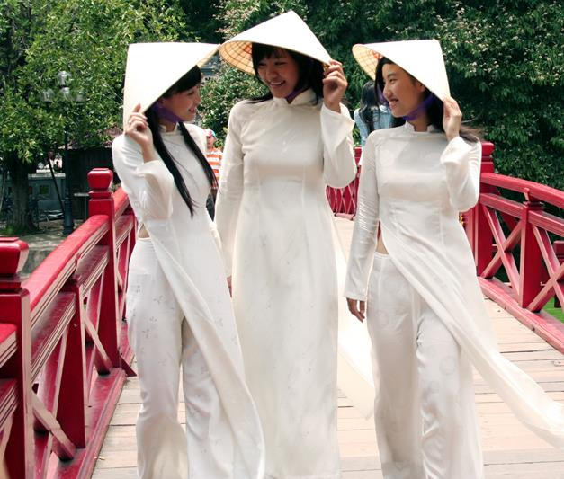
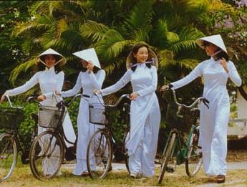
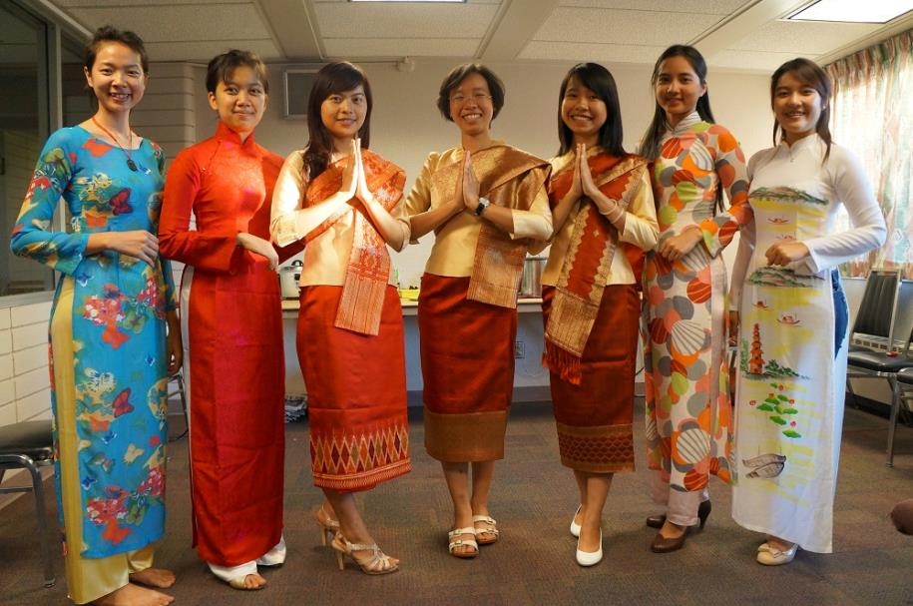

Slide 18
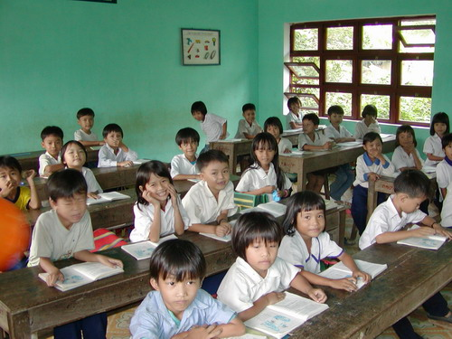

Slide 19
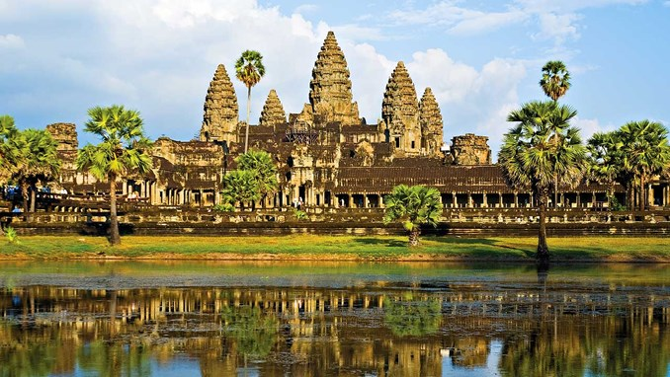

Slide 20
