Slide 1
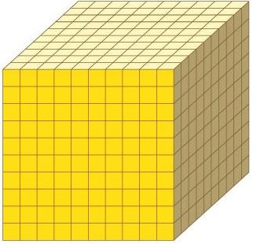
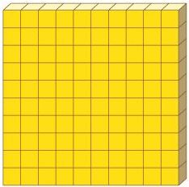
M.A.B. Block Fractions

Slide 2
If a flat is 1 whole……

Slide 3
How much is…?
Where’s that on a numberline?

Slide 4
How much is…?
Where’s that on a numberline?

Slide 5
How much is…?
Where’s that on a numberline?

Slide 6
How much is…?
Where’s that on a numberline?

Slide 7
If a flat is 1 whole……

Slide 8
How much is…?
Where’s that on a numberline?

Slide 9
How much is…?
Where’s that on a numberline?

Slide 10
How much is…?
Where’s that on a numberline?

Slide 11
Now it’s your turn to investigate.
You’ll need:
1 dice – (1-10 numbers)
MAB blocks - share!!!
Maths paper to record

Slide 12
If a flat is 1 whole, how much is…?
Using longs:
Roll your dice and trace that many longs.
What’s your number?

Slide 13
If a flat is 1 whole, how much is…?
Using minis:
Roll your dice 3 times and trace that many minis.
What’s your number?

Slide 14
What did you learn?
How have you been successful?
What would you tell someone who found this tricky?

