Slide 1
Exploring the World
Today we visit...

Slide 2
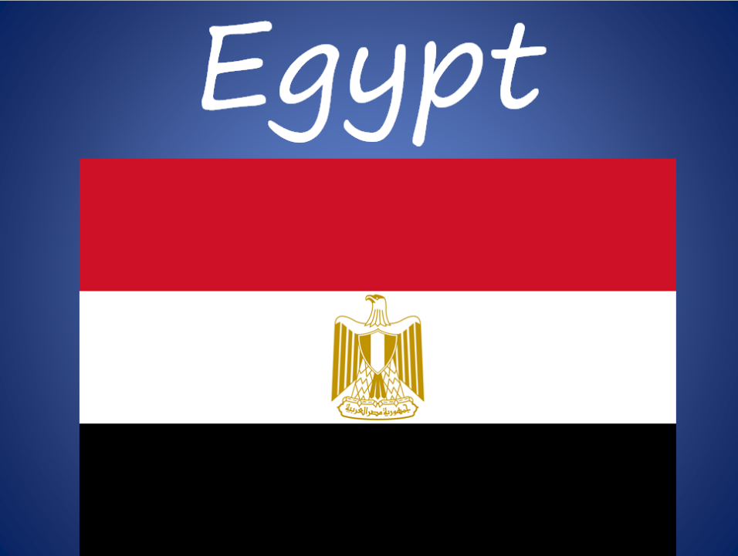

Slide 3
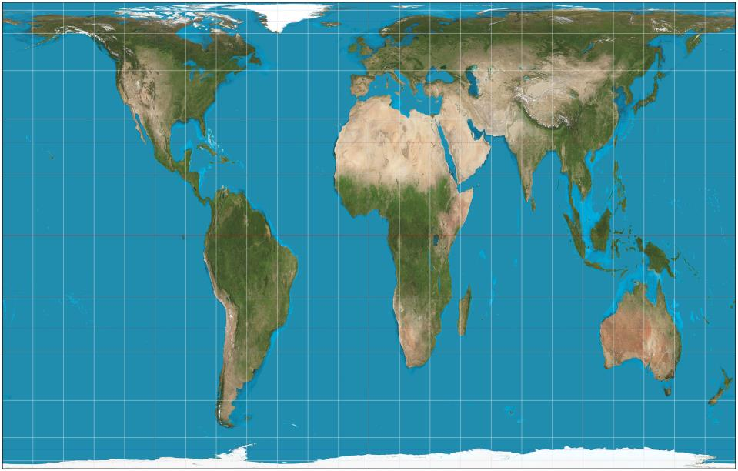
https://www.google.com.au/maps/place/Mexico/@23.6260333,-102.5377501,2681675m/data=!3m1!1e3!4m2!3m1!1s0x84043a3b88685353:0xed64b4be6b099811

Slide 4
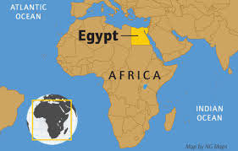

Slide 5
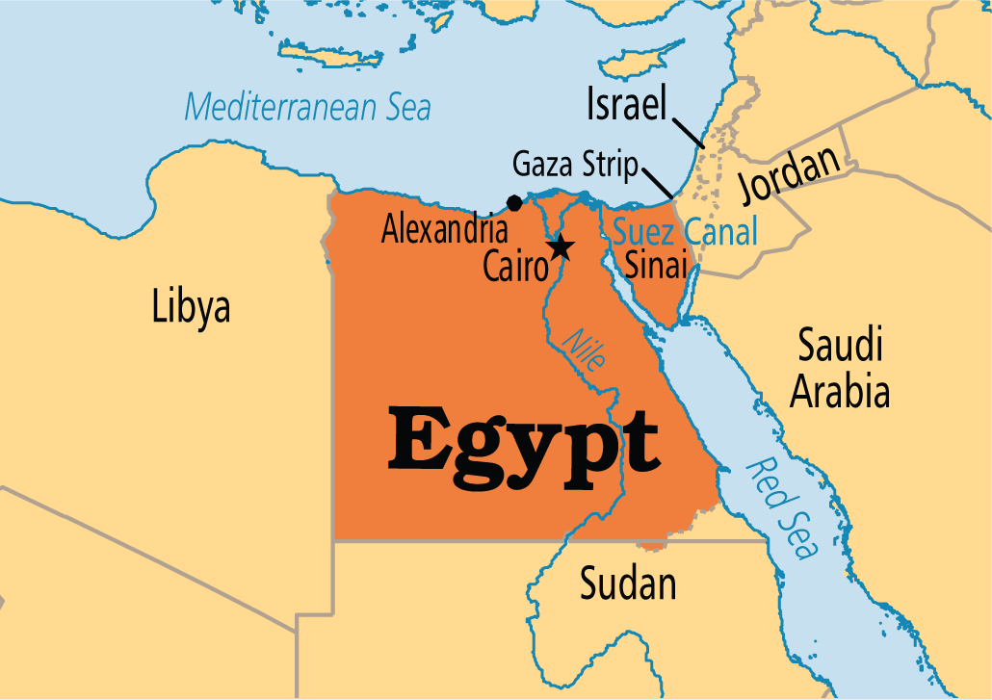

Slide 6
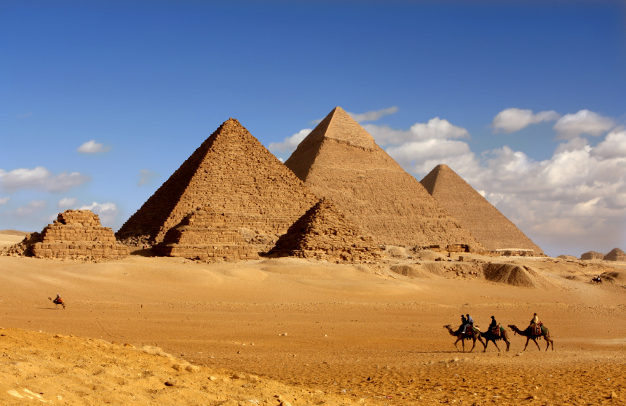

Slide 7
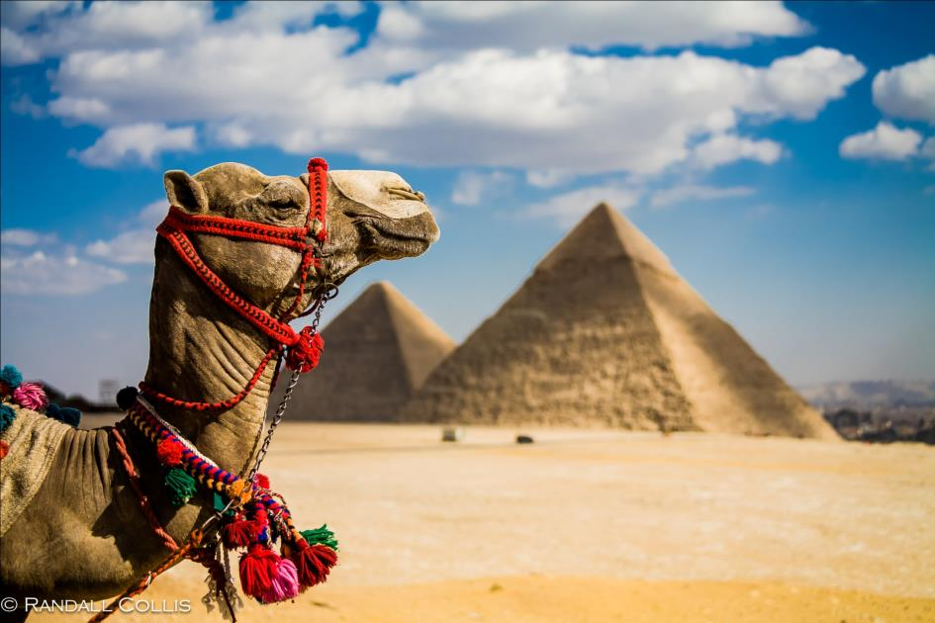

Slide 8
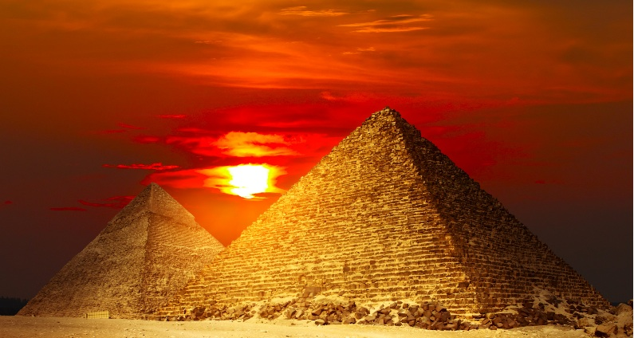

Slide 9
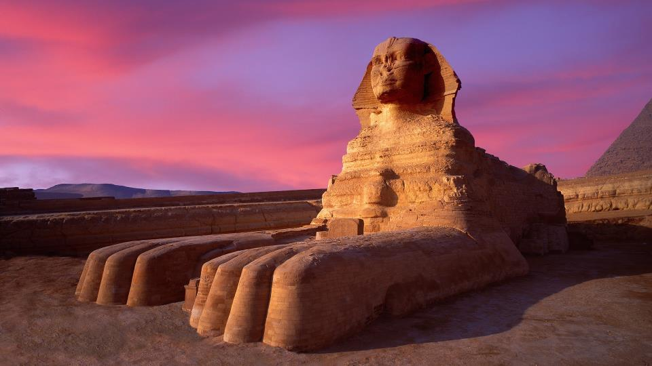

Slide 10
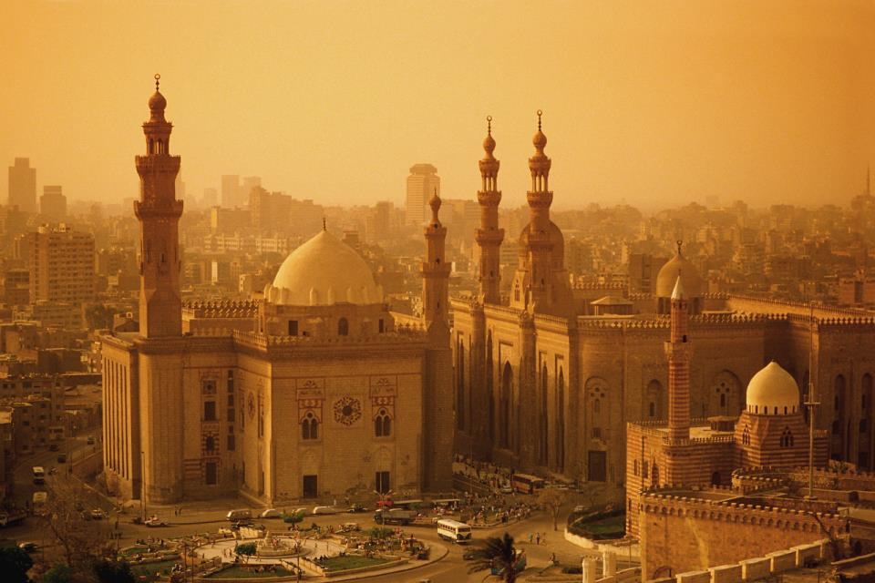

Slide 11
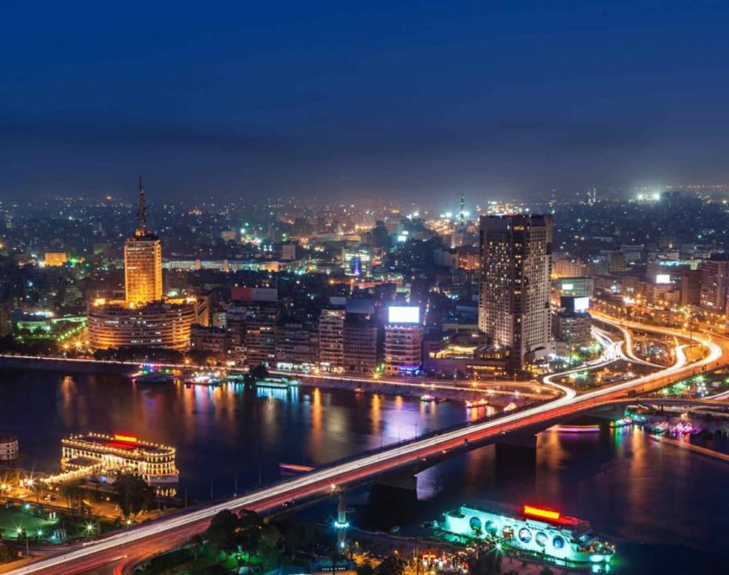

Slide 12
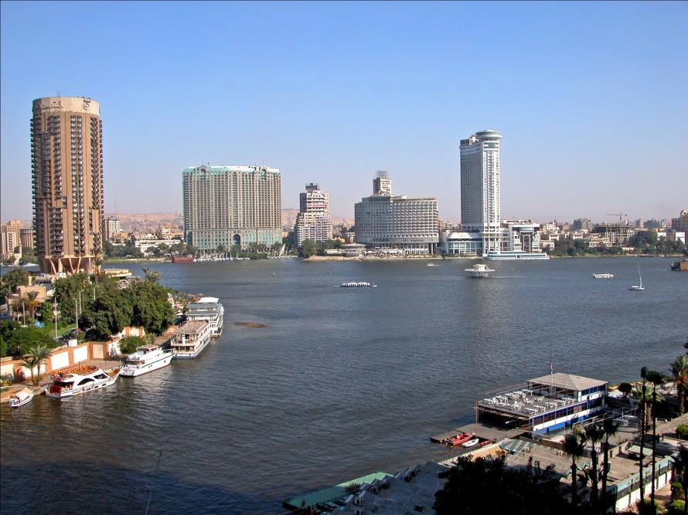

Slide 13
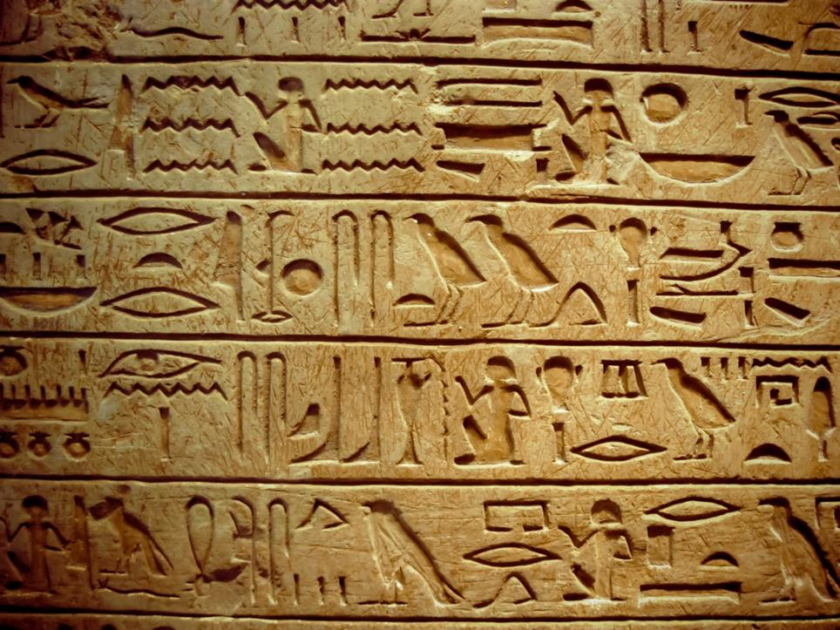

Slide 14
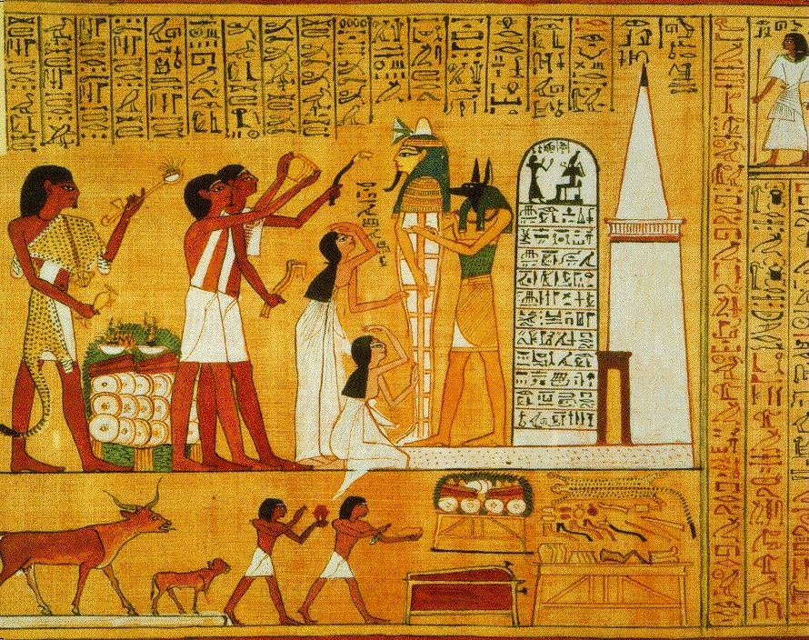

Slide 15
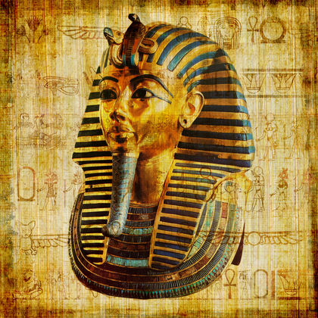

Slide 16
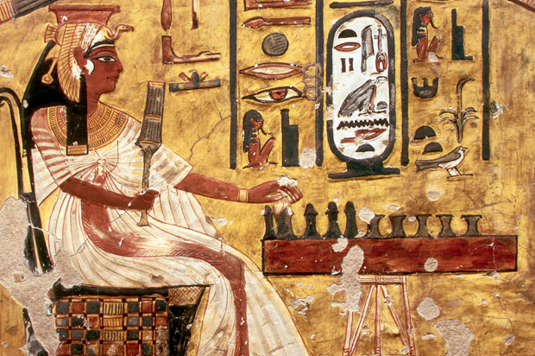

Slide 17
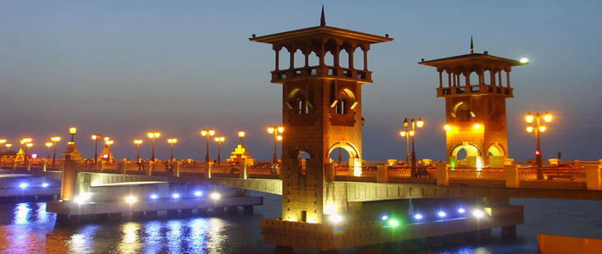

Slide 18
http://www.timeforkids.com/destination/egypt/native-lingo

Slide 19
Egypt is officially known as the Arab Republic of Egypt. In 2012, the population of Egypt was just over 83 million (83,688,164). Egypt is bordered by the Gaza Strip, Israel, Libya and Sudan as well as the Mediterranean Sea and the Red Sea. The official language of Egypt is Arabic, but others languages such as English and French are also understood by many. The capital city is Cairo, which also has the largest population. Other major cities include Alexandria and Giza. Egypt is a very dry country. The Sahara and Libyan Desert make up most of the area of Egypt. The longest river in the world, the Nile, runs through Egypt. Egypt is famous for its ancient civilization, the Ancient Egyptians, who date back to around 3150 B.C. Egypt is home the Great Pyramid of Giza, one of the Seven Wonders of the Ancient World. The most popular sport in Egypt is football (soccer).

Slide 20
