Slide 1
Exploring the World
Today we visit...

Slide 3
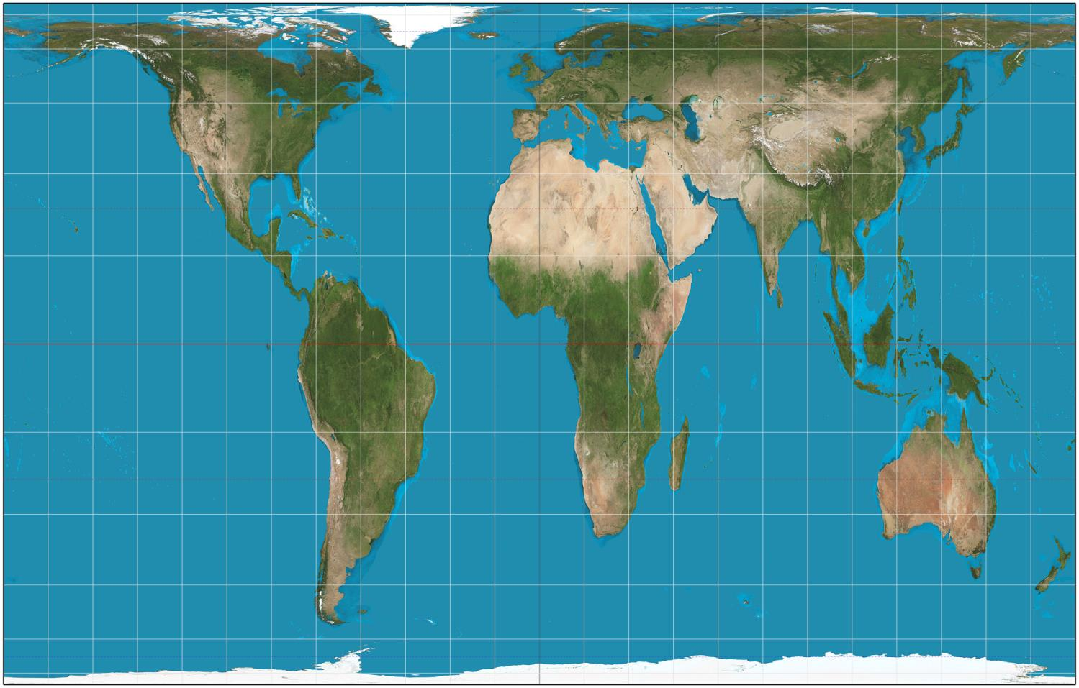

Slide 4
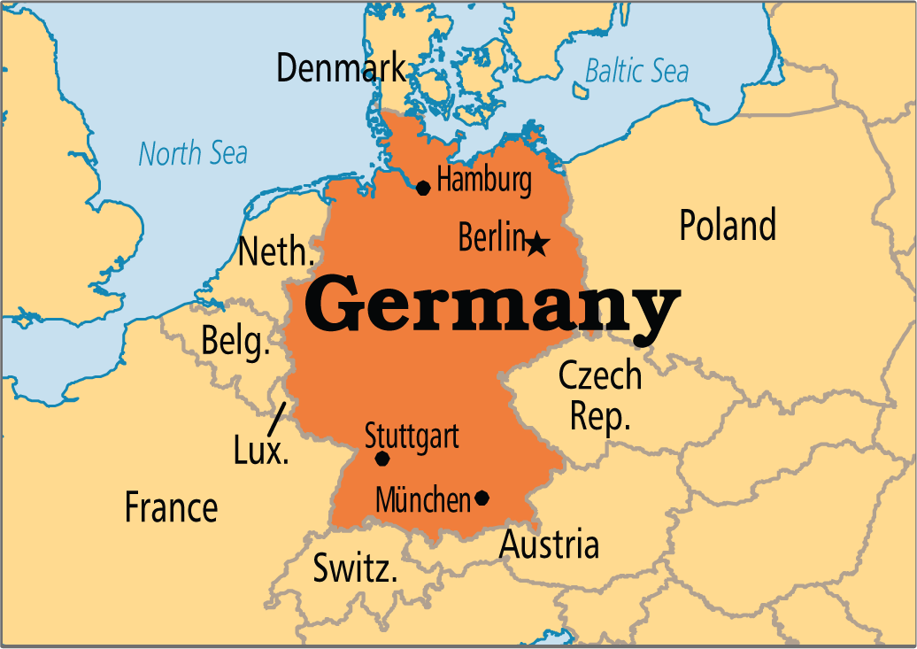

Slide 5
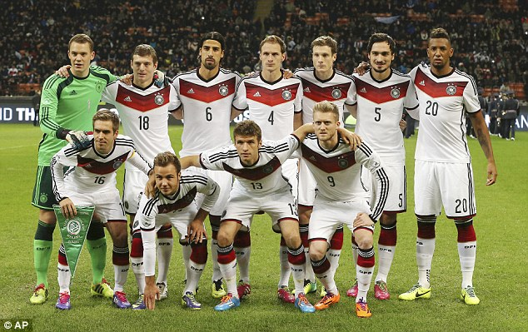

Slide 6
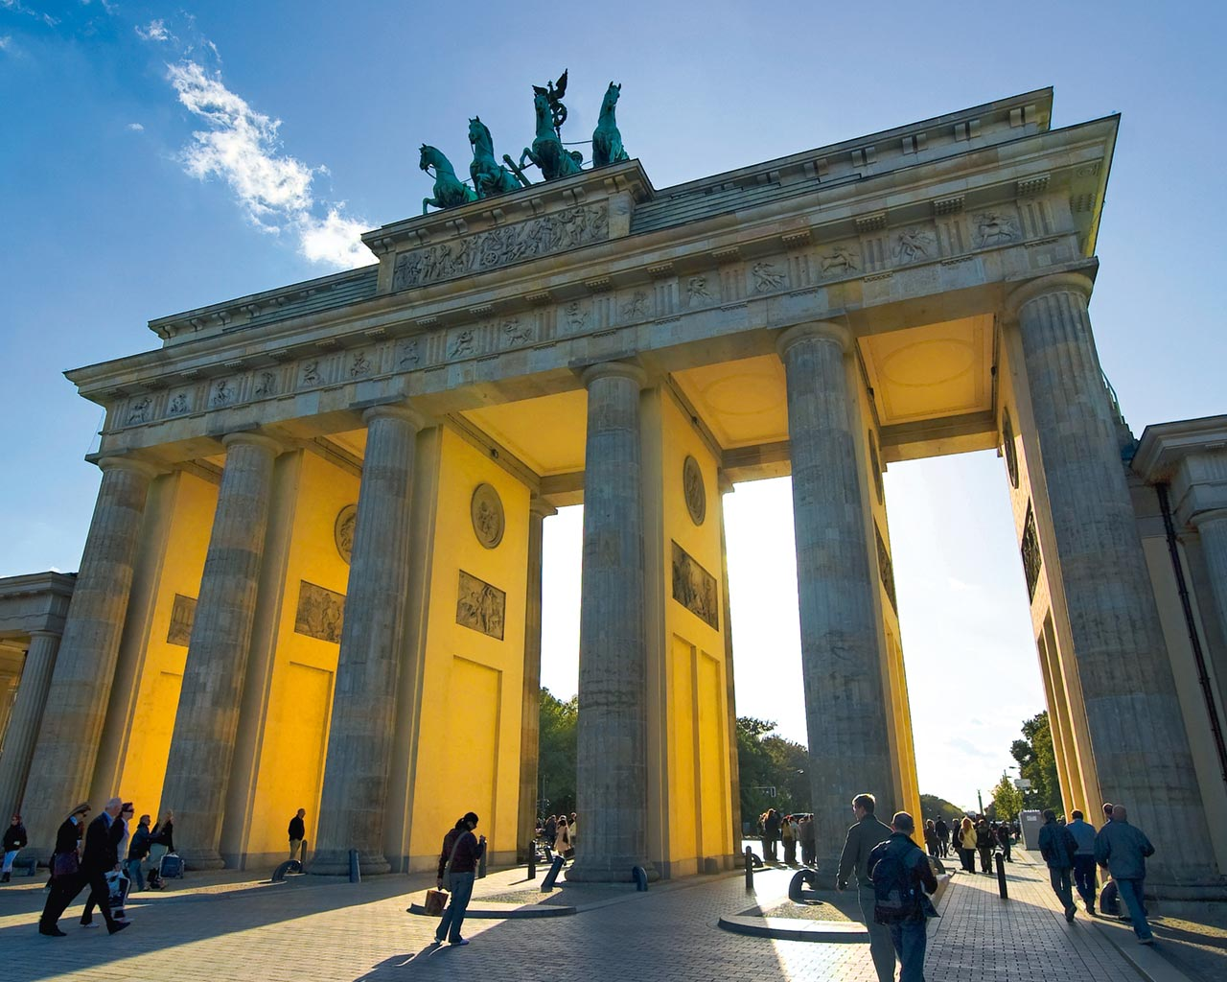

Slide 7
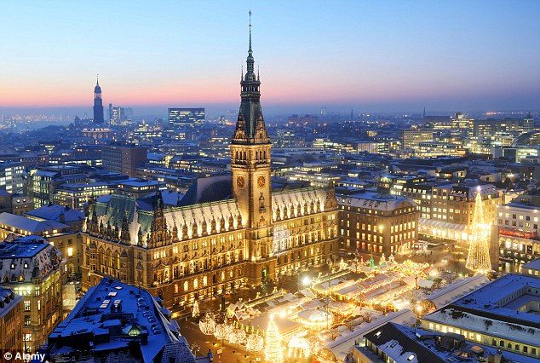

Slide 8
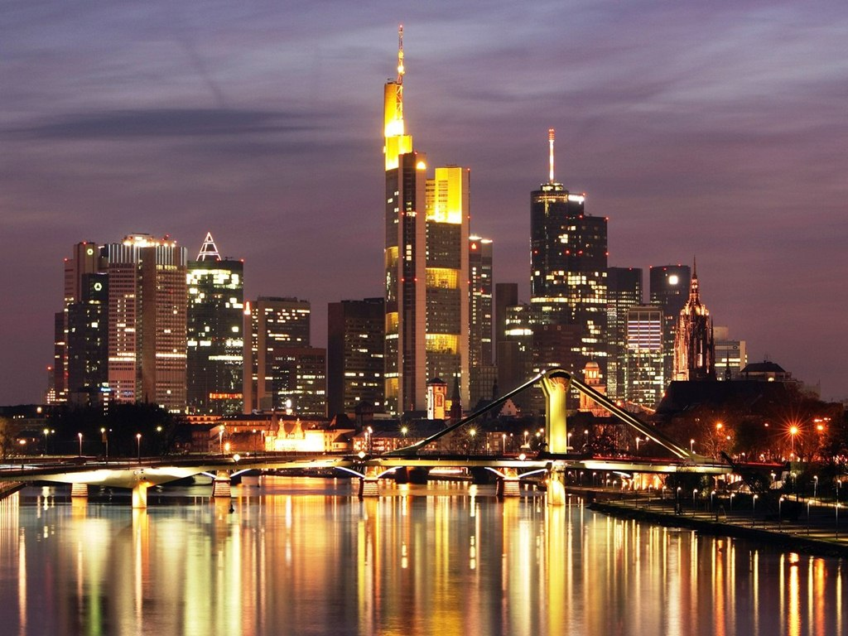

Slide 9
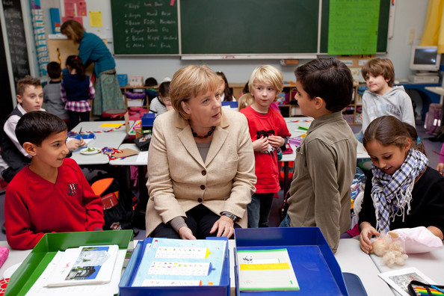

Slide 10
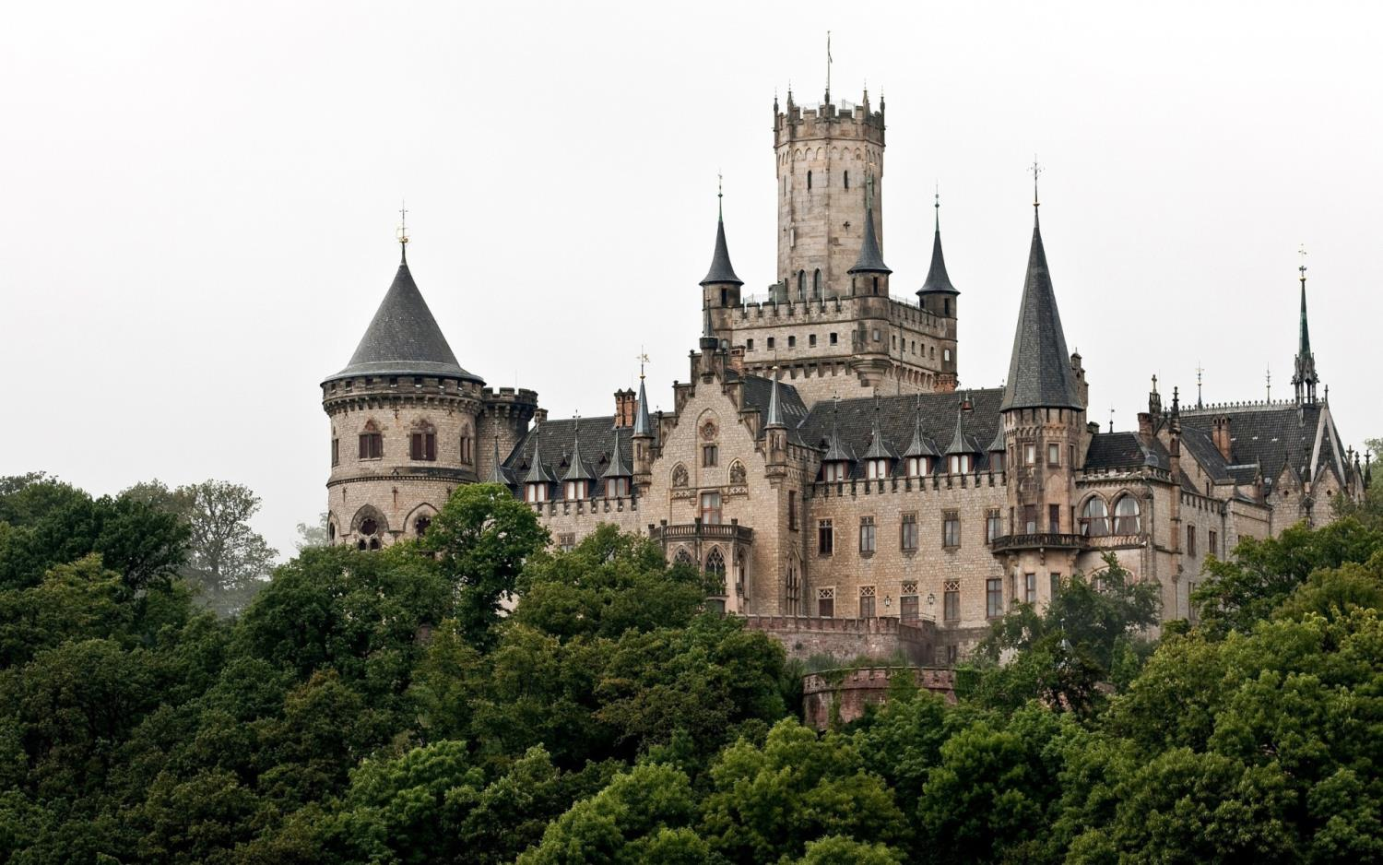

Slide 11
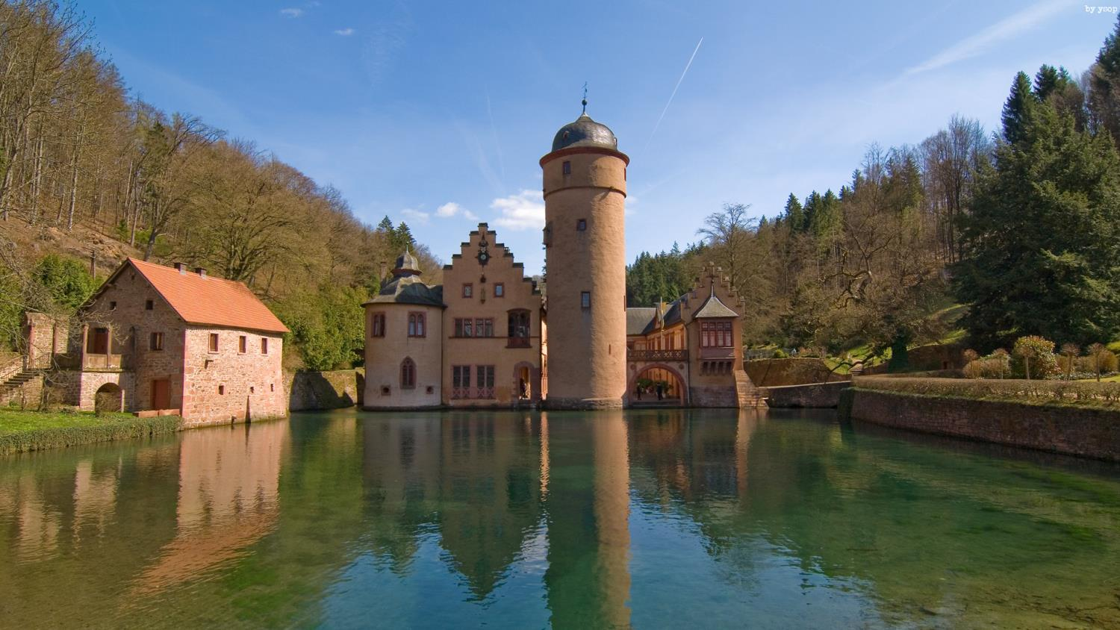

Slide 12
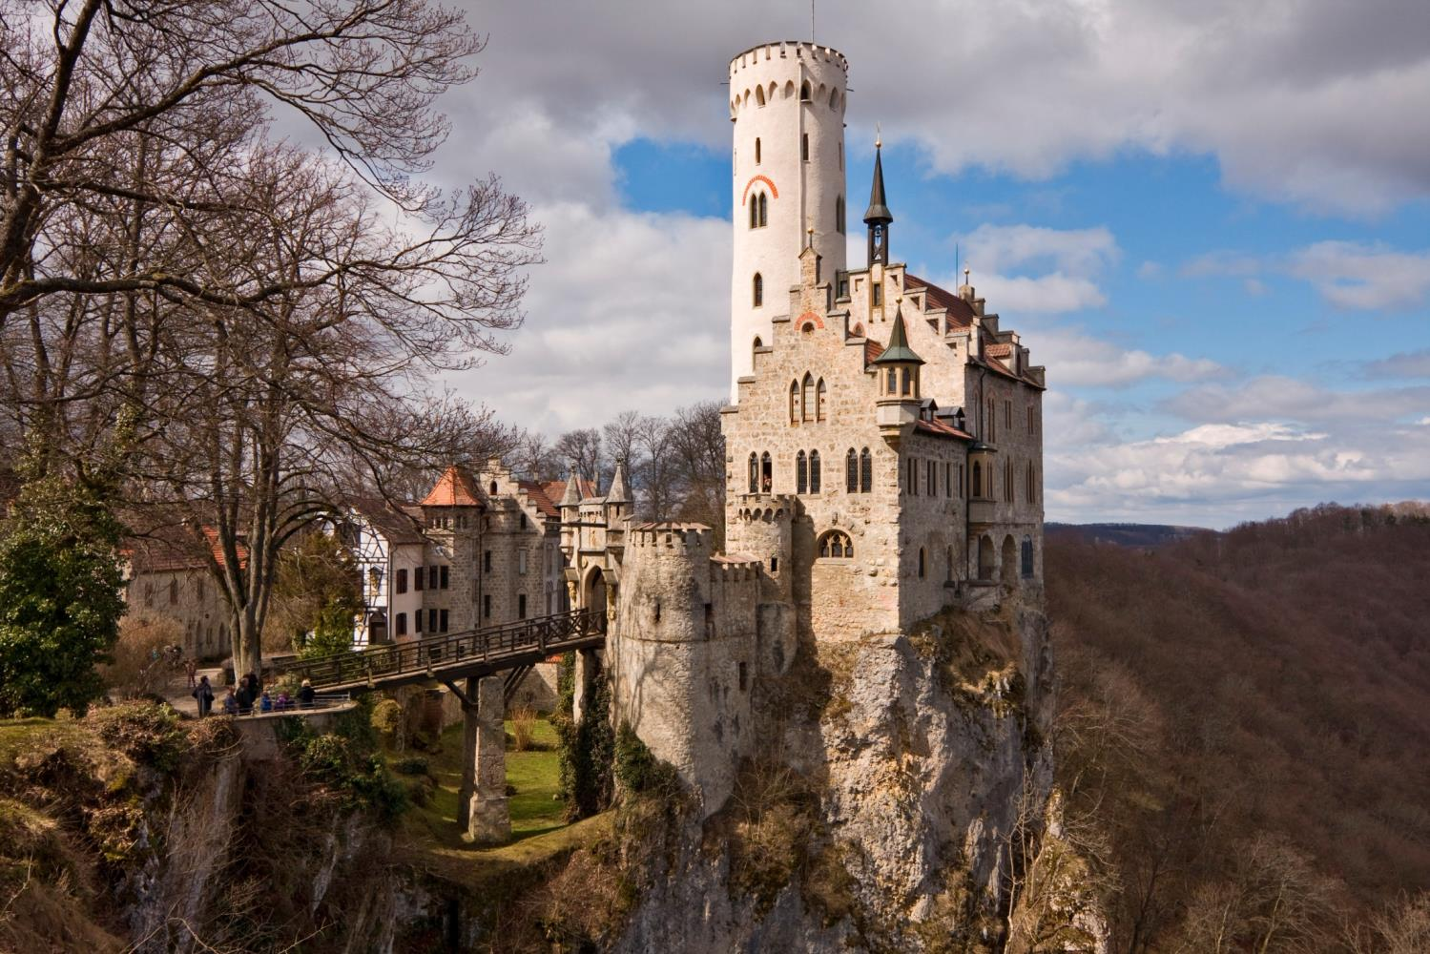

Slide 13
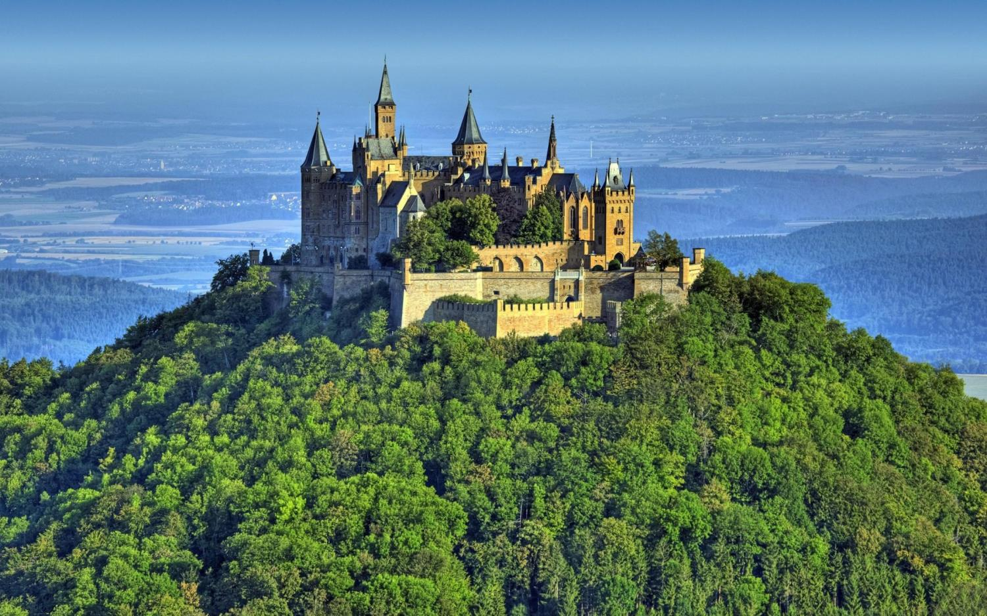

Slide 14
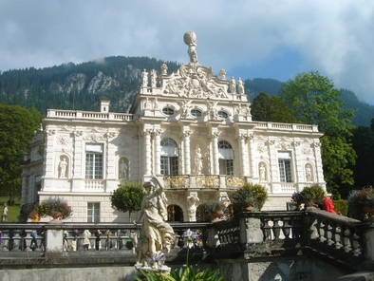

Slide 15
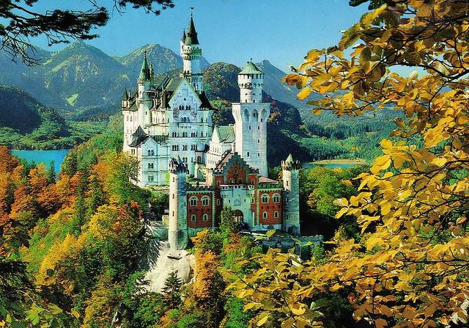

Slide 16
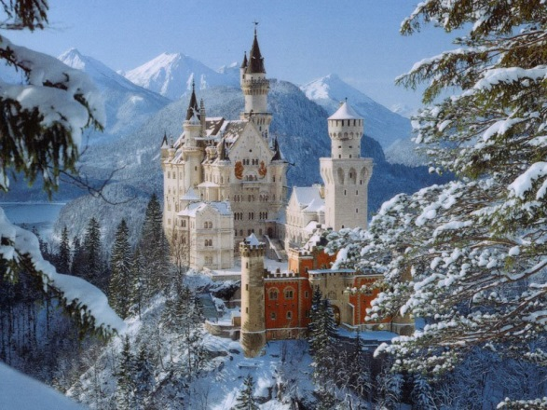

Slide 17
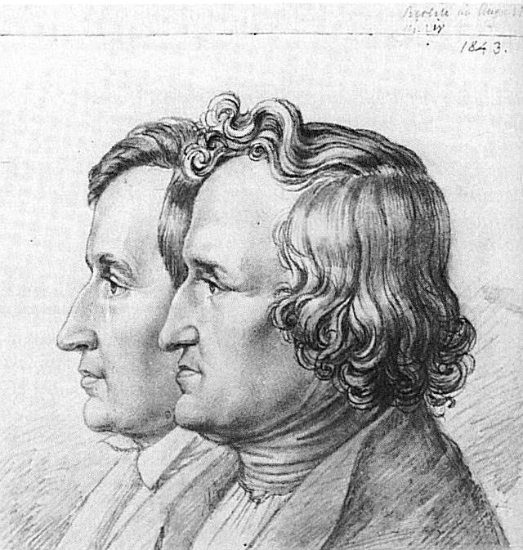

Slide 18
The Bremen Town-Musicians (with audio) Brother and Sister Cinderella (with audio) The Frog King (with audio) Hänsel and Grethel Little Briar-Rose Little Red-Cap Little Snow-White Mother Holle Rapunzel The Seven Ravens (with audio) The Wolf and the Seven Little Kids

