Slide 1
Exploring the World
Today we visit...

Slide 2
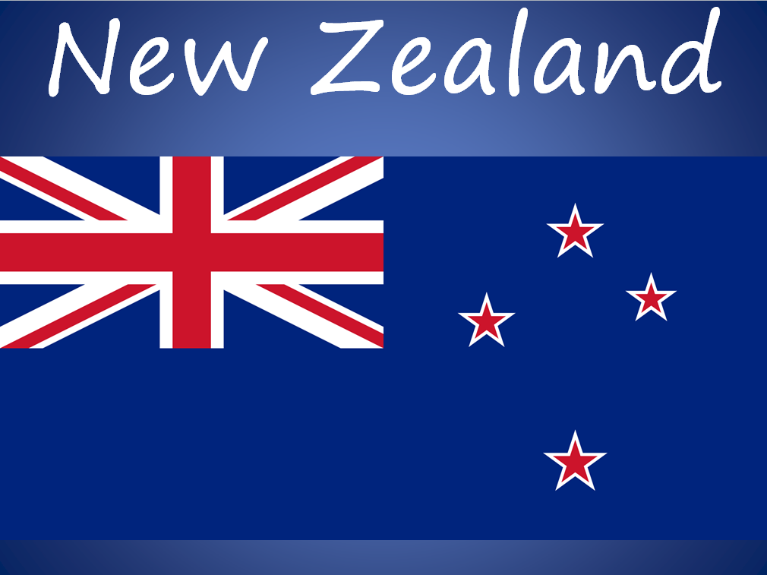

Slide 3
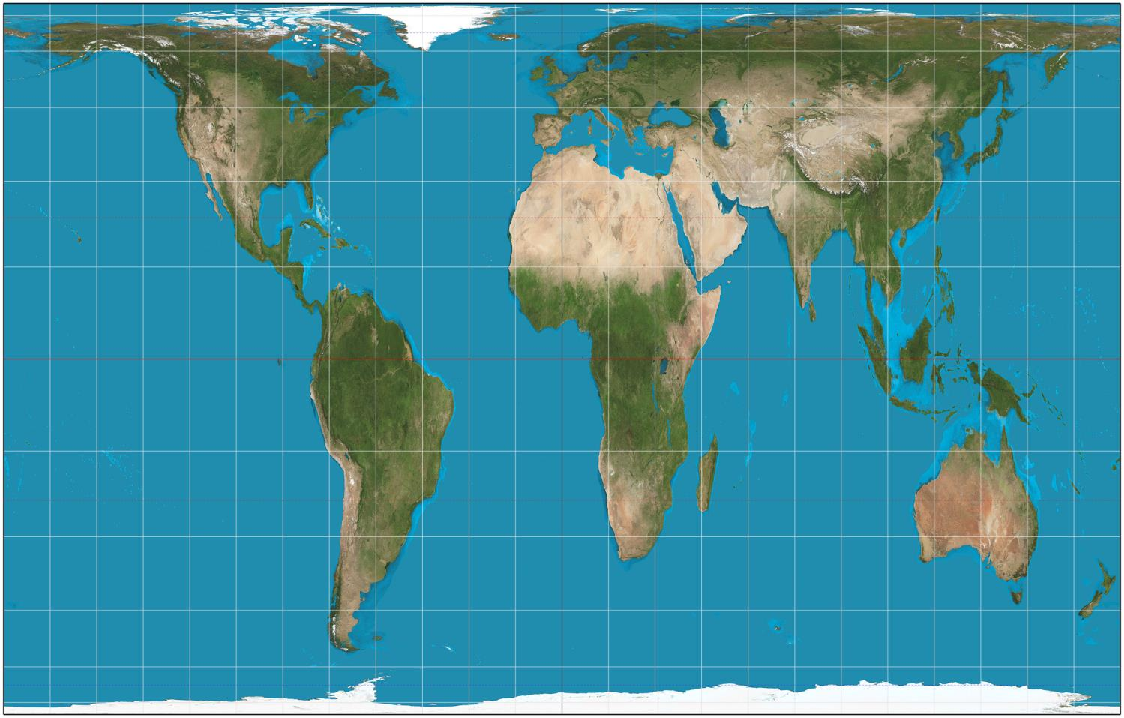
https://www.google.com.au/maps/place/New+Zealand/@-43.3744881,172.4662705,8518906m/data=!3m1!1e3!4m2!3m1!1s0x6d2c200e17779687:0xb1d618e2756a4733

Slide 4
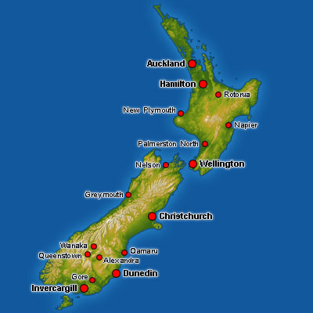

Slide 5
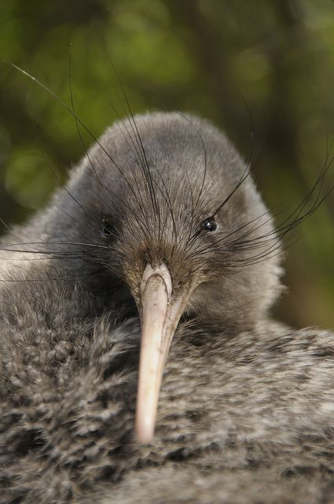
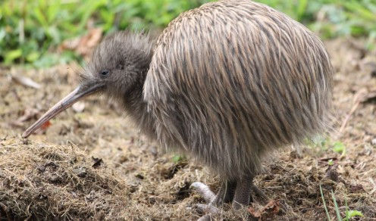
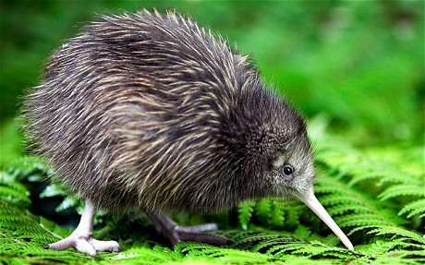

Slide 6
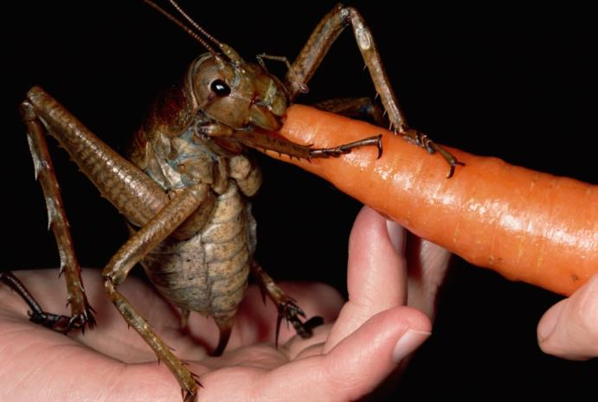
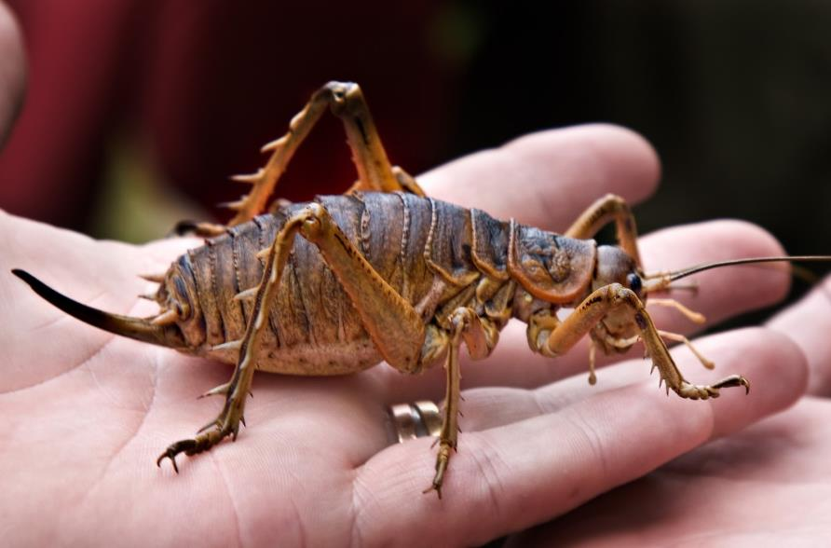
New Zealand is home to one of the world’s heaviest insects. It’s called the weta and is part of the cricket family. It weighs 2.5 ounces (70 grams). That is very heavy for an insect; it weighs three times more than a mouse and looks like a giant cockroach.

Slide 7
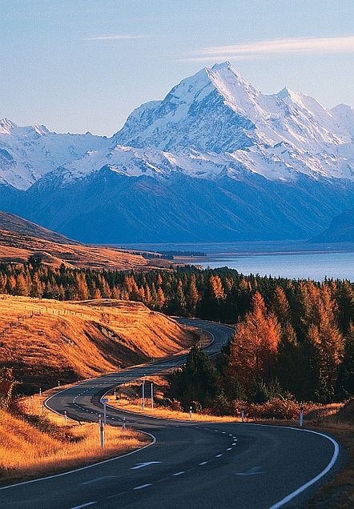

Slide 8
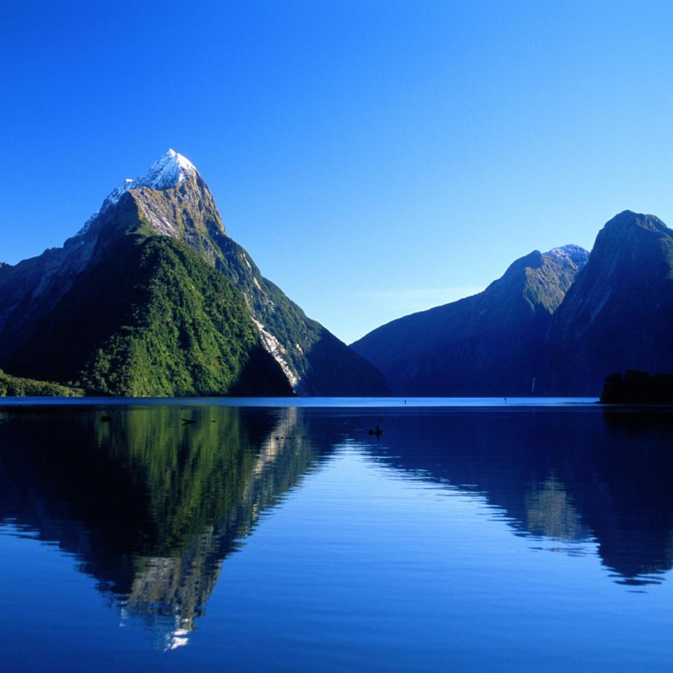

Slide 9
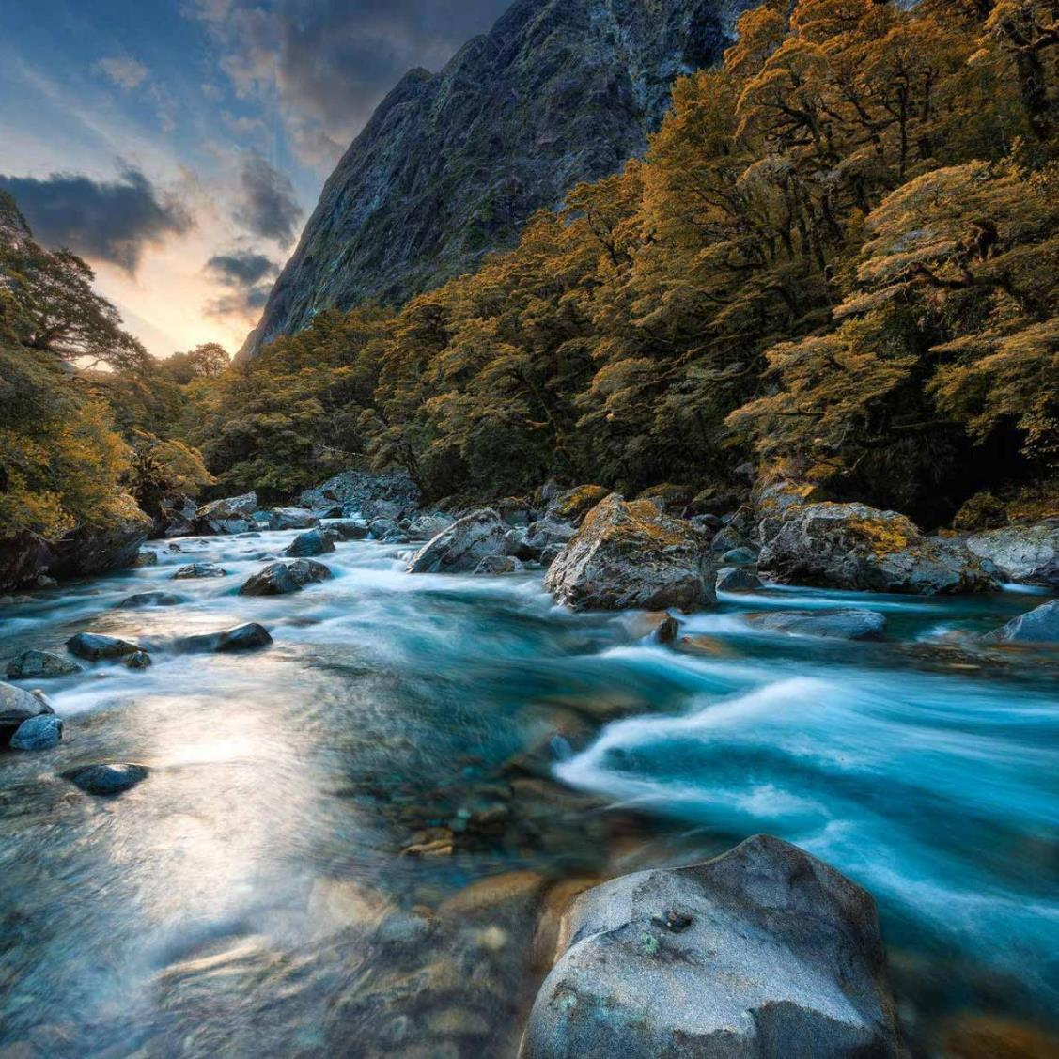

Slide 10
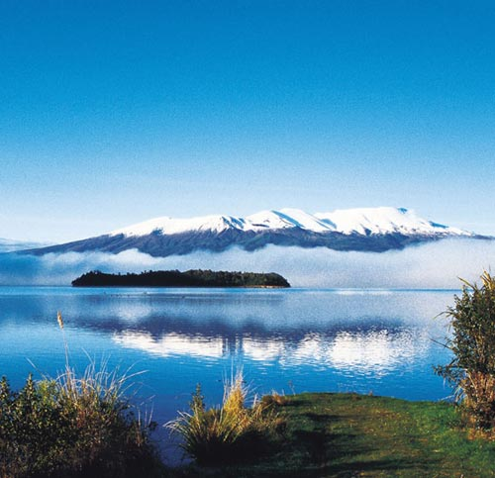

Slide 11
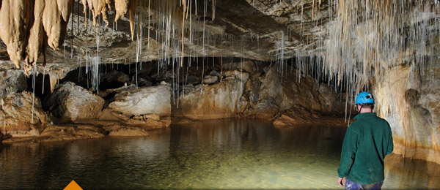

Slide 12
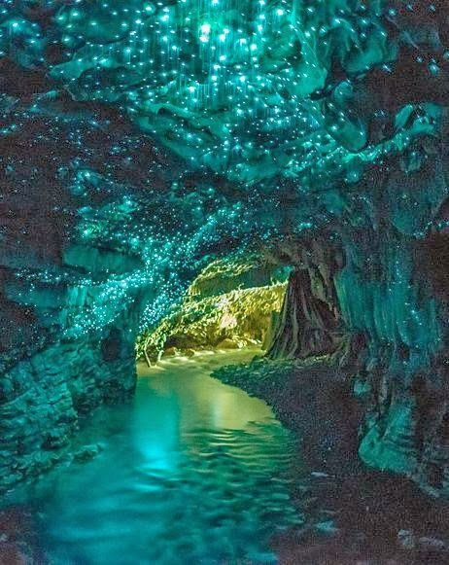

Slide 13
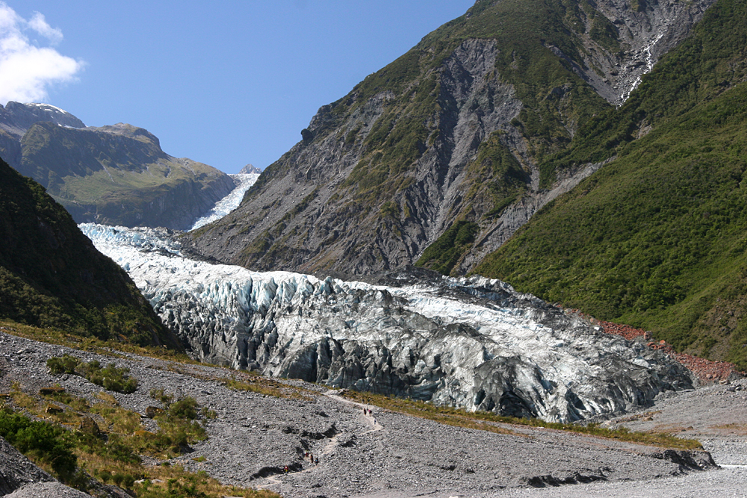

Slide 14
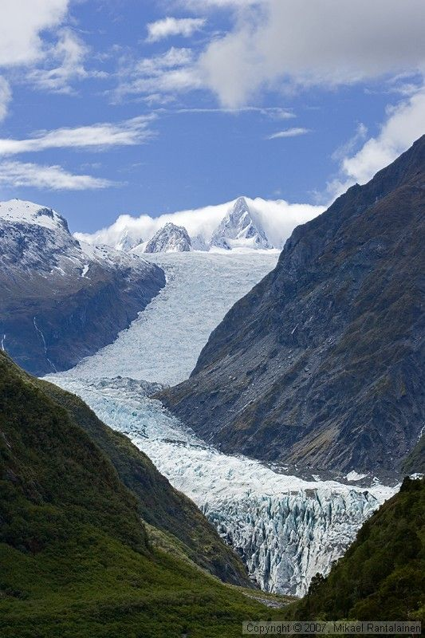

Slide 15
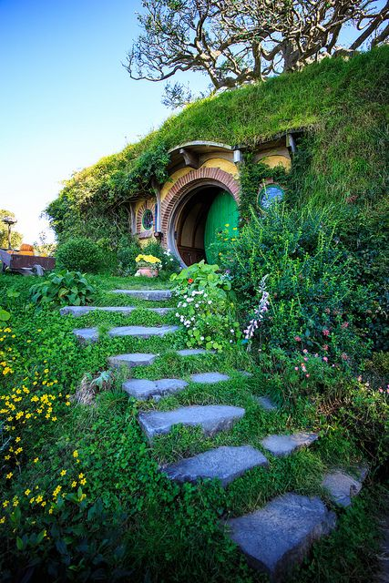
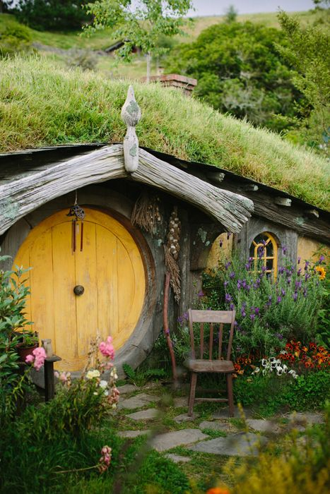

Slide 16
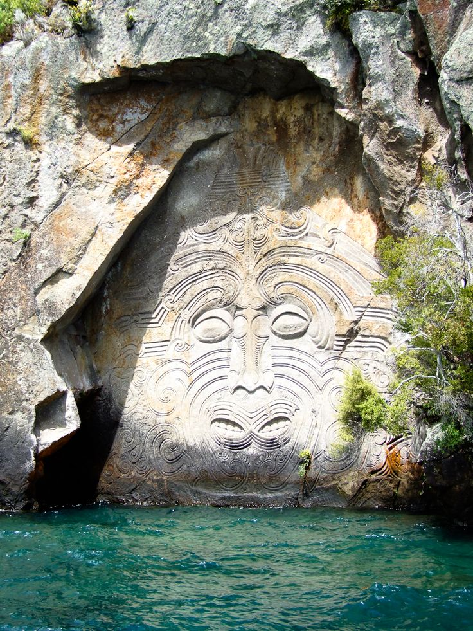

Slide 17
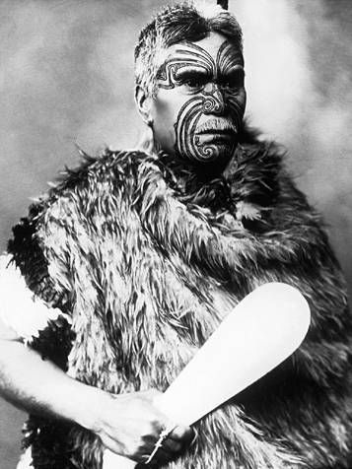

Slide 18
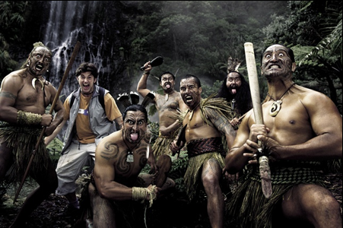

Slide 19
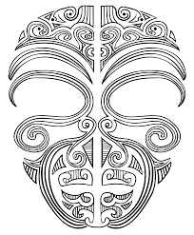
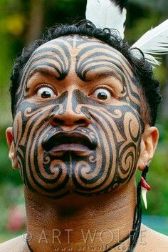
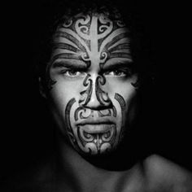

Slide 20
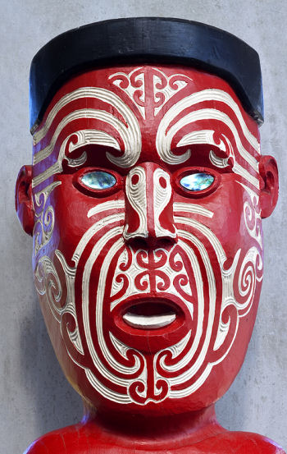
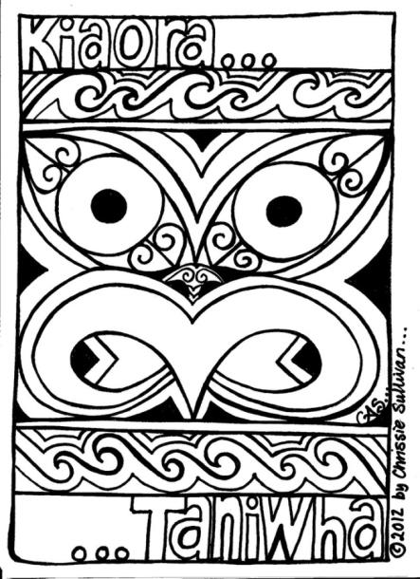
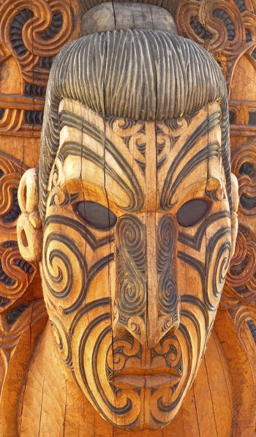
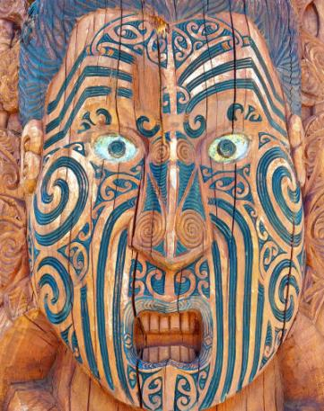

Slide 21
The capital city of New Zealand is Wellington while the largest city is Auckland. Other major cities include Christchurch, Hamilton and Dunedin.
The population of New Zealand was estimated to be around 4.5 million at the start of 2013.
The official spoken languages of New Zealand are English and te reo Maori, with English being the most widely used.
Maori are the indigenous Polynesian people of New Zealand.
The Maori name for New Zealand is Aotearoa.
The term ‘Kiwi’ is also used as a nickname for a New Zealander.
The Lord of the Rings movies were filmed in New Zealand.
Rugby, cricket and netball are the most popular sports in New Zealand
There are over 50 volcanoes, some of which can still erupt.
Maori people are indigenous to the island and descend from Polynesia.
The Maori named the country, Aotearoa, which means “The Land of the Long White Cloud.”
New Zealand is the very first country to see the sun every day!
The longest place name in the world is Taumatawhakatangihangakoauauotamateapokaiwhenuakitanatahu, which is a hill in Hawkes Bay.
There is a bird called the kea, and it does the strangest thing; it pulls windscreen wipers off cars and eats the rubber.

Slide 22
