Slide 1
Exploring the World
Today we visit...

Slide 3
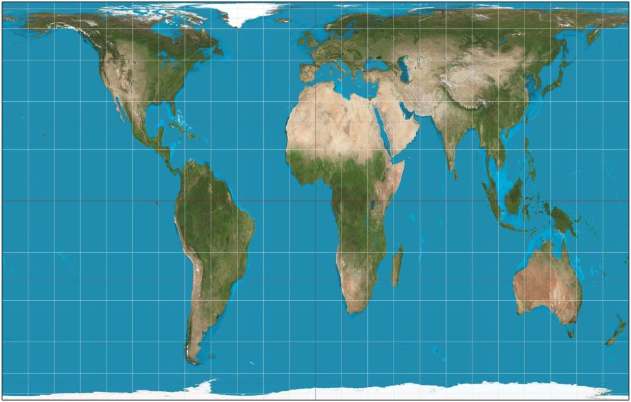
https://www.google.com.au/maps/place/Mexico/@23.6260333,-102.5377501,2681675m/data=!3m1!1e3!4m2!3m1!1s0x84043a3b88685353:0xed64b4be6b099811

Slide 4
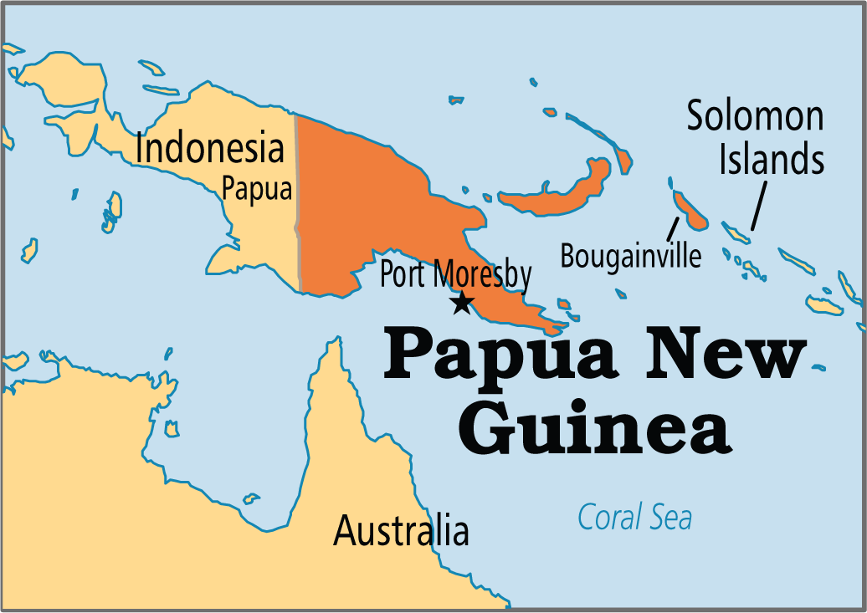

Slide 5
]There are hundreds of ethnic groups indigenous to Papua New Guinea, the majority being from the group known as Papuans,
There are also numerous people from other parts of the world now resident, including Chinese, Europeans, Australians, Filipinos, and Polynesians,
Papua New Guinea has more languages than any other country, with over 820 indigenous languages, representing 12% of the world's total, but most have fewer than 1,000 speakers. The most widely spoken indigenous language is Enga, with about 200,000 speakers,
There are four official languages for Papua New Guinea: English, sign language,[4] Tok Pisin, and Hiri Motu.
English is the language of government and the education system, but it is not spoken widely.
The primary lingua franca of the country is Tok Pisin (commonly known in English as New Guinean Pidgin or Melanesian Pidgin), in which much of the debate in Parliament is conducted, many information campaigns and advertisements are presented, and until recently a national newspaper, Wantok, was published. The only area where Tok Pisin is not prevalent is the southern region of Papua, where people often use the third official language, Hiri Motu.
Although it lies in the Papua region, Port Moresby has a highly diverse population which primarily uses Tok Pisin, and to a lesser extent English,

Slide 6
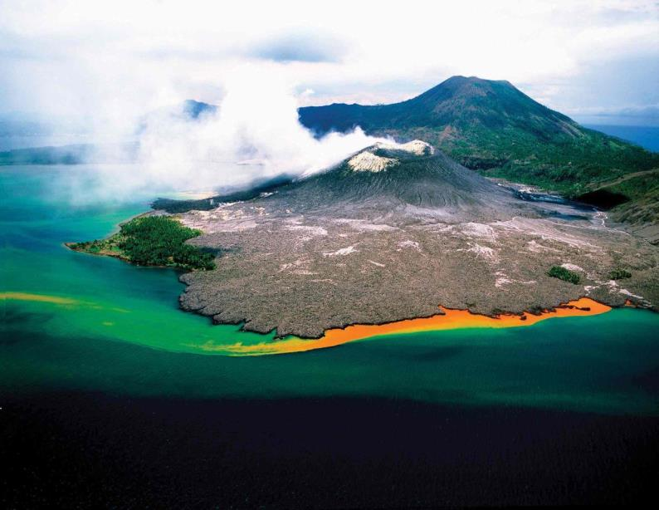

Slide 7
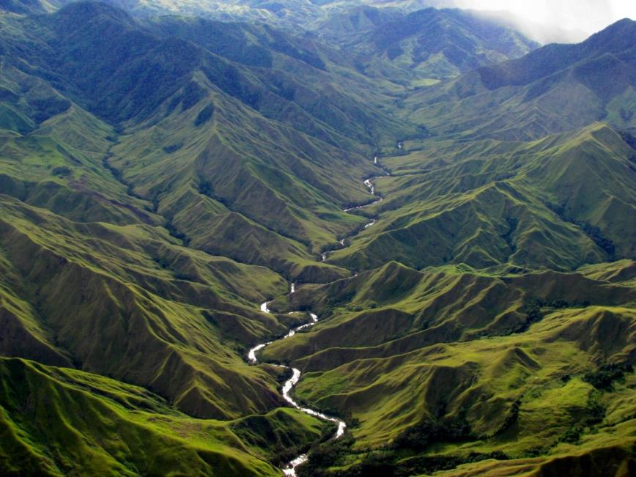

Slide 8
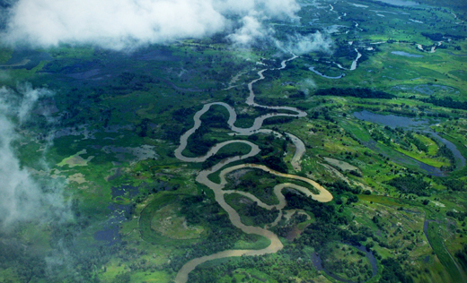

Slide 9
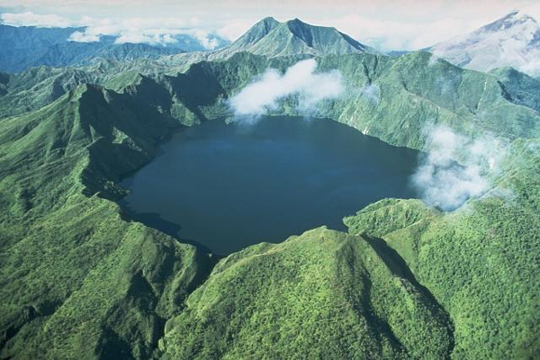

Slide 10
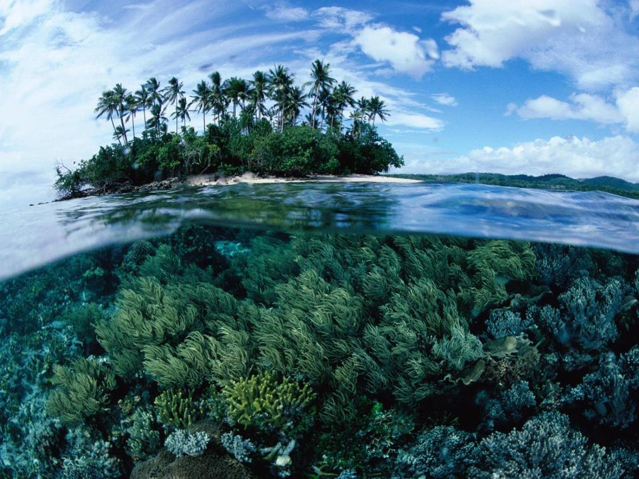

Slide 11
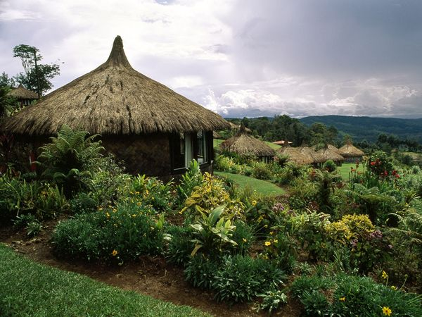

Slide 12
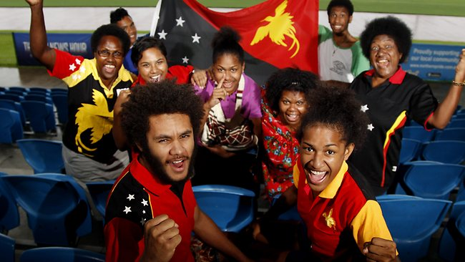

Slide 13
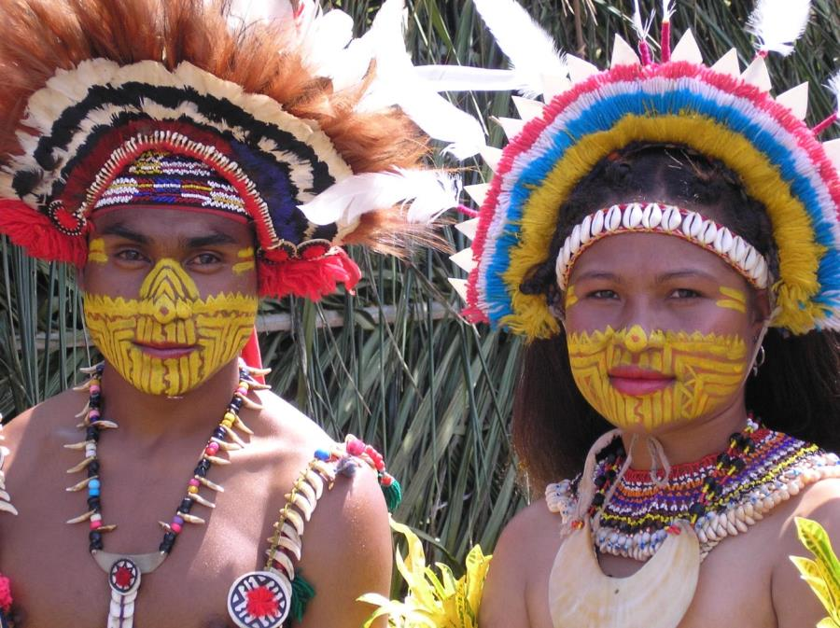

Slide 14
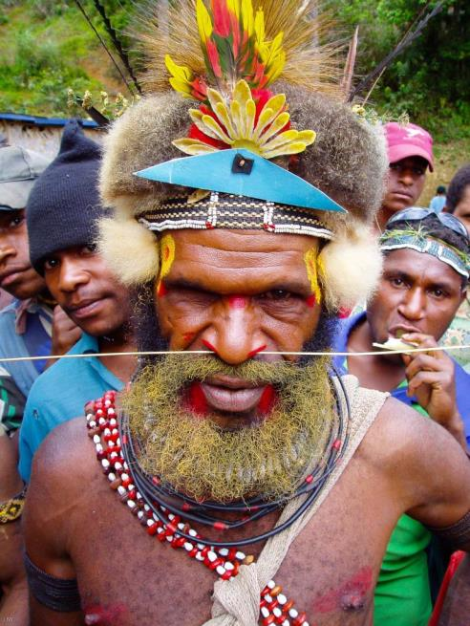

Slide 15
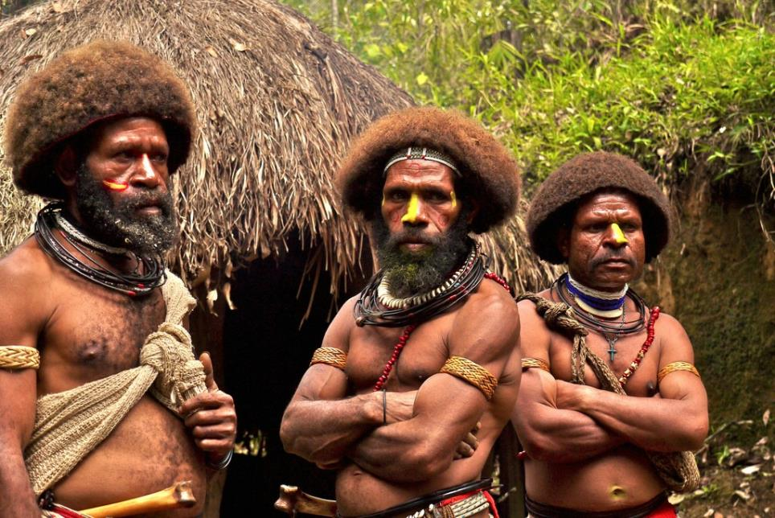

Slide 16
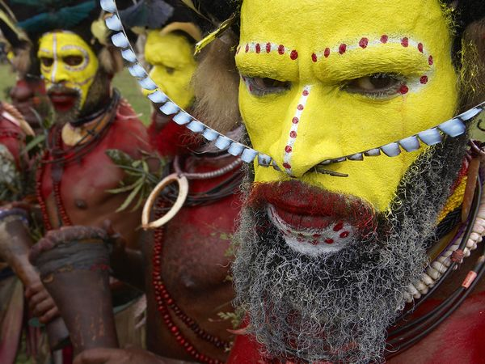

Slide 17
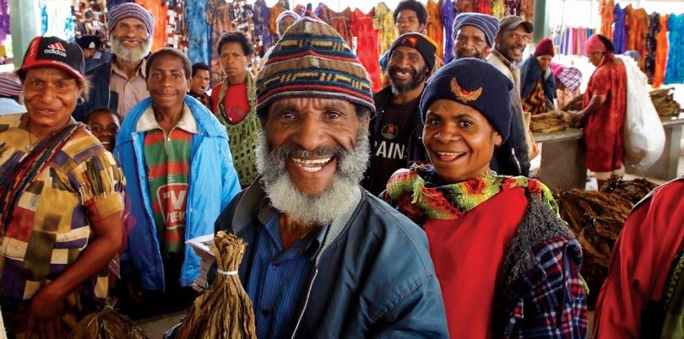

Slide 18
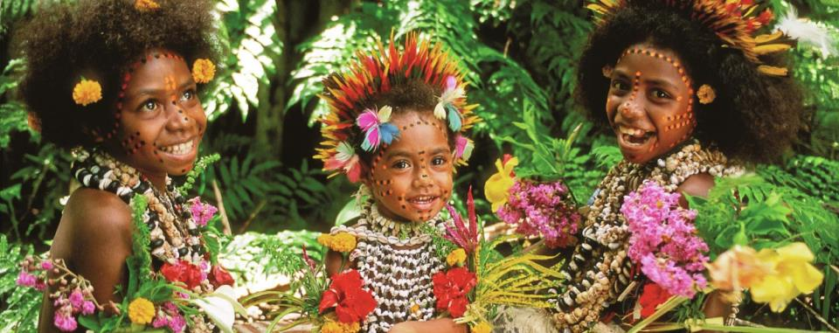

Slide 19
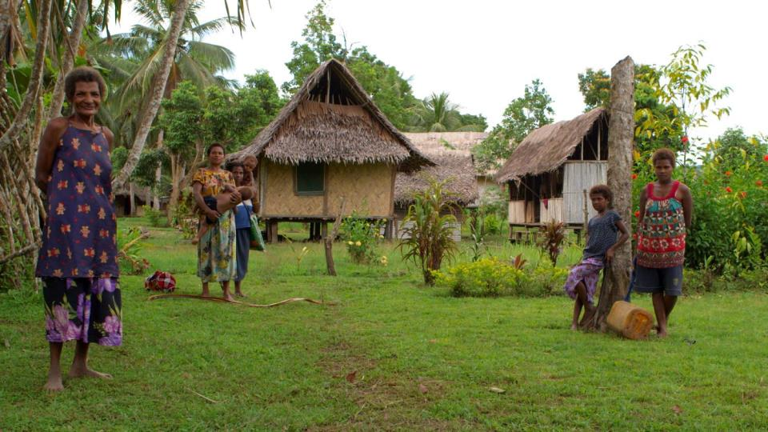

Slide 20
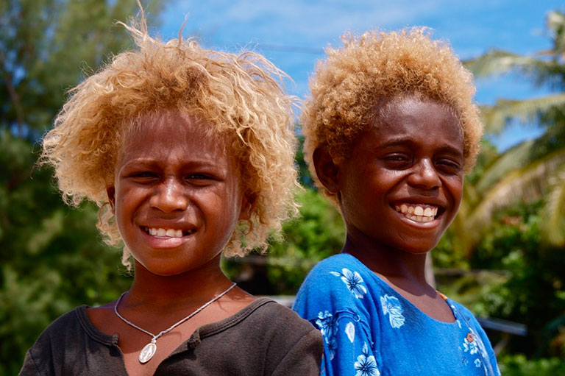

Slide 21
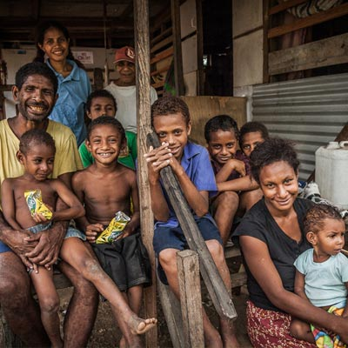

Slide 22
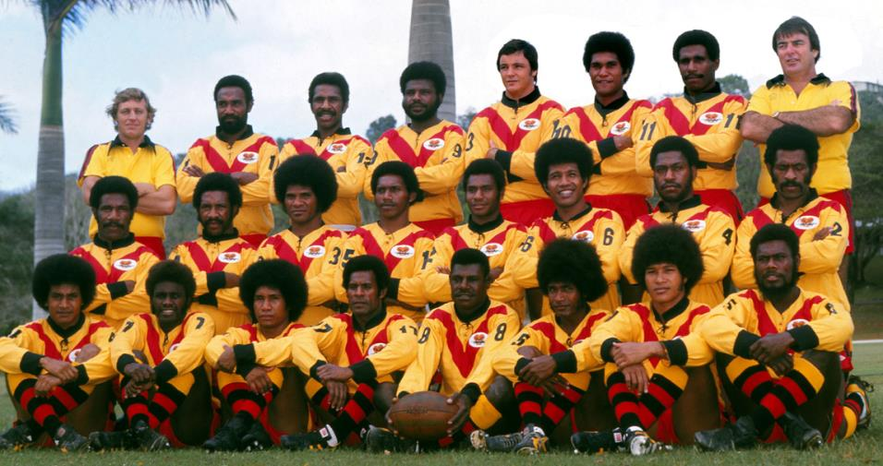

Slide 23
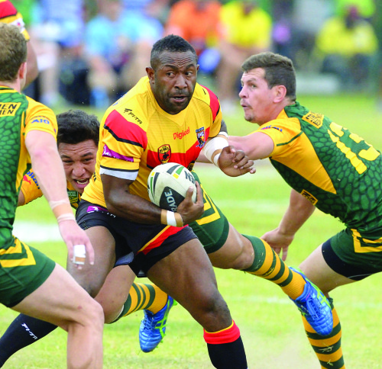

Slide 24
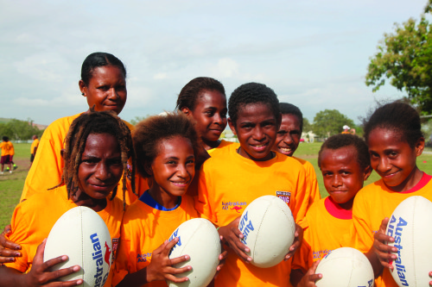

Slide 25
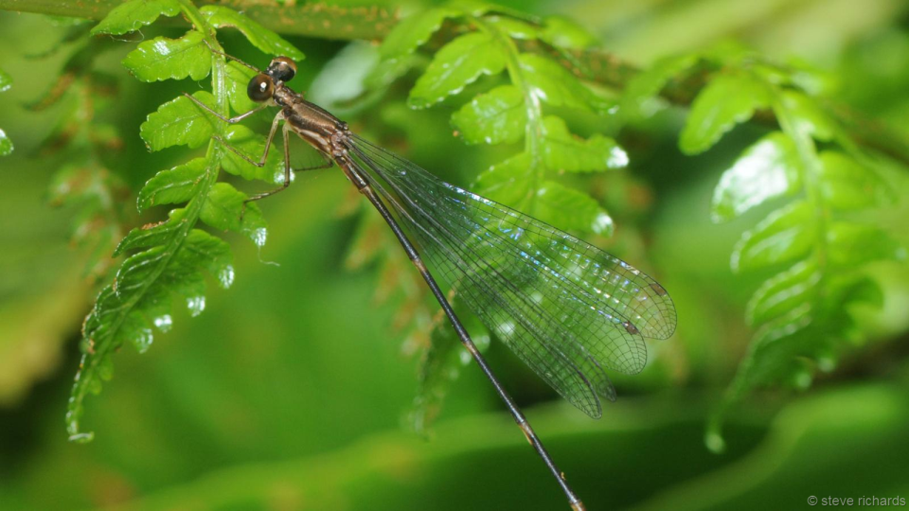

Slide 26
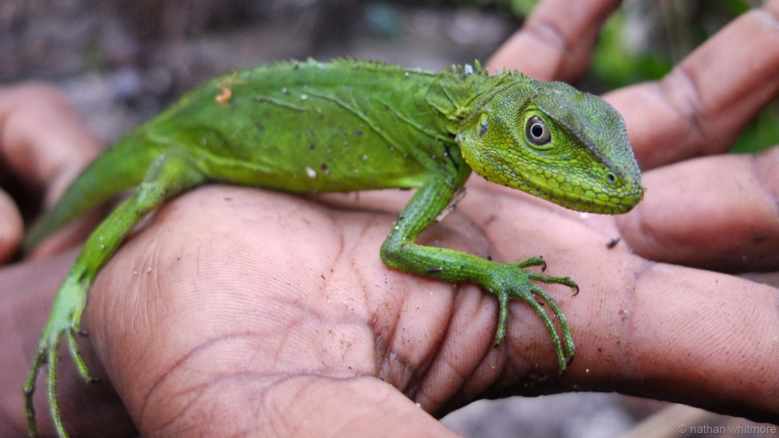

Slide 28
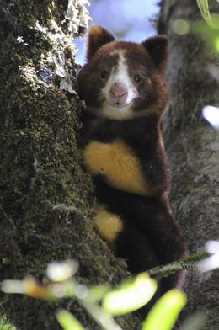

Slide 29
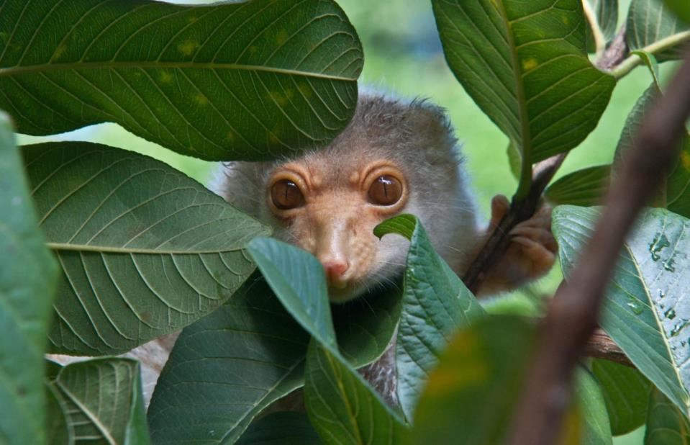

Slide 30
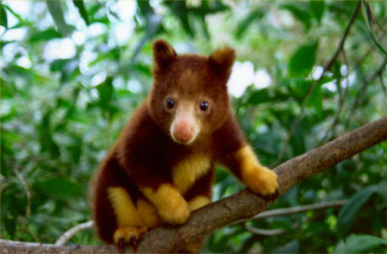

Slide 31
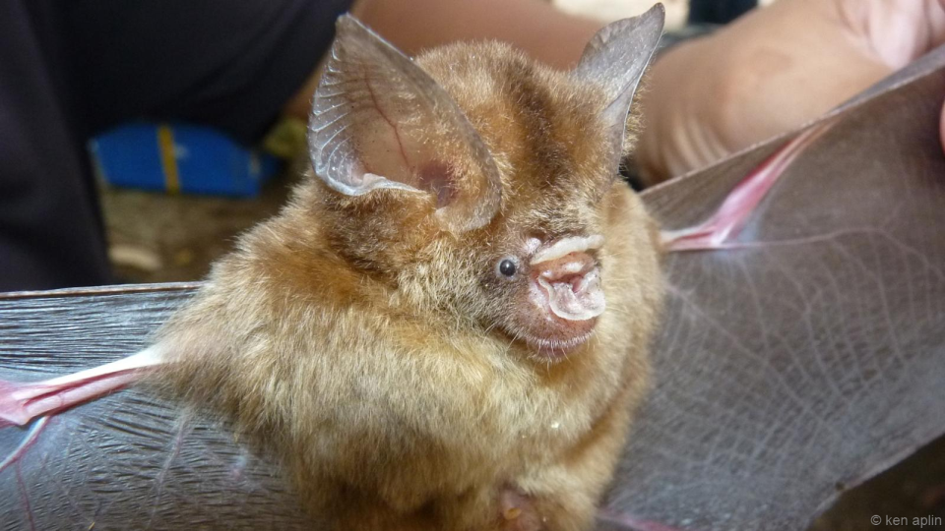

Slide 32
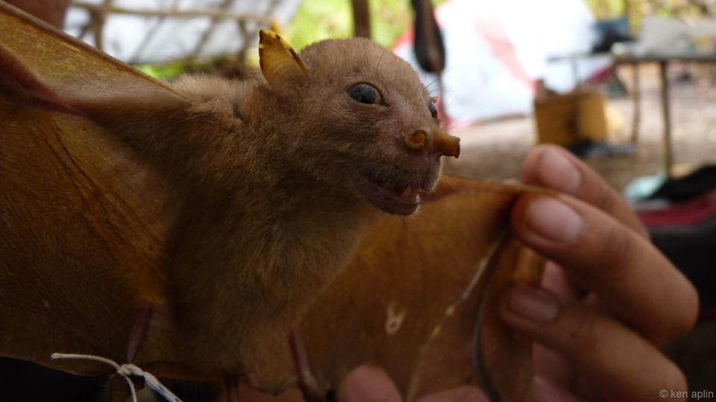

Slide 33
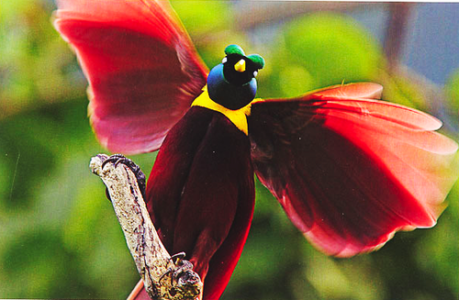

Slide 34
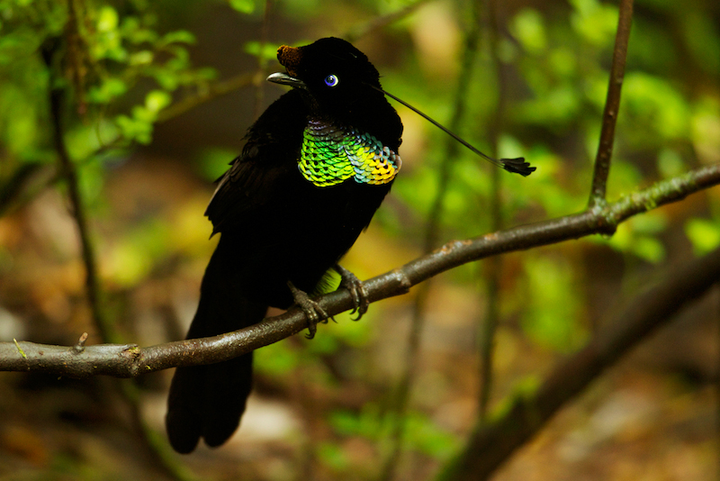

Slide 35
