Slide 1
Exploring the World
Today we visit...

Slide 2
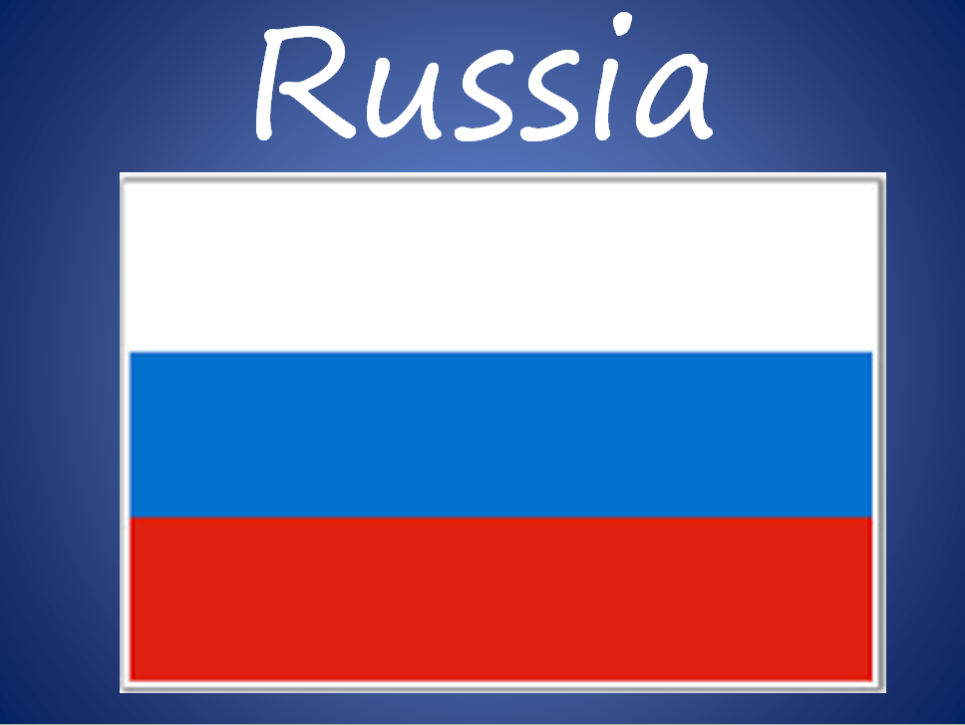

Slide 3
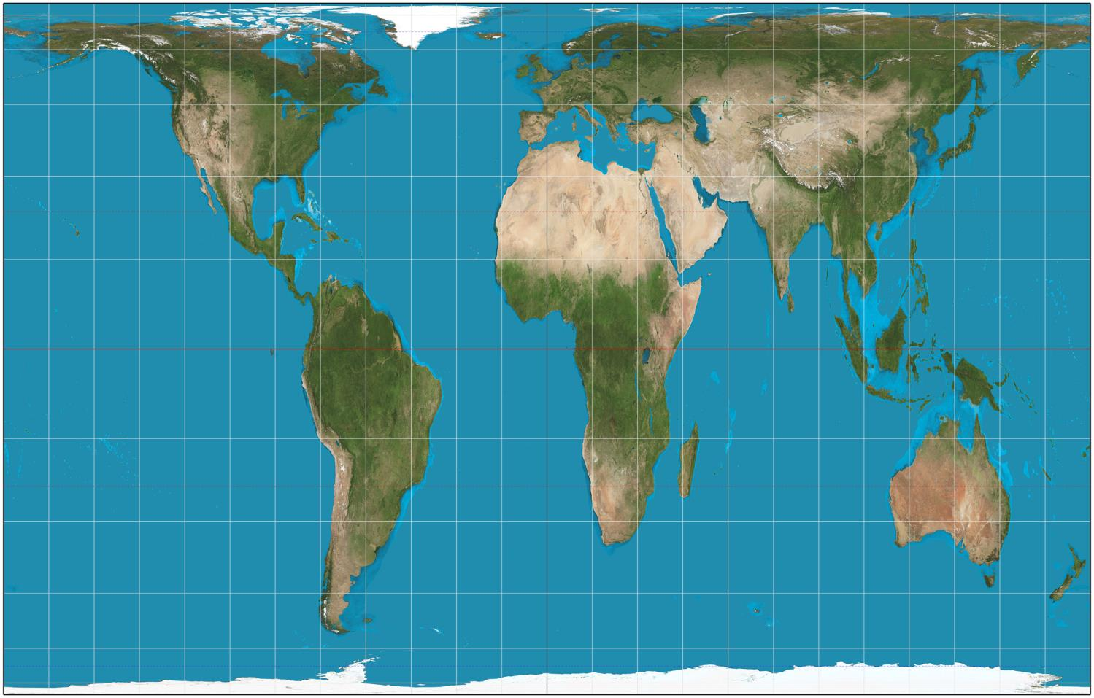
https://www.google.com.au/maps/place/Mexico/@23.6260333,-102.5377501,2681675m/data=!3m1!1e3!4m2!3m1!1s0x84043a3b88685353:0xed64b4be6b099811

Slide 4
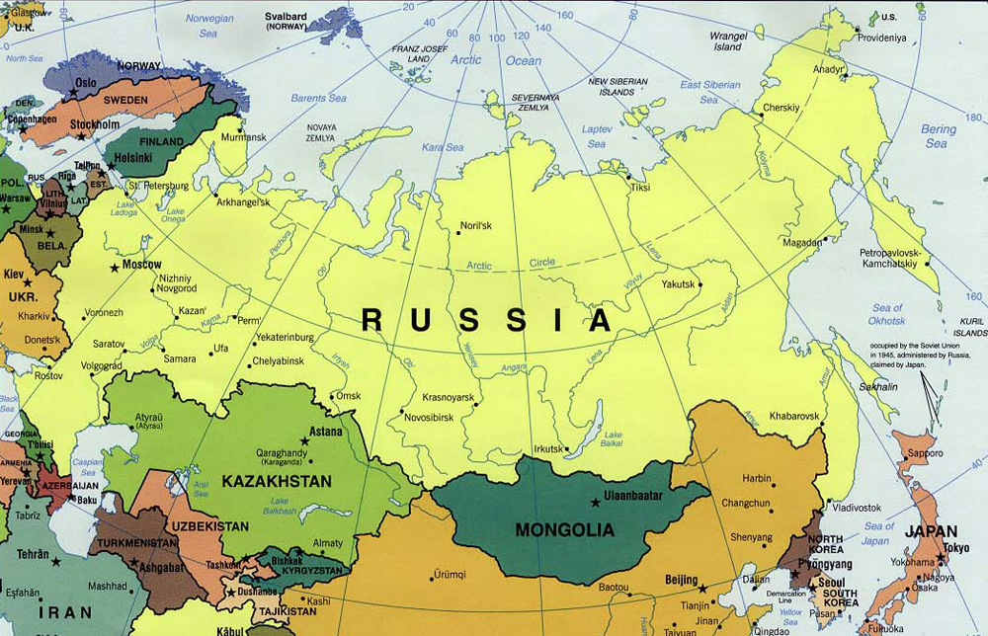

Slide 5
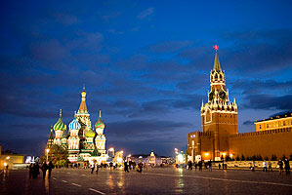

Slide 6
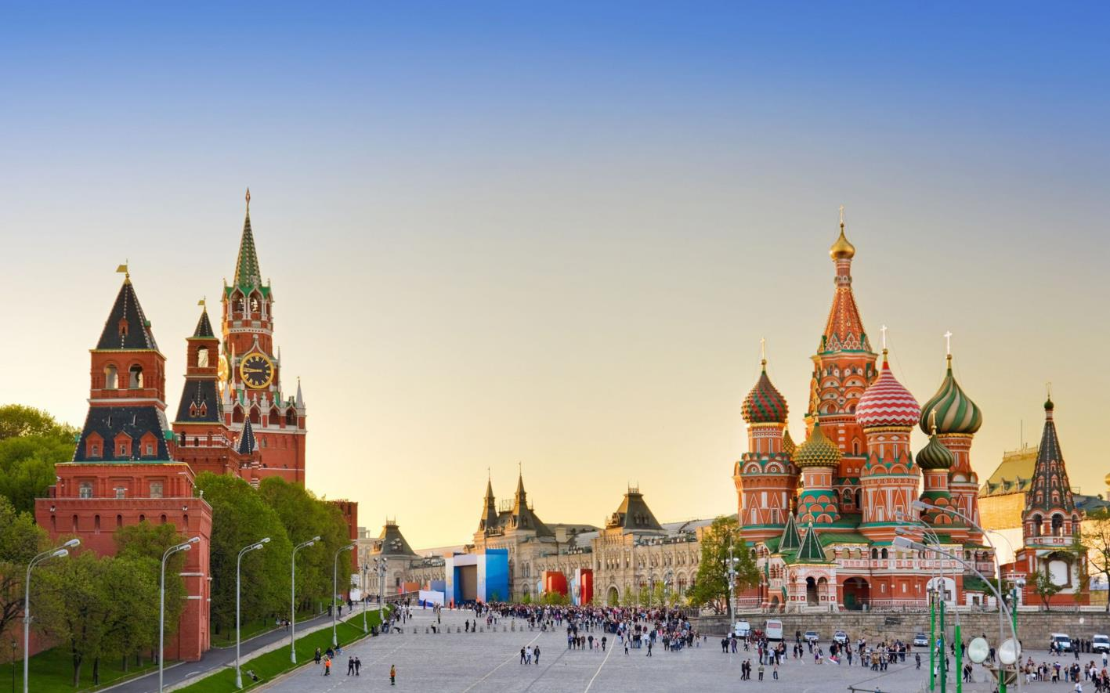

Slide 7
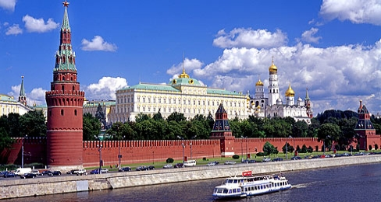

Slide 8
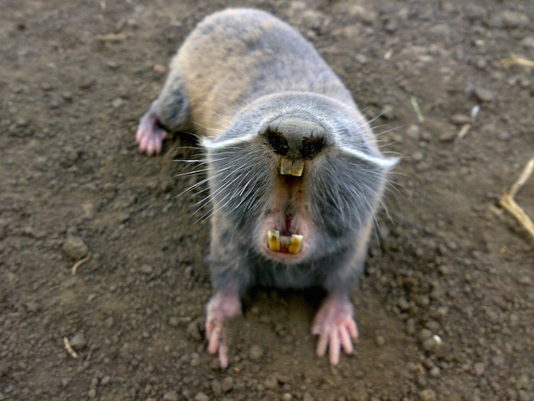
The Russian Mole-Rat
Spalax giganteus is all about those teeth. It doesn't just use them to eat hard foodstuffs like roots, but also to dig out a burrow for itself.

Slide 9
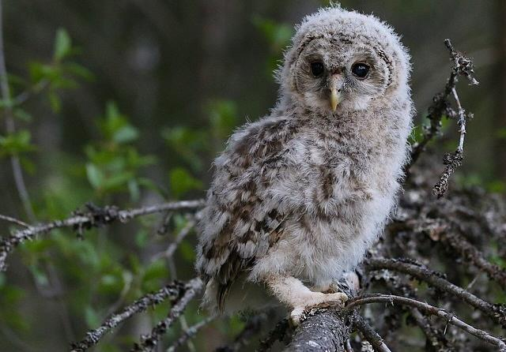
The Ural Owl
Whoohooo's that fuzzy little bird, you ask? It is Strix uralensis, also known as the Ural Owl. Even though it is named after the Russian mountain range.

Slide 10
