Slide 1
NAPLAN PRACTISE
Work through the problem with your group.
If you don’t get it, ask others to explain it to you.
If your group is stuck, keep trying until we come back together and share our discoveries

Slide 2
Strategies to Use
Talk through the problem
What is it asking?
Can we draw it?
Can we make it?
Does that answer make sense?

Slide 3
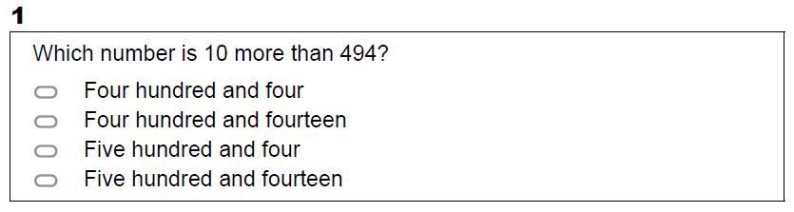
Set One

Slide 4
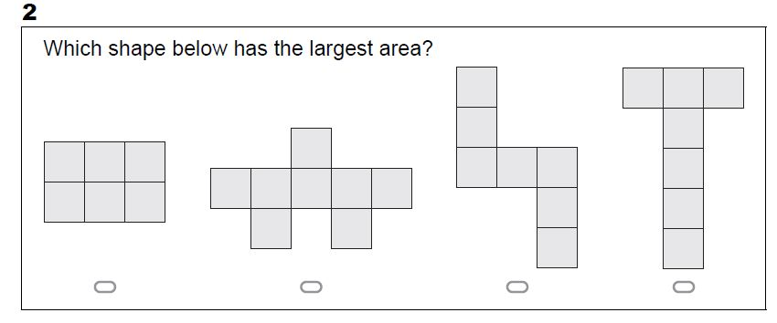
Set One

Slide 5
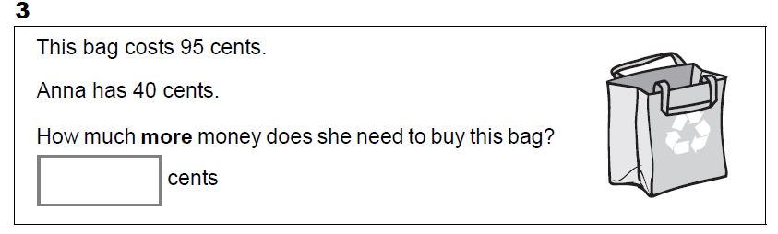
Set One

Slide 6
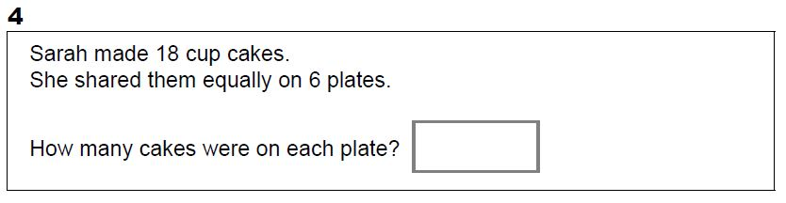
Set One

Slide 7
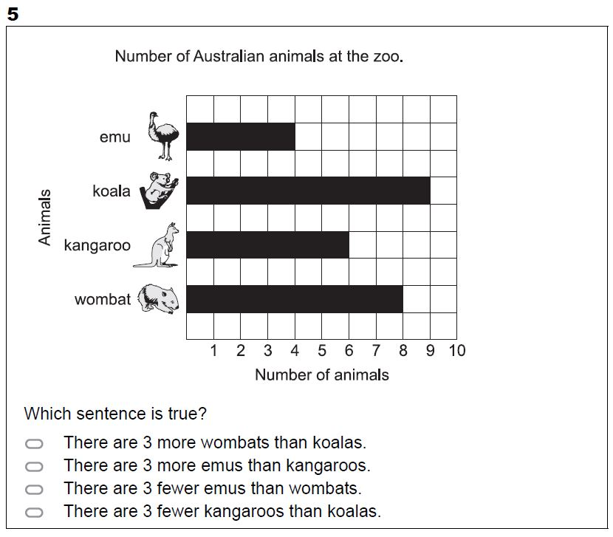
Set One

Slide 8
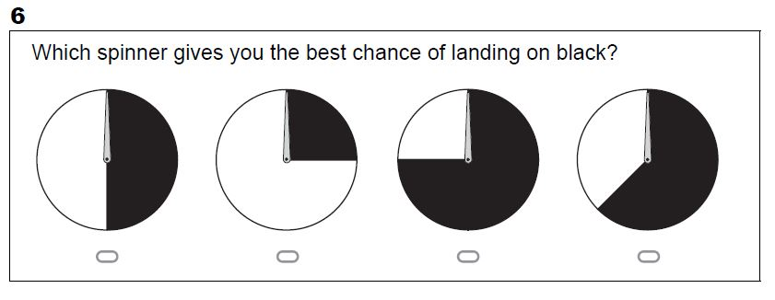
Set One

Slide 9
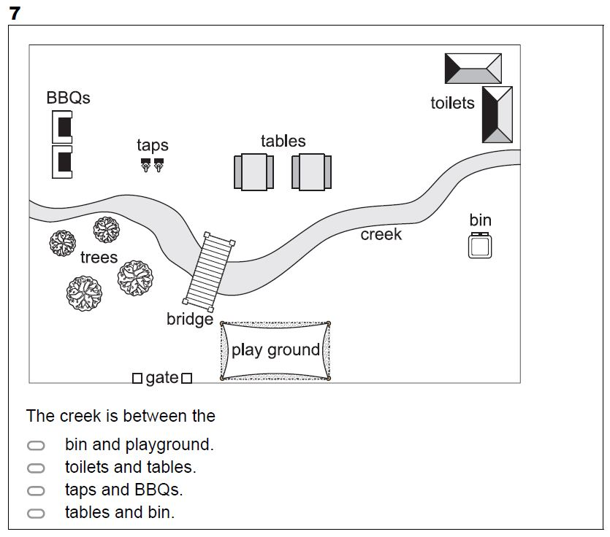
Set One

Slide 10
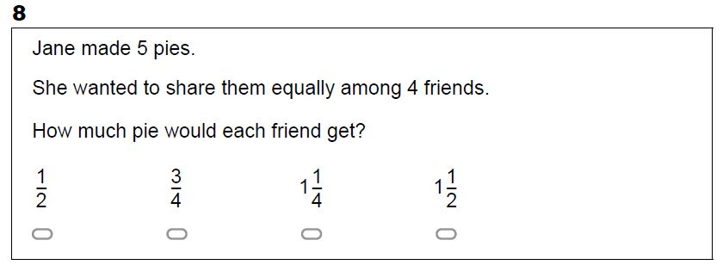
Set One

Slide 11
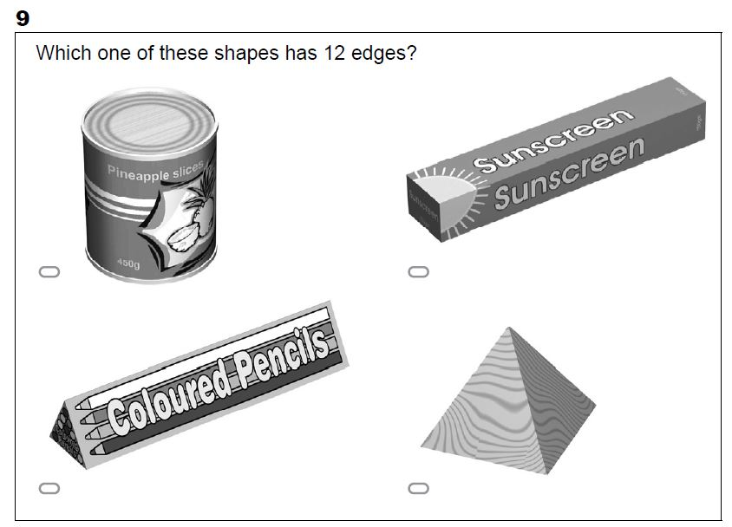
Set One

Slide 12
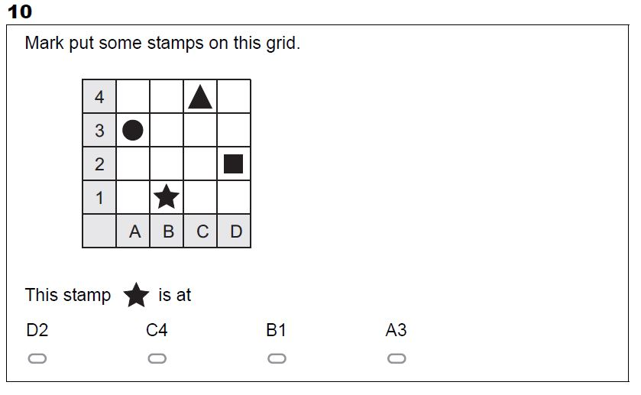
Set One

Slide 13
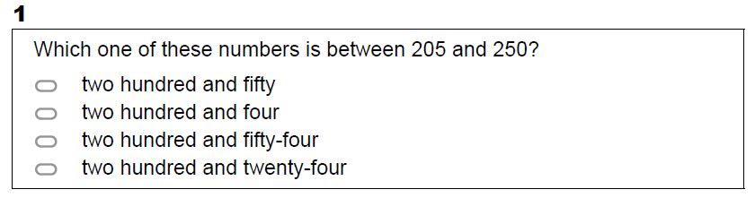
Set Two

Slide 14
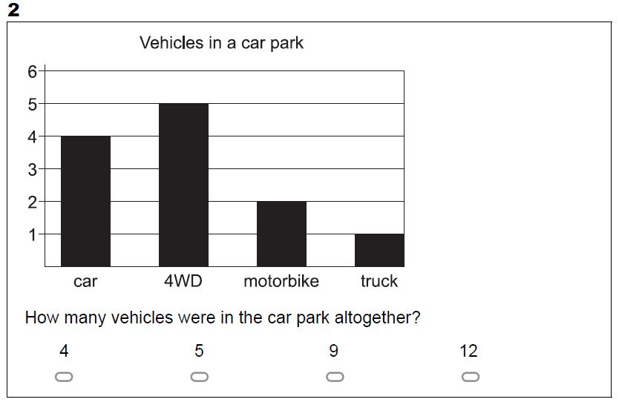
Set Two

Slide 15
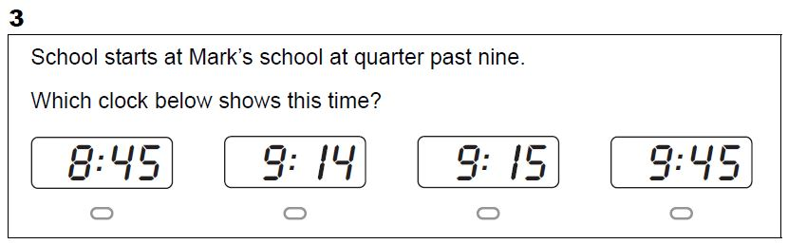
Set Two

Slide 16
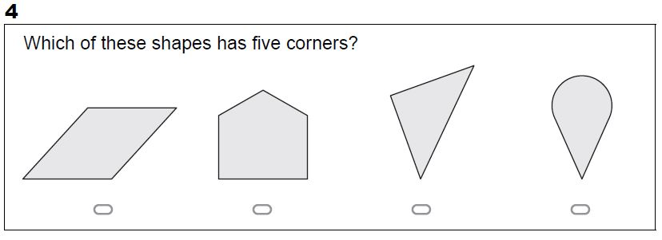
Set Two

Slide 17
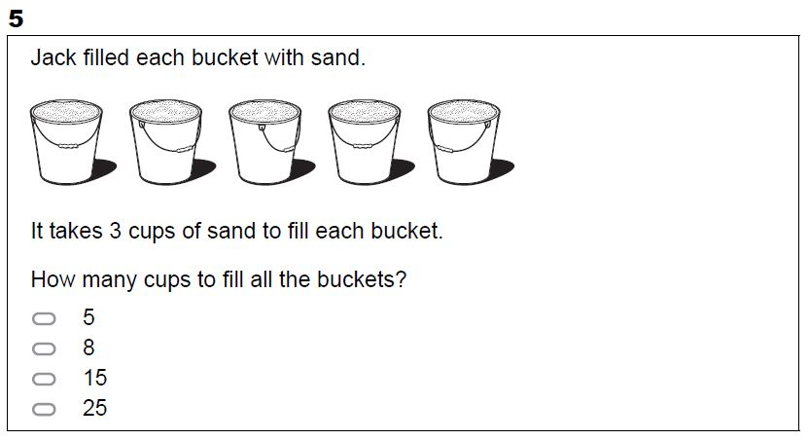
Set Two

Slide 18
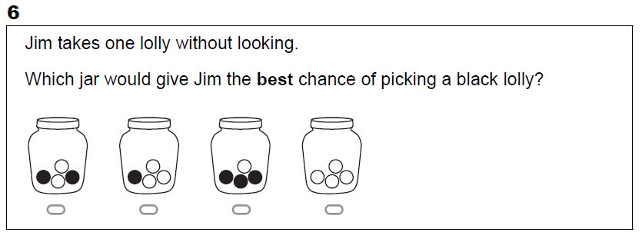
Set Two

Slide 19
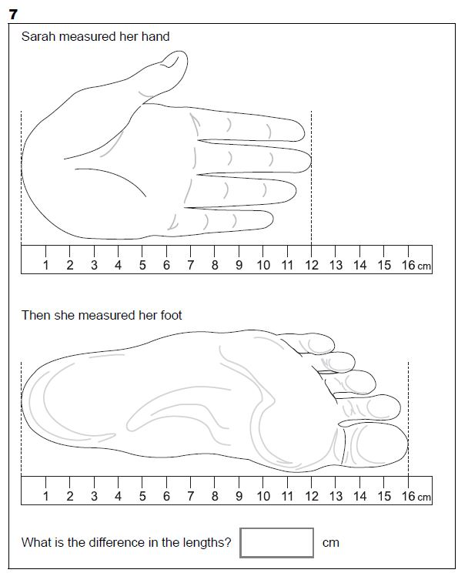
Set Two

Slide 20
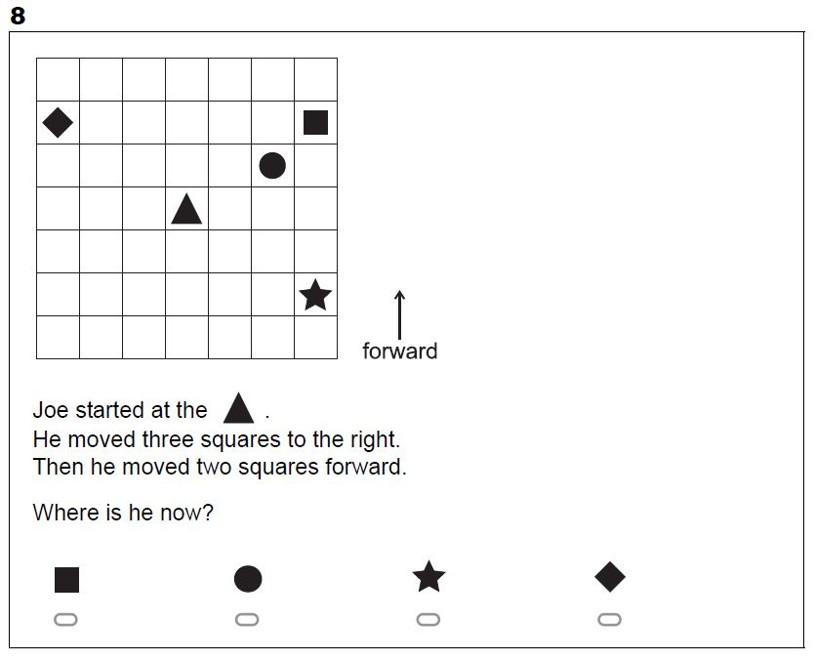
Set Two

Slide 21
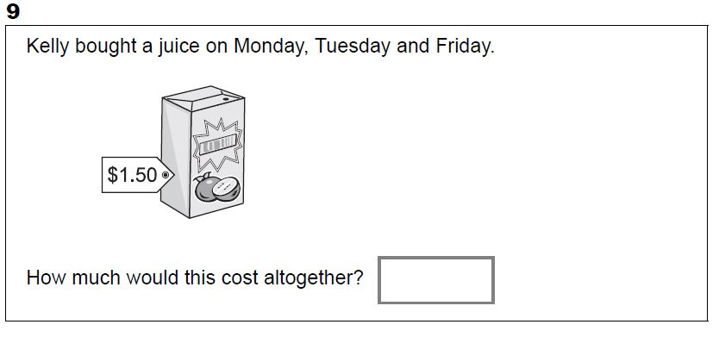
Set Two

Slide 22
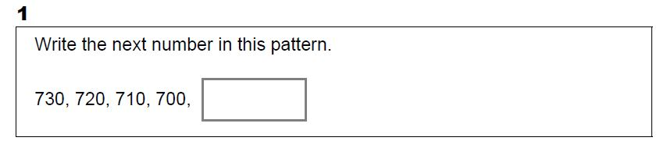
Set Three

Slide 23
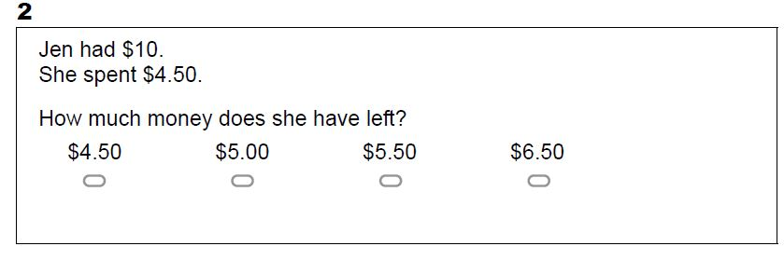
Set Three

Slide 24
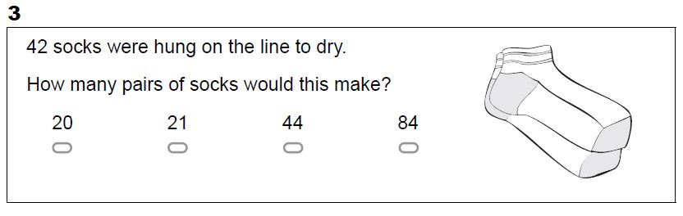
Set Three

Slide 25
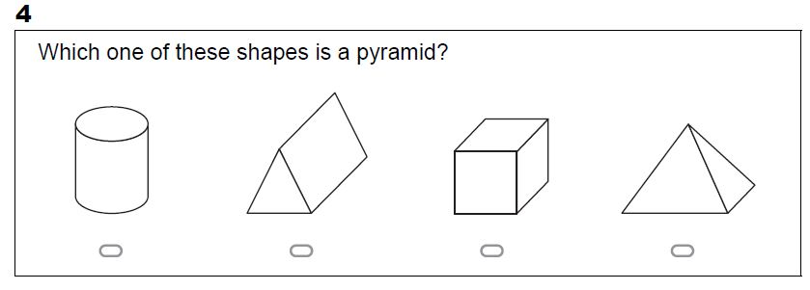
Set Three

Slide 26
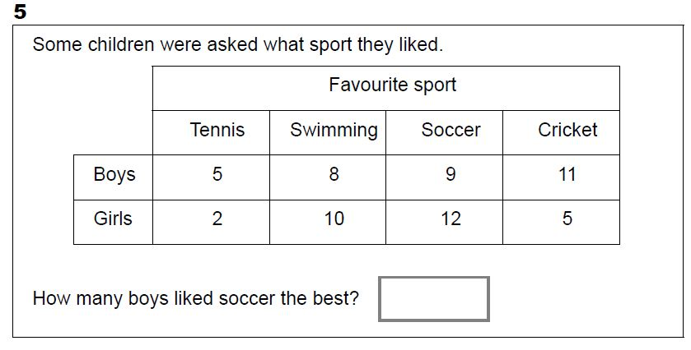
Set Three

Slide 27
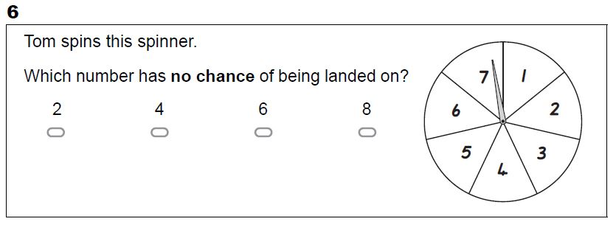
Set Three

Slide 28
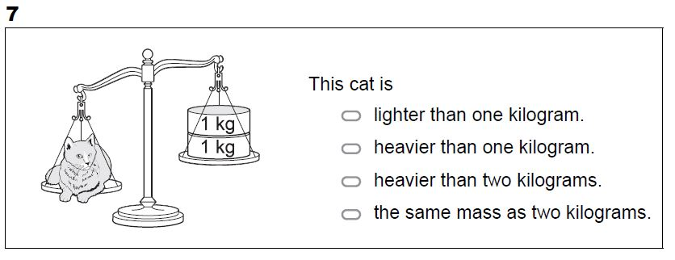
Set Three

Slide 29
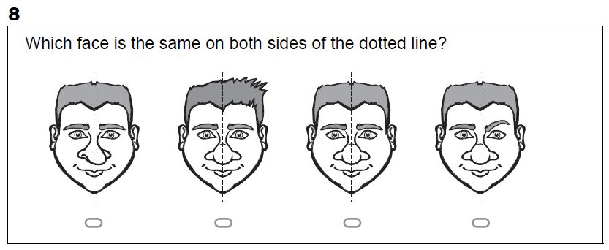
Set Three

Slide 30
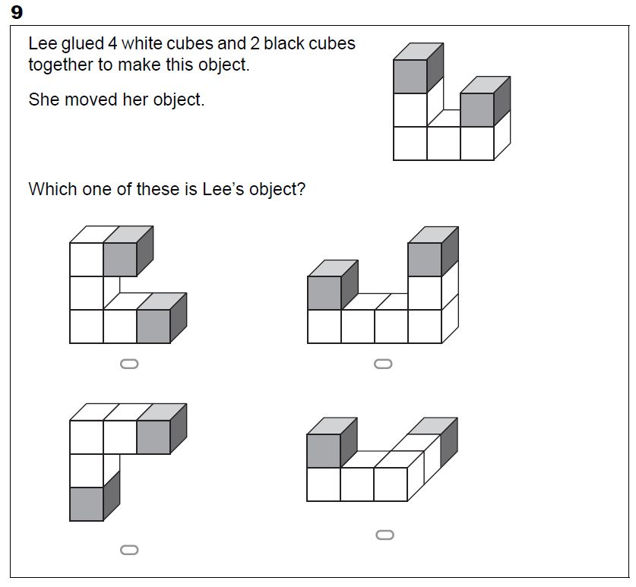
Set Three

Slide 31
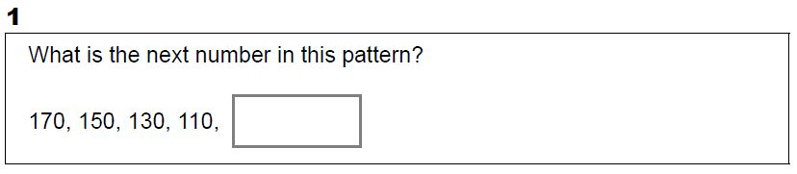
Set Four

Slide 32
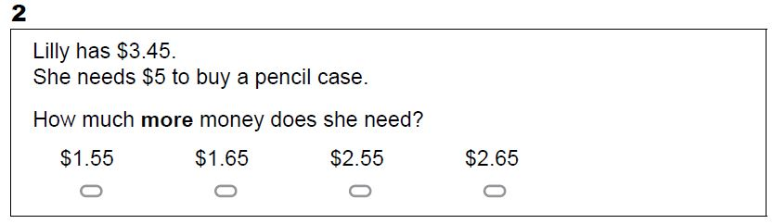
Set Four

Slide 33
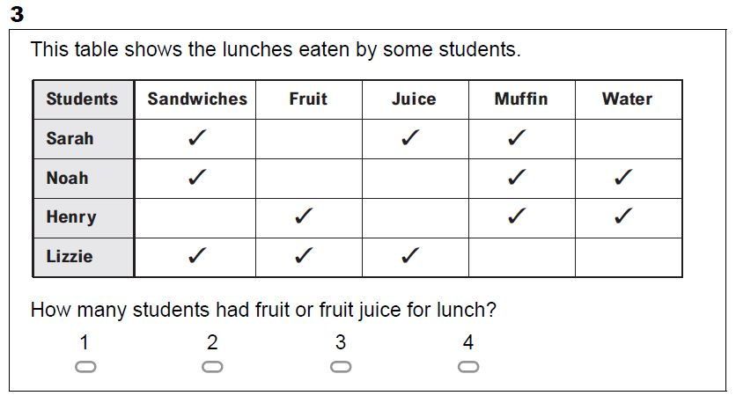
Set Four

Slide 34
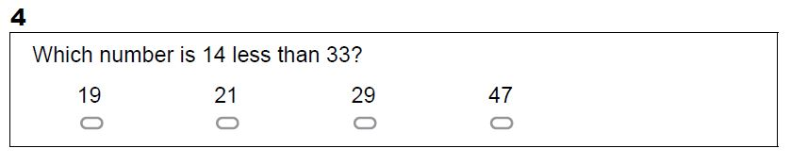
Set Four

Slide 35
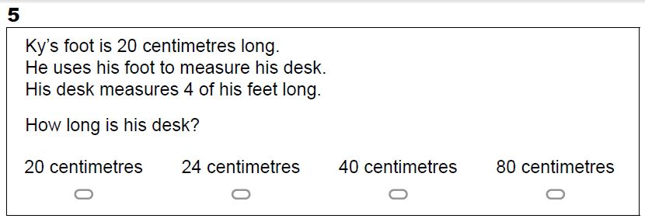
Set Four

Slide 36
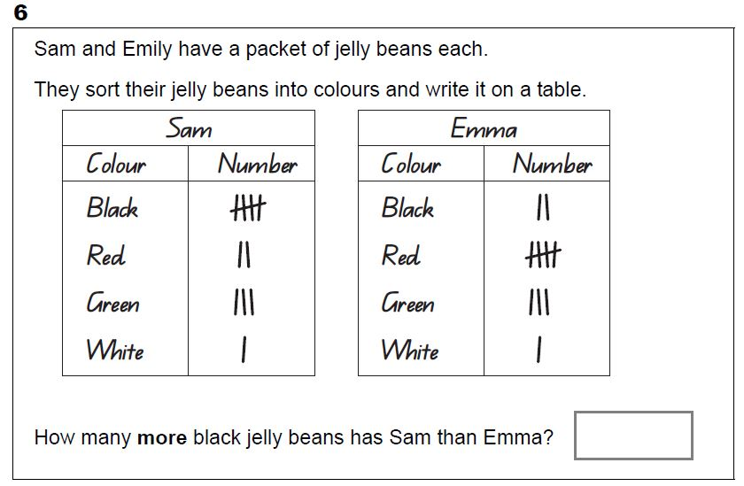
Set Four

Slide 37
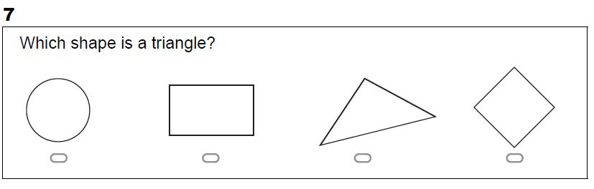
Set Four

Slide 38
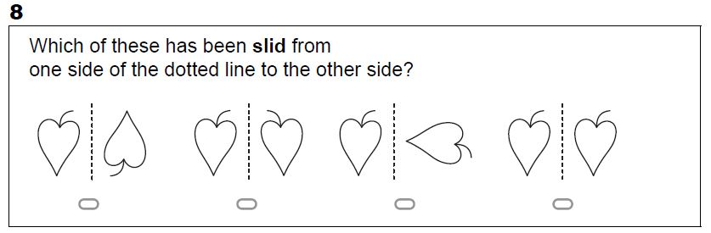
Set Four

Slide 39
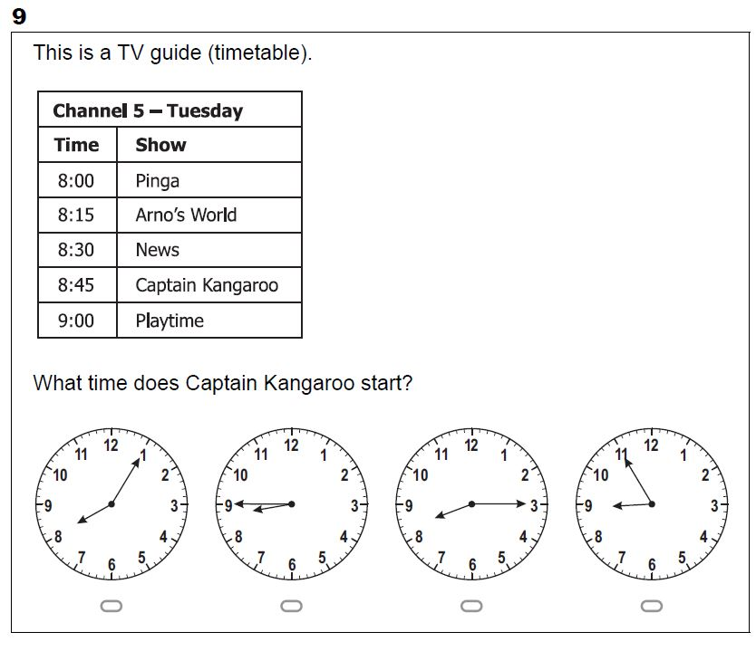
Set Four

Slide 40
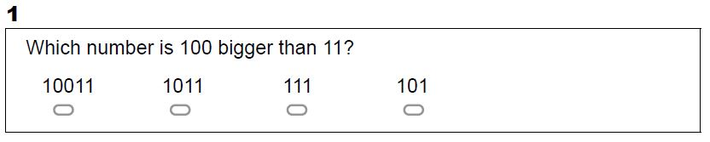
Set Five

Slide 41
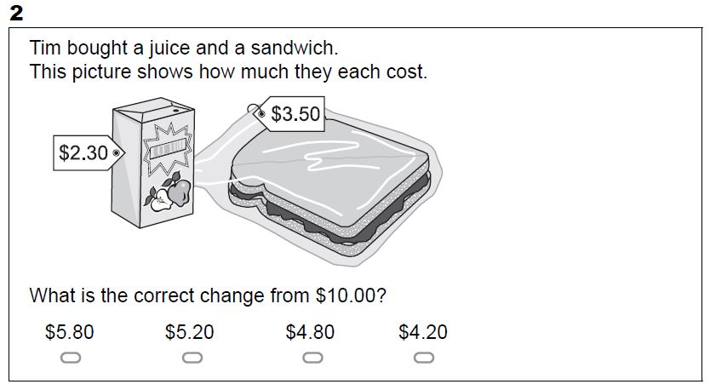
Set Five

Slide 42
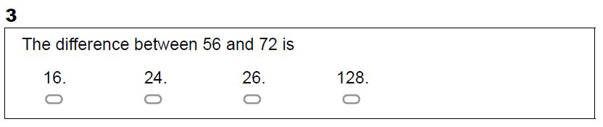
Set Five

Slide 43
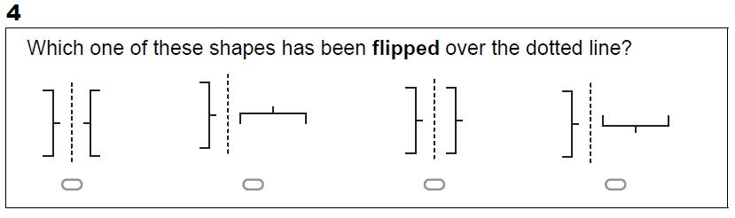
Set Five

Slide 44
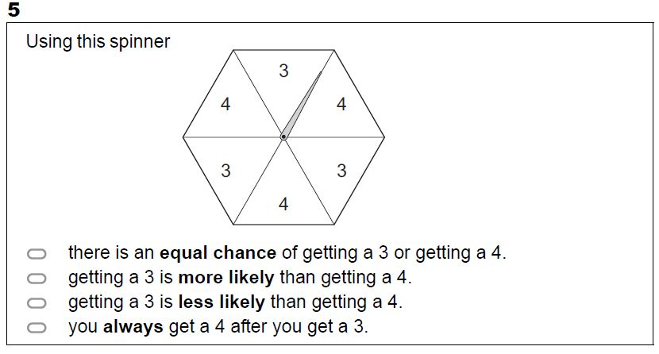
Set Five

Slide 45
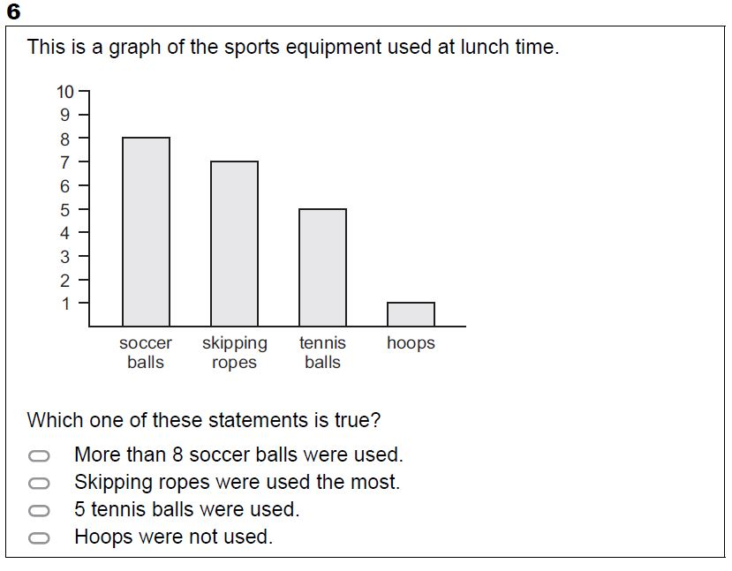
Set Five

Slide 46
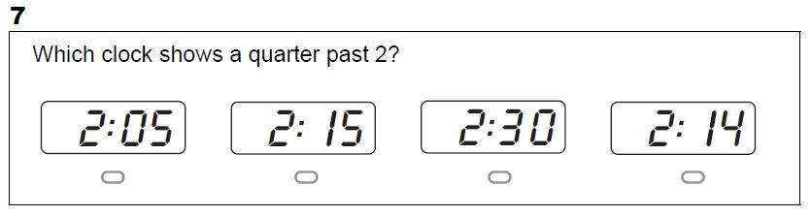
Set Five

Slide 47
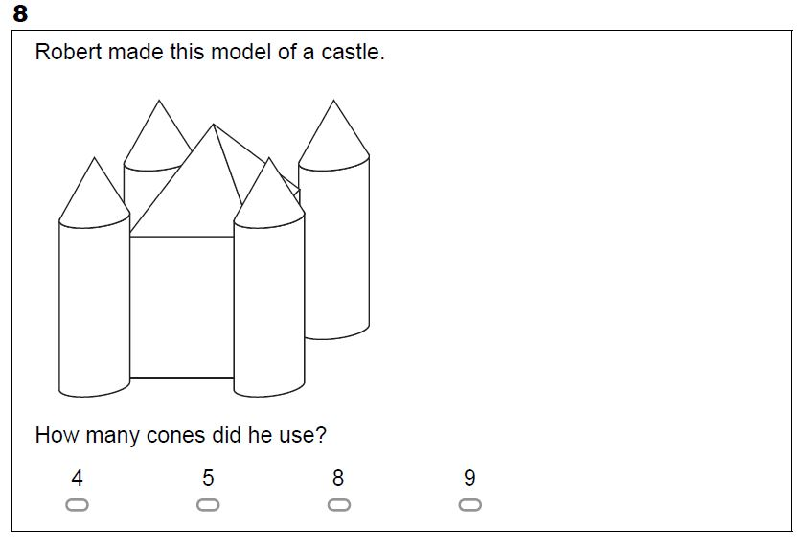
Set Five

Slide 48
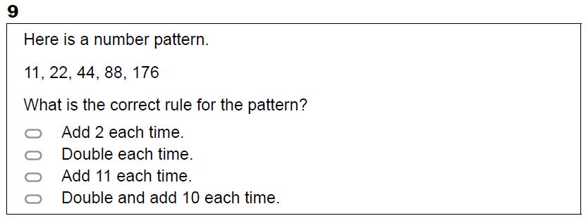
Set Five

Slide 49
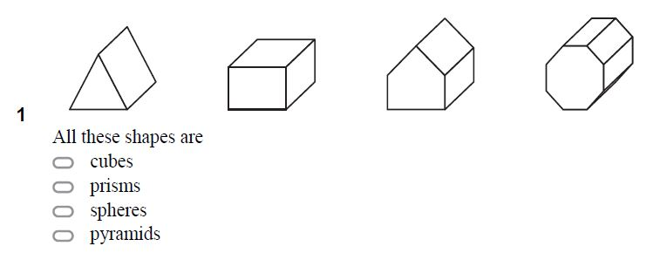
Set Six

Slide 50
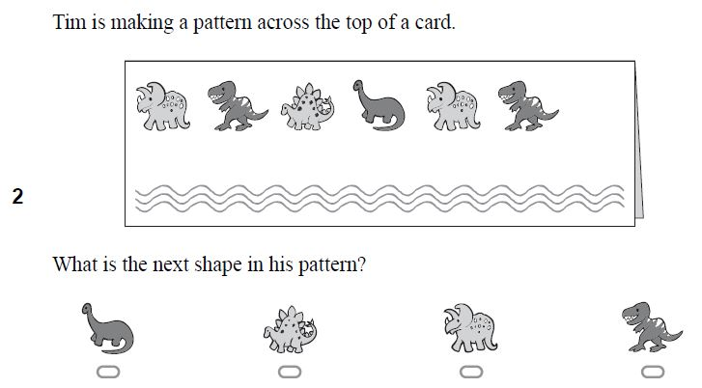
Set Six

Slide 51
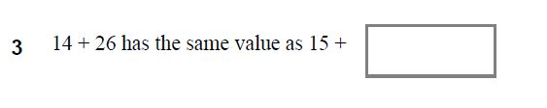
Set Six

Slide 52
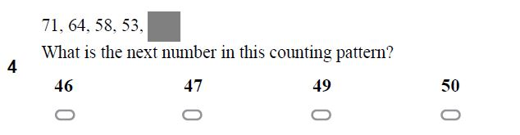
Set Six

Slide 53

Set Six

Slide 54

Set Six

Slide 55

Set Six

Slide 56

Set Six

Slide 57

Set Seven

Slide 58

Set Seven

Slide 59

Set Seven

Slide 60

Set Seven

Slide 61

Set Seven

Slide 62

Set Seven

Slide 63

Set Seven

Slide 64

Set Seven

Slide 65

Set Eight

Slide 66

Set Eight

Slide 67

Set Eight

Slide 68

Set Eight

Slide 69

Set Eight

Slide 70

Set Eight

Slide 71

Set Eight

Slide 72

Set Eight

Slide 73

Set Nine

Slide 74

Set Nine

Slide 75

Set Nine

Slide 76

Set Nine

Slide 77

Set Nine

Slide 78

Set Nine

Slide 79

Set Nine

Slide 80

Set Nine

Slide 81
Set Nine

