Slide 1
Money Quiz!!!!

Slide 2
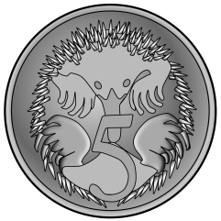
Write the question number and the answer in your maths book.
How much money is shown?
1

Slide 3
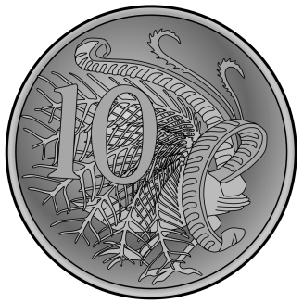
Write the question number and the answer in your maths book.
How much money is shown?
2

Slide 4
Write the question number and the answer in your maths book.
How much money is shown?
3

Slide 5
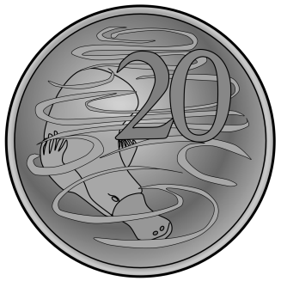
Write the question number and the answer in your maths book.
How much money is shown?
4

Slide 6
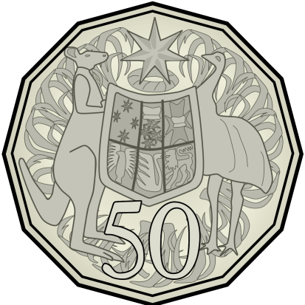
Write the question number and the answer in your maths book.
How much money is shown?
5

Slide 7
Write the question number and the answer in your maths book.
How much money is shown?
2

