Slide 1
Writing Sentences
Grade 3/4 MD MdJ 2019

Slide 2
Pre Assessment
Choose a topic and write around 50 words.
Your teachers are looking to see:
Whether your writing make sense.
What you know about how sentences work in writing.
What we need to teach you about sentences.

Slide 3
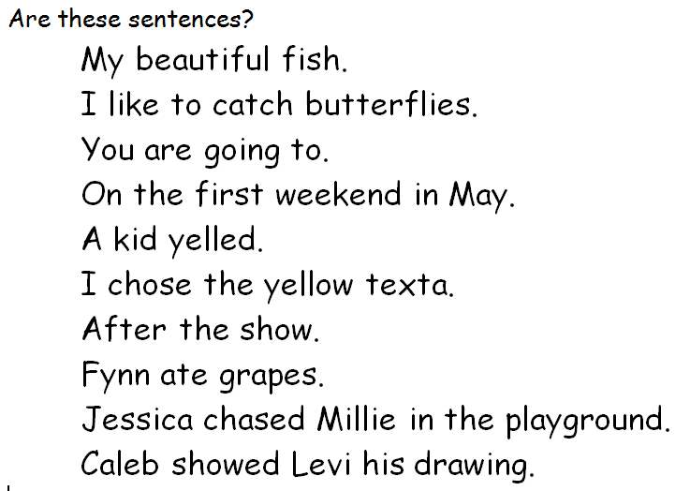

Slide 4
We are learning to write interesting sentences.
I will be successful if…
I am able to correctly identify the subject and verb in a sentence and use this to write my own sentences.

Slide 5
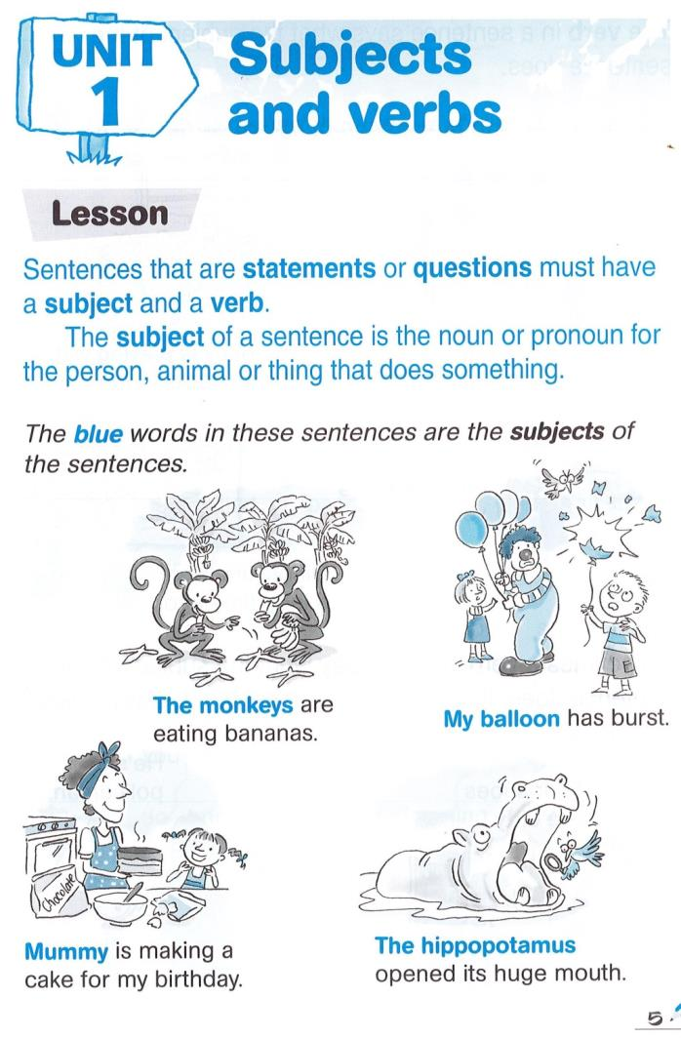
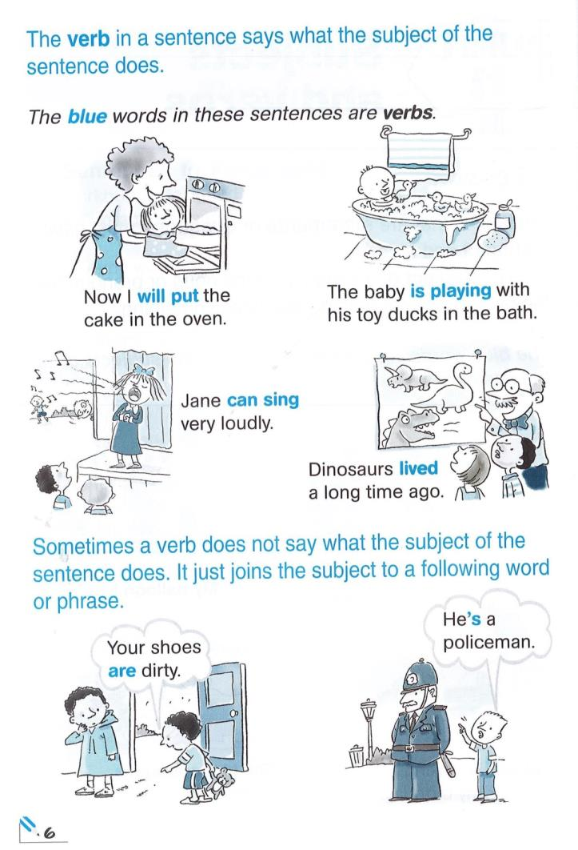

Slide 6
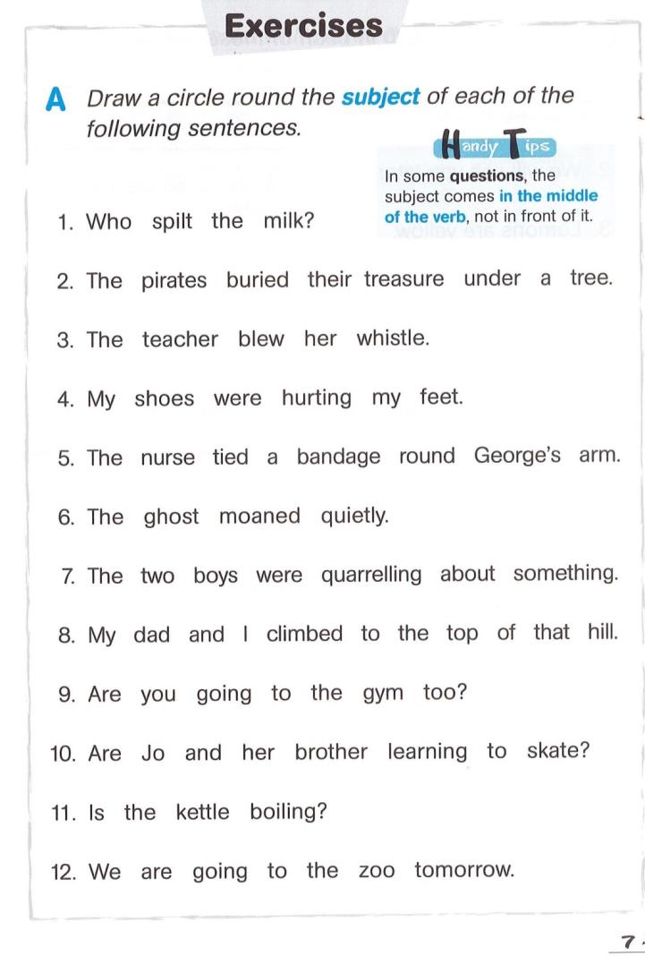
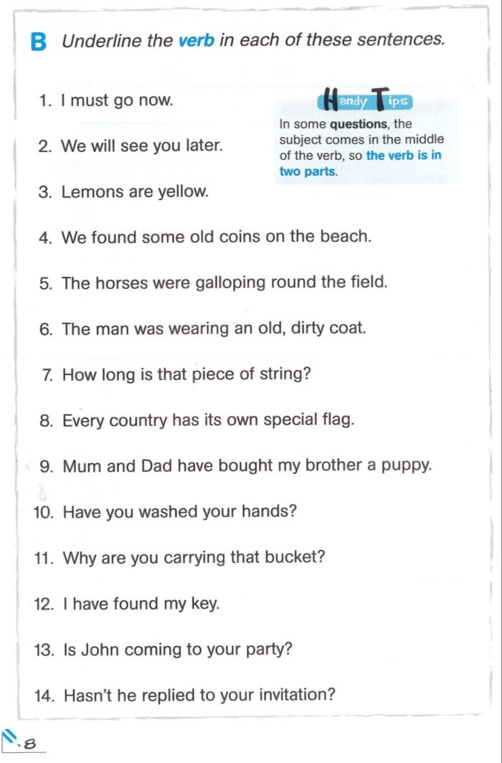

Slide 7
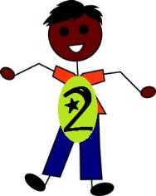
We are learning to write interesting sentences.
I will be successful if…
I am able to correctly identify the object in a sentence and use this to write my own sentences.

Slide 8
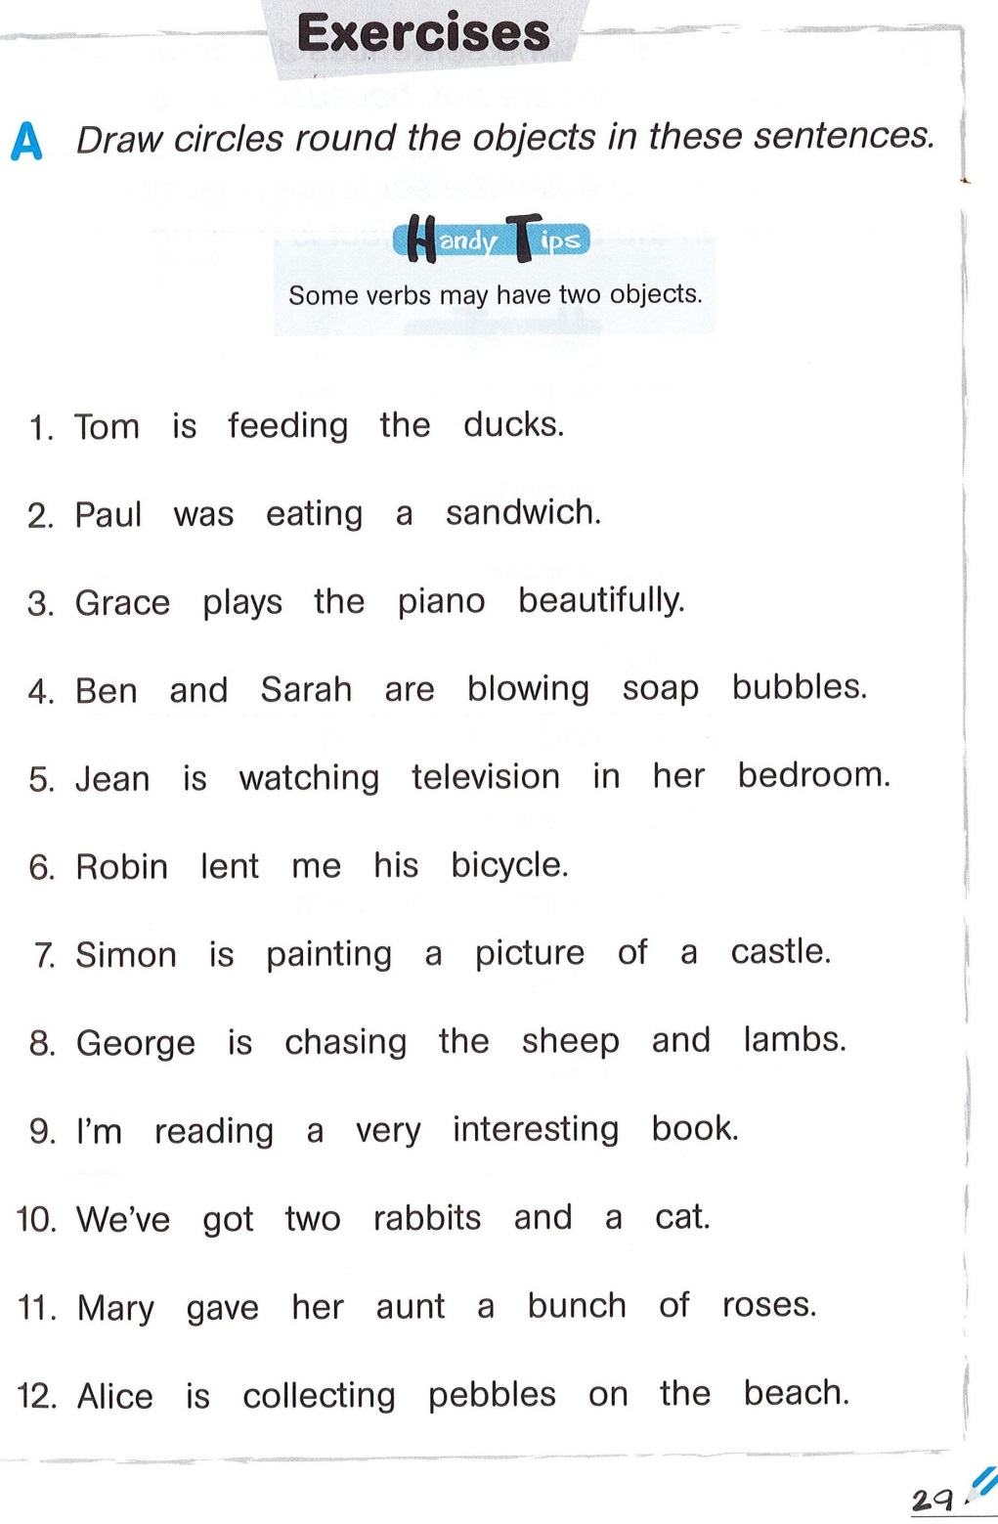

Slide 9
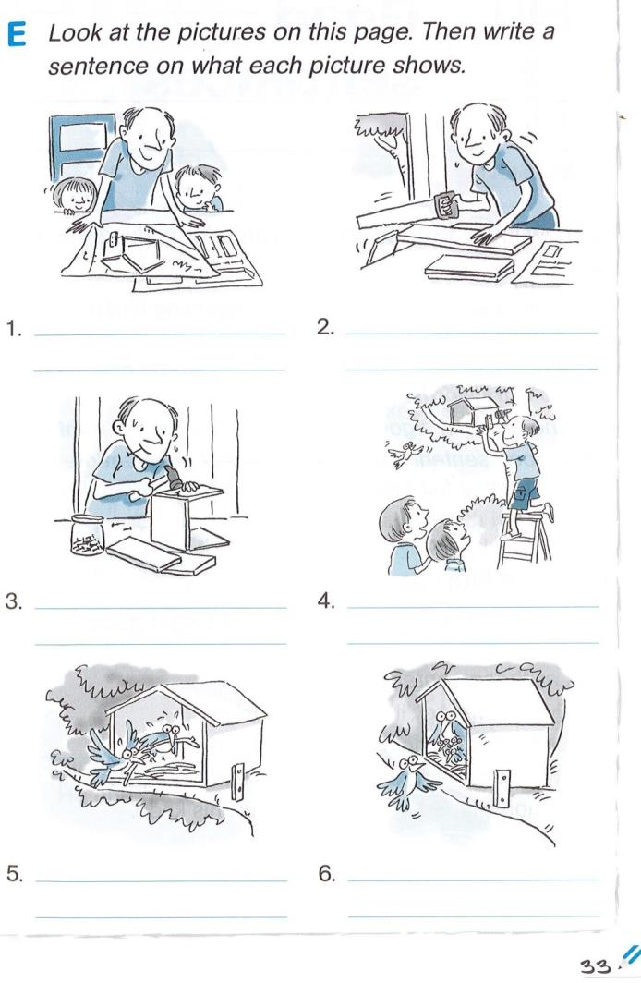

Slide 10
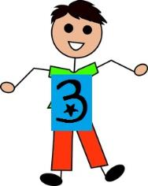
We are learning to write interesting sentences.
I will be successful if…
I am able to correctly identify when to finish a sentence with punctuation and use this to write my own sentences.

Slide 11
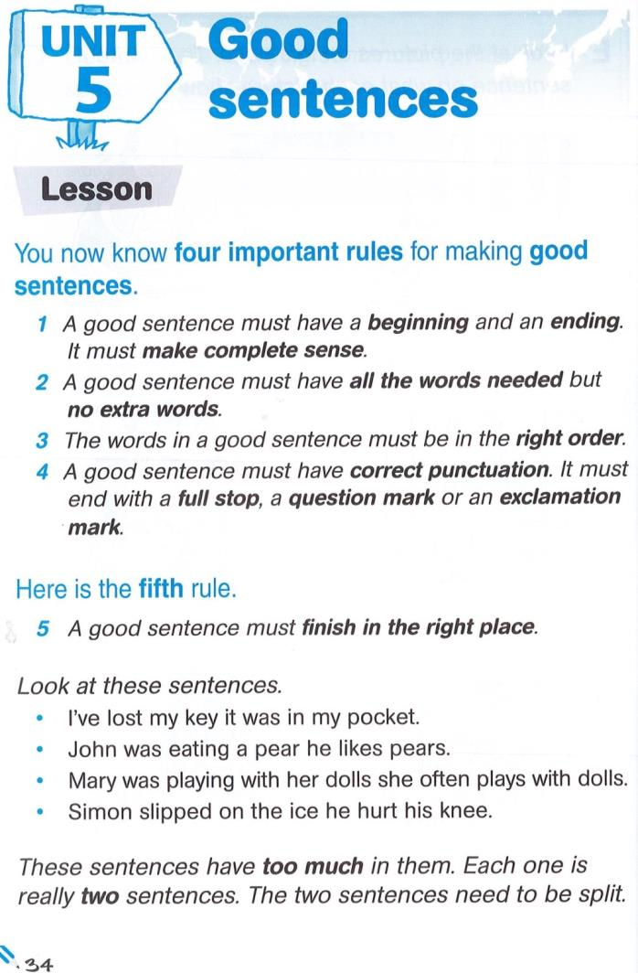
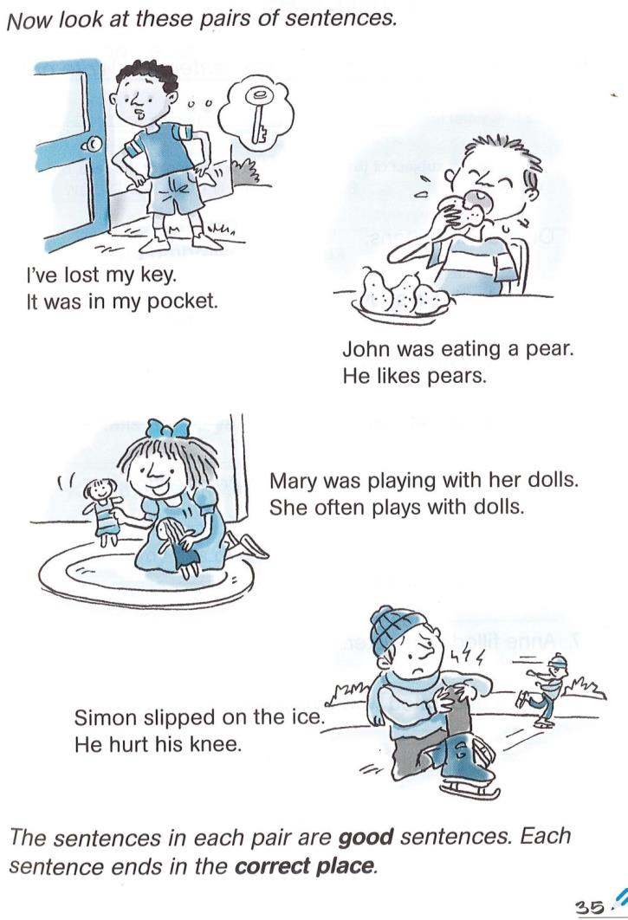

Slide 12
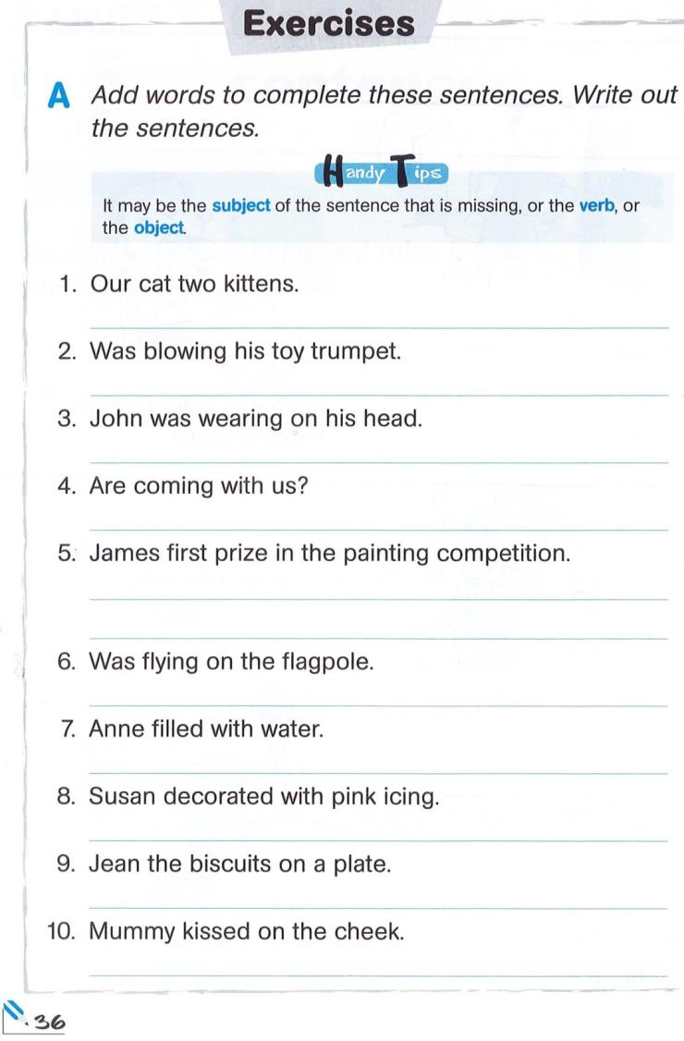
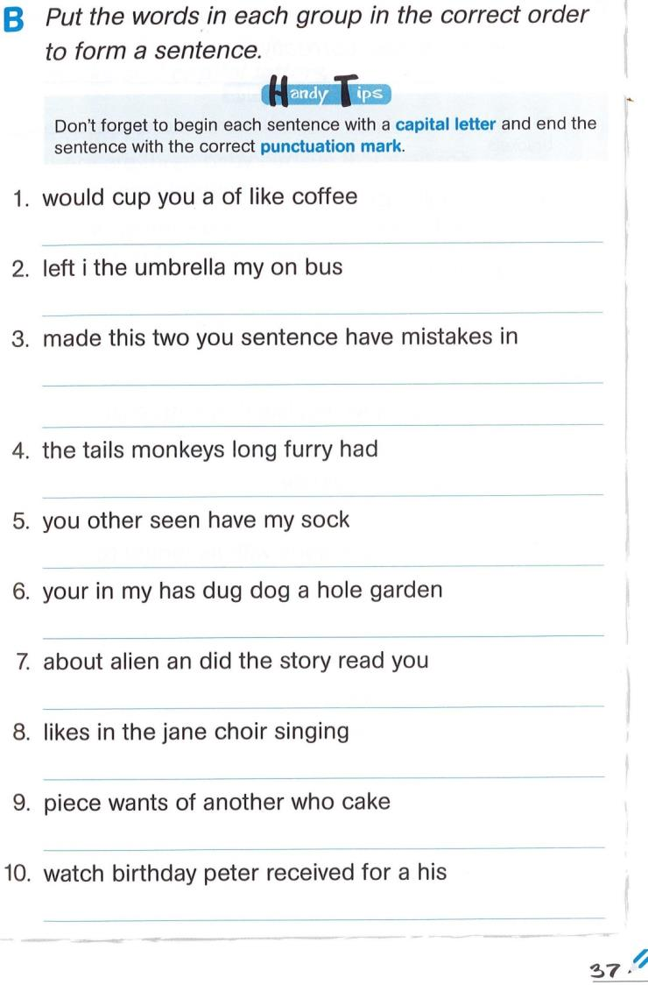

Slide 13
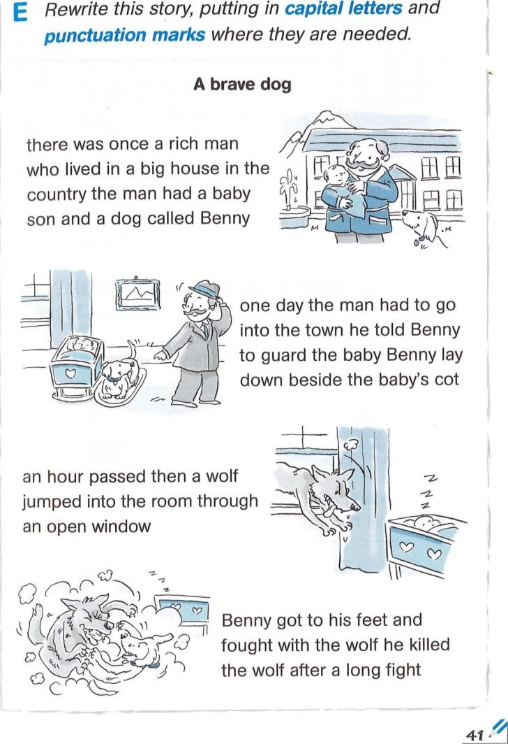

Slide 14
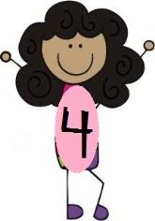
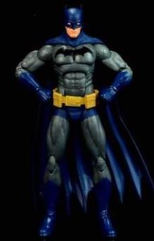
Game:
Superman Loves Verbs.
Batman Loves Nouns
Everybody stands behind their chair.
If a verb is called –
Superman gets ready to fly.
If a noun is called –
Batman grabs his utility belt.
Who can stay in?!

Slide 15
We are learning to write interesting sentences.
I will be successful if…
I am able to correctly identify pronouns and use this to write my own sentences.

Slide 16
Videos: https://www.youtube.com/watch?v=ZADSyQZlvCc Pronouns Song
https://www.youtube.com/watch?v=MagsCvE99zY&t=7s Is Am Are Verb Song

Slide 17
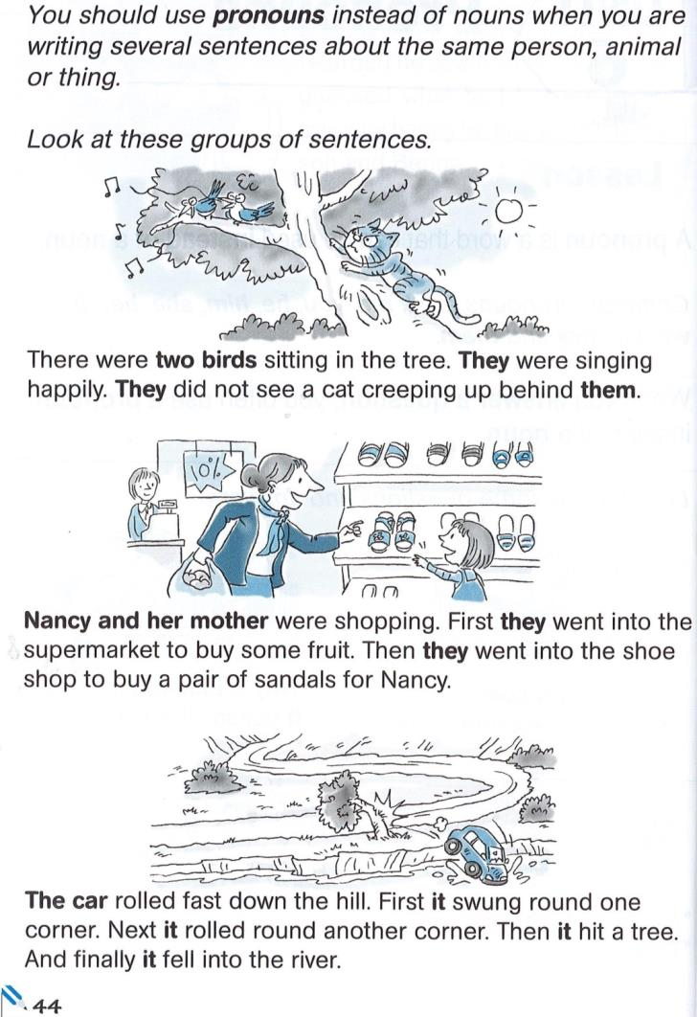

Slide 18
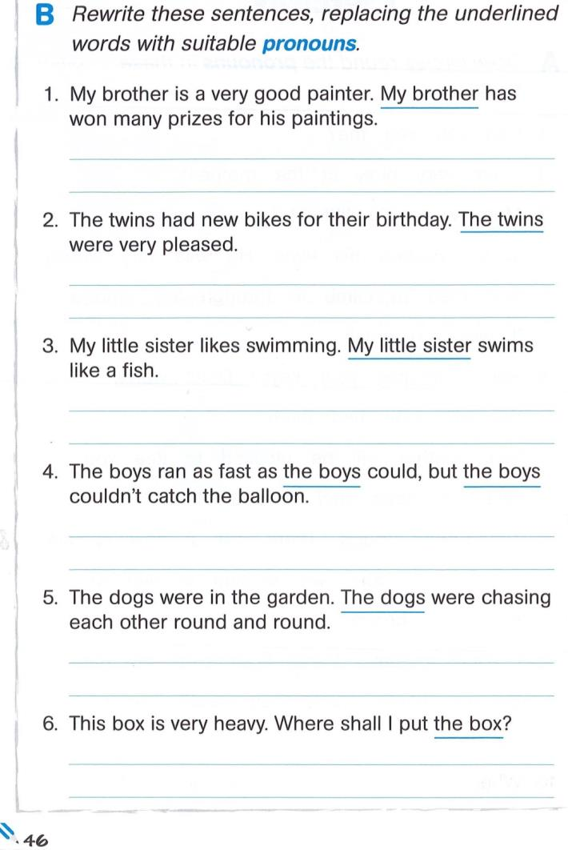
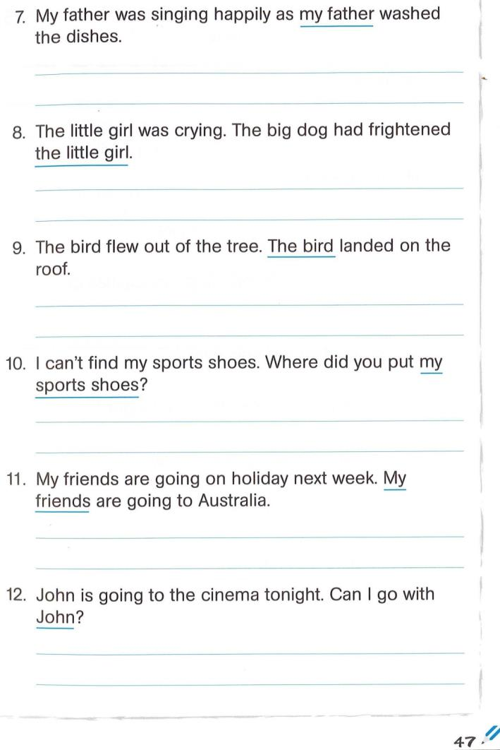

Slide 19
We are learning to write interesting sentences.
I will be successful if…
I am able to put detail in my sentences.

Slide 20
Video: https://www.youtube.com/watch?v=UrrMEex1_lg Good Charlotte - "Who, What, Where, When, Why & How"

Slide 21
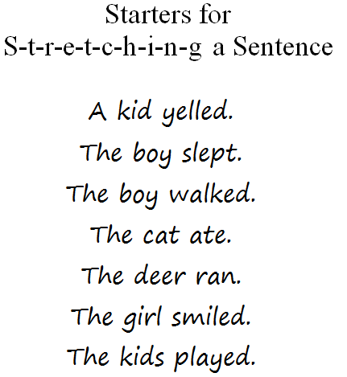
Use a slinky to take a simple sentence and stretch to add detail
Who?
Did what?
When?
Where?
Why?
How?

Slide 22
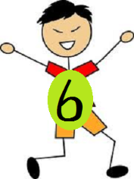
We are learning to write interesting sentences.
I will be successful if…
I am able to put detail in my sentences.
I am able to identify and use adjectives.

Slide 23
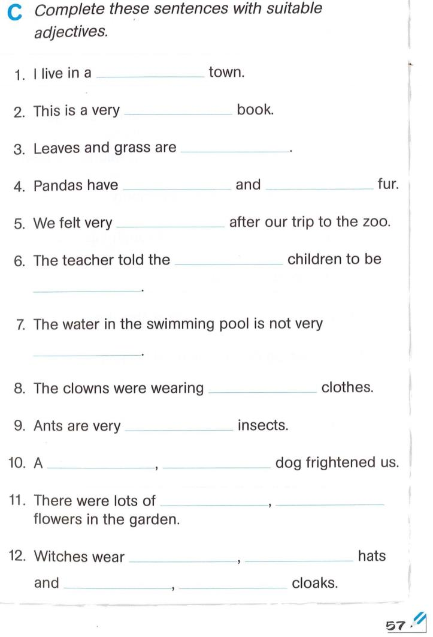

Slide 24
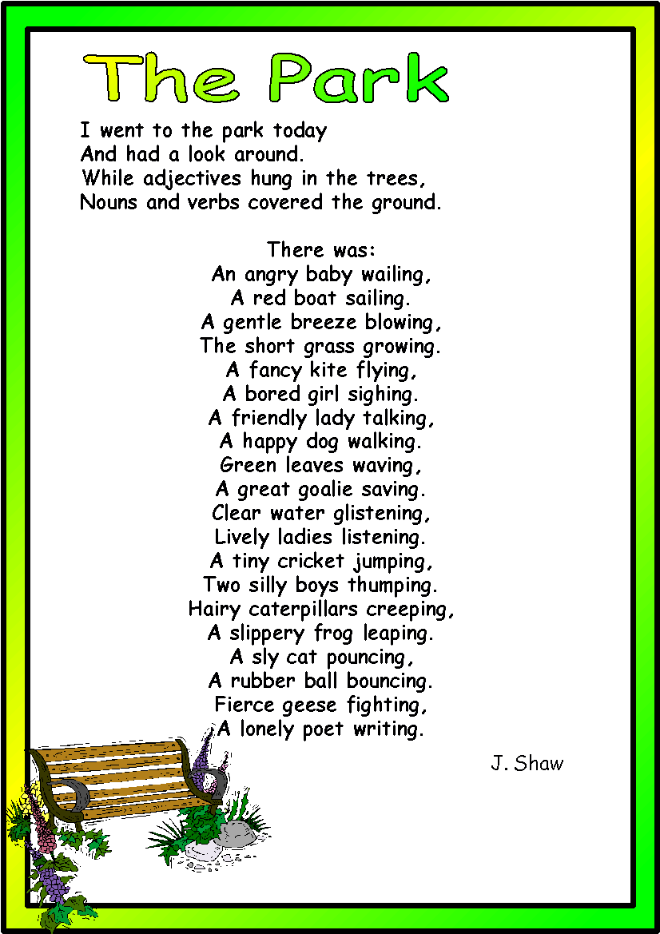

Slide 25
Video: https://www.youtube.com/watch?v=A4XZDyxJ23Q
Song: All About That Adjective

Slide 26
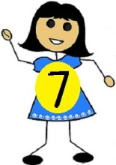
We are learning to write interesting sentences.
I will be successful if…
I am able to put detail in my sentences.
I am able to identify and use adverbs.

Slide 27
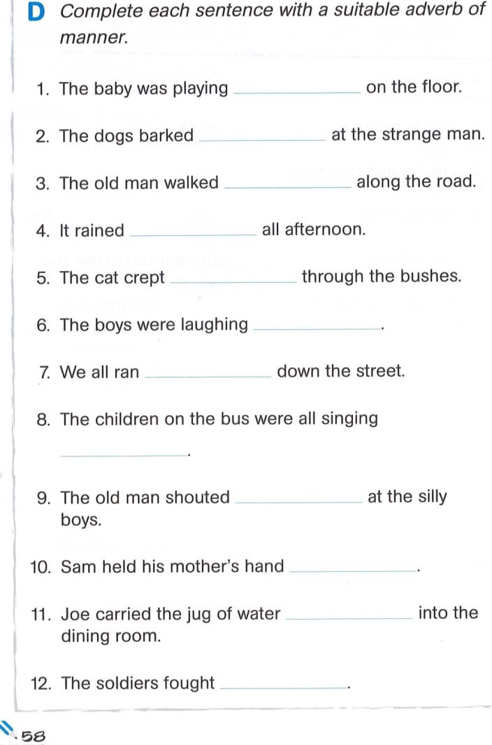

Slide 28
We are learning to write interesting sentences.
I will be successful if…
I am able to write simple and complex sentences.
I am able to identify and use connectives (conjunctions).

Slide 29
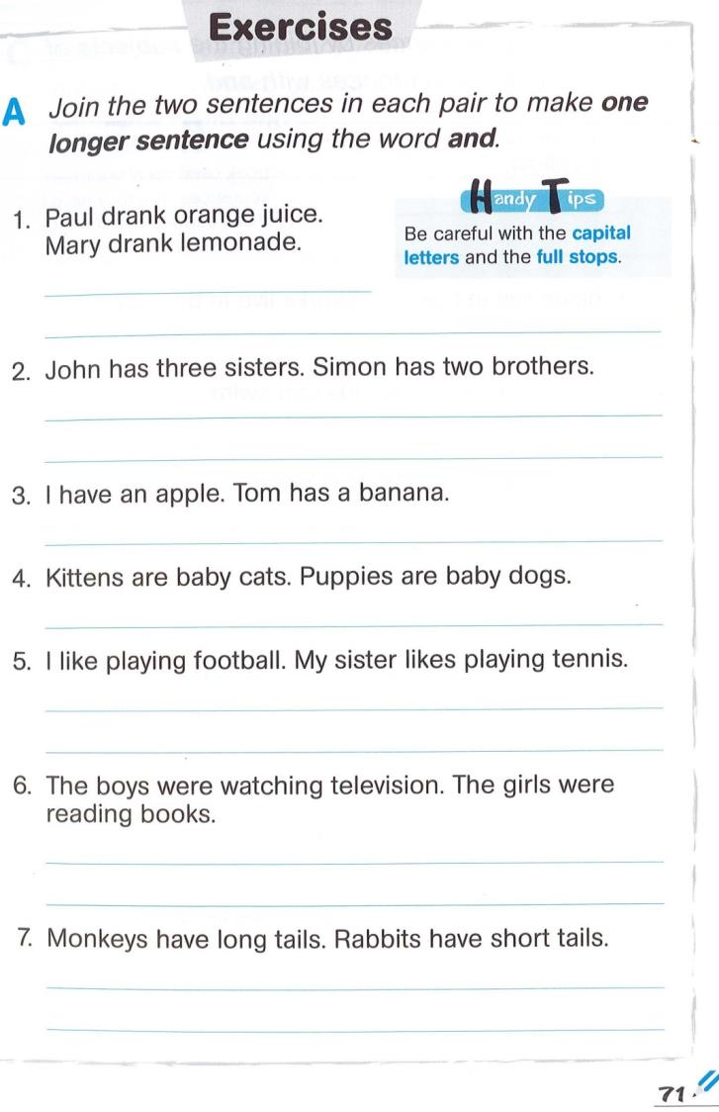

Slide 30
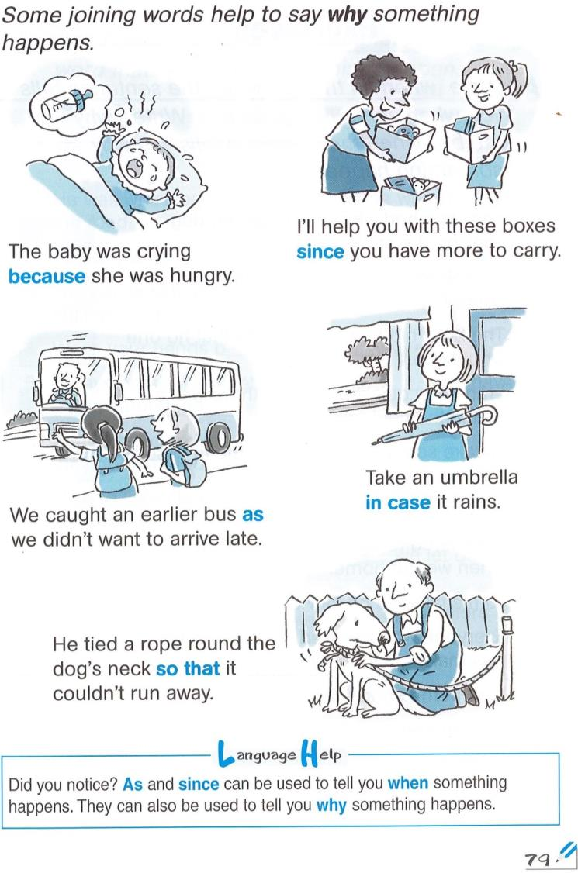

Slide 31
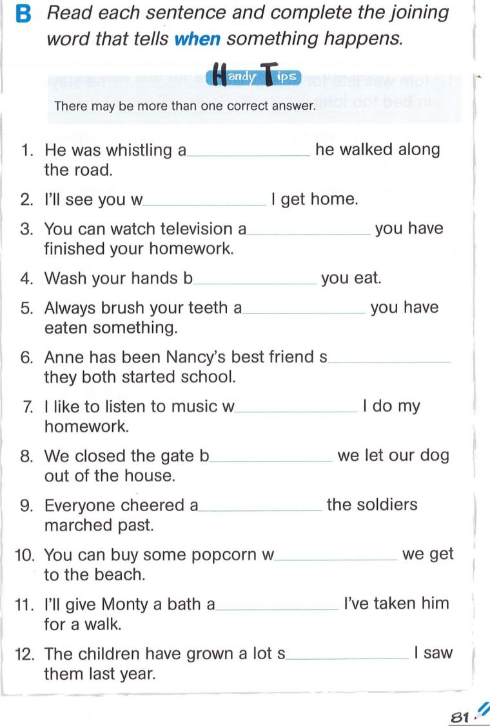
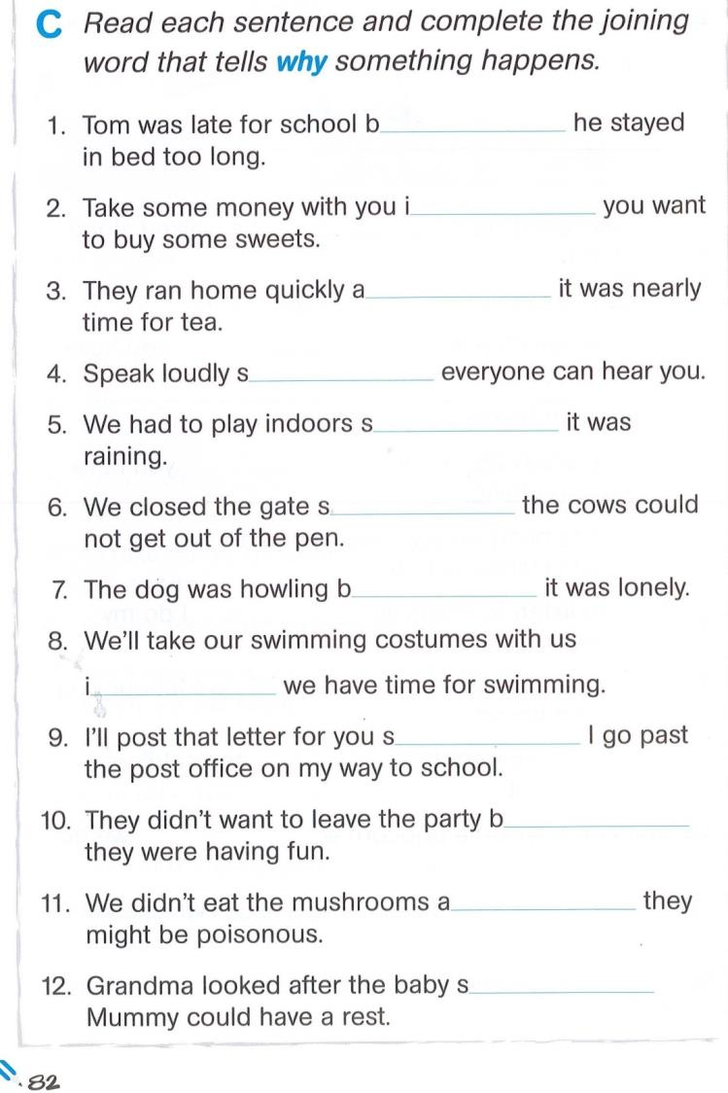

Slide 32
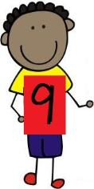
We are learning to write interesting sentences.
I will be successful if…
I am able to begin sentences in a variety of ways.

Slide 33
